Slide 1
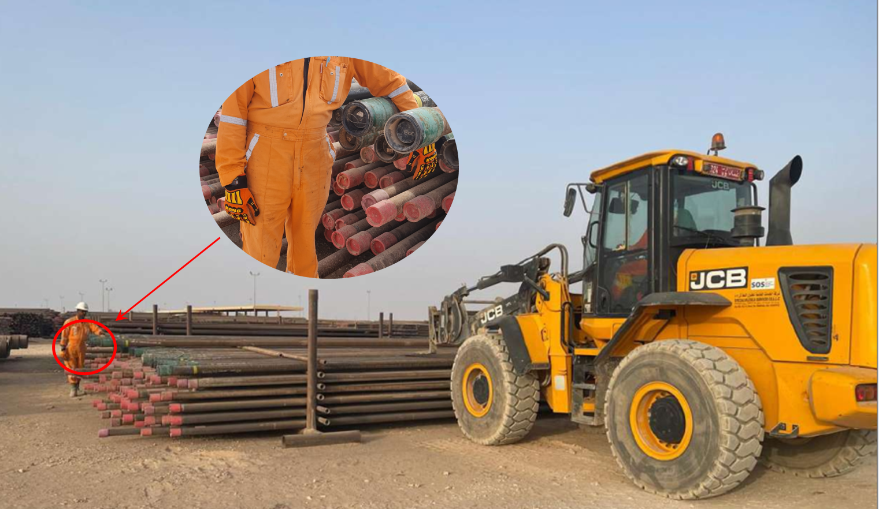
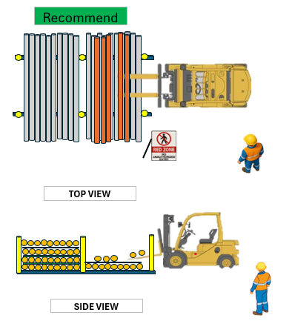
PDO Second Alert
Date: Time: | 29.08.2025 08:45 Am | Incident title: PIM# | LTI#13 1181256 | Risk Category: Injury / Asset Damaged: | Hand & Finger Hand Fracture (LWC) | Actual Severity: Potential severity: | 3P C3P | Activity: Location: | Offloading Pipes Nimr
Target Audience: Driller & Rig Manager
What happened?
While the forklift operator was positioning the pipes into the storage rack the (Banksmen) attempted to manually stop a rolling pipe, a slip of hand on the pipe caused the subsequent pipe to impact his hand resulting to fracture injury. He had his left arm caught in-between the two pipes.
Why it happened/Finding :
Usage of sub-standard pipe, causing uncontrolled pipe movement.
Failure to adhere to the Red Zone area putting himself in the line of fire
The yard is filled with scrap pipes making the work area congested.
Injured person tried to stop a rolling pipe by hand, not following the procedure.
Reflective Question:
How do you ensure hazards have been controlled or eliminated?
How do you ensure RED Zone areas are not entered during operations?
How do you ensure awareness of line of fire is cascaded effectively?
How do you ensure supervision is effective to prevent line of fire situation?
Keep yourself & others out of line of fire
Notes:
Ensure all dates and titles are input
A short description should be provided without mentioning names of contractors or individuals. You should include, what happened, to who (by job title) and what injuries this resulted in. Nothing more!
Four to five bullet points highlighting the main findings from the investigation. Remember the target audience is the front line staff so this should be written in simple terms in a way that everyone can understand.
The strap line should be the main point you want to get across
The images should be self explanatory, what went wrong (if you create a reconstruction please ensure you do not put people at risk) and below how it should be done.

