Slide 1
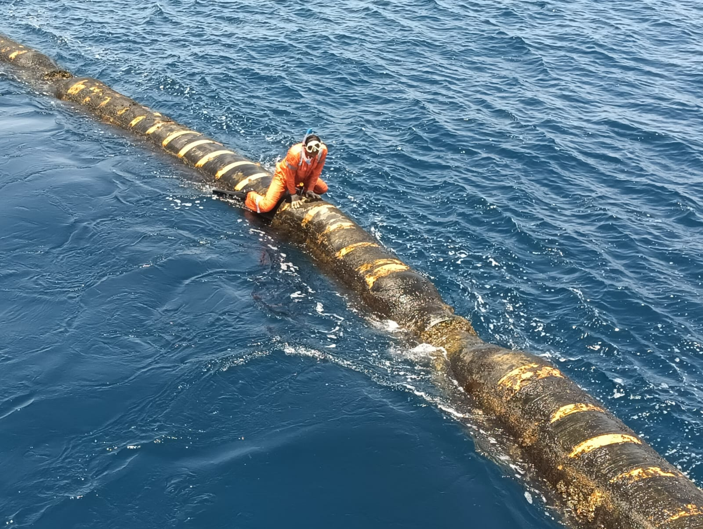
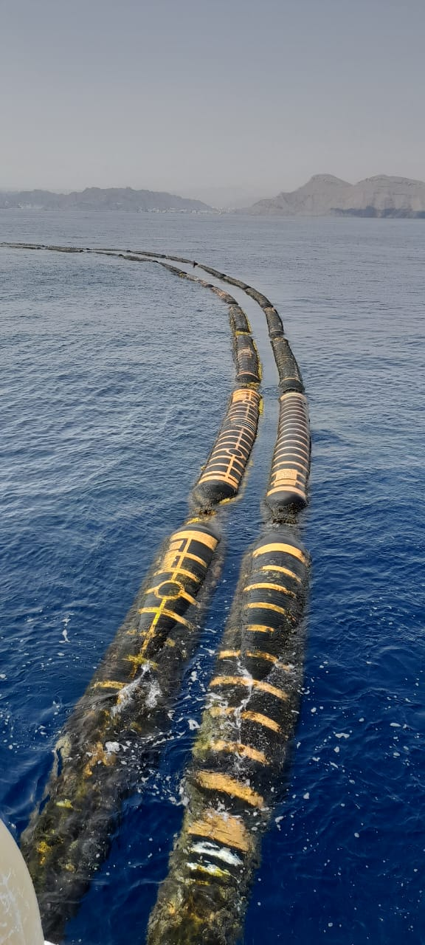
PDO Second Alert
Date: Time: | 03/03/2025 09:10 | Incident title: PIM# | LTI#02 1174545 | Risk Category: Injury / Asset Damaged: | Caught Between Foot injury | Actual Severity: Potential severity: | 3P B3P | Activity: Location: | Marine Maintenance MAF
Target Audience: Logistics, Operation & Construction
What happened?
While the Diver was trying to replace the damaged tie back ropes for the SBM2 floating hose, his left foot got caught between the two floating hoses which moved due to the sea swell. This resulted in a fracture of 3 small toes and a dislocation of the small toe, all on his left foot.
Why it happened/Finding :
Diver was seated on top of the moving floating hose
Change in weather & Sea swell affected the movement of the floating hoses
The two floating hoses came together trapping the Diver’s foot
Reflective Questions
Do you ensure all work task is risk assessed ?
Do you ensure the Dynamic risks imposed by weather are always monitored?
Do you ensure environmental conditions are risk assessed before starting work?
Do you know the correct posture for your task?
Do you ensure adequate planning for non-routine tasks?
Do you call the PDO Emergency number when required?
Conduct maintenance tasks in calm weather
Always ensure weather related risks are assessed before starting work
Notes:
Ensure all dates and titles are input
A short description should be provided without mentioning names of contractors or individuals. You should include, what happened, to who (by job title) and what injuries this resulted in. Nothing more!
Four to five bullet points highlighting the main findings from the investigation. Remember the target audience is the front line staff so this should be written in simple terms in a way that everyone can understand.
The strap line should be the main point you want to get across
The images should be self explanatory, what went wrong (if you create a reconstruction please ensure you do not put people at risk) and below how it should be done.

Slide 2
Management Reflective Questions
As a learning from this incident and ensure continual improvement all contract managers must review their HSE risk management against the questions asked below
Confirm the following:
Do your personnel know the PDO emergency number and when to call?
Are all hazardous tasks covered in your risk register?
How does your organization plan non-routine work?
Does your organization sufficiently assess environmental and weather-related risks?
* If the answer is NO to any of the above questions, please ensure you take action to correct this finding
Notes:
Ensure all dates and titles are input
Make a list of closed questions (only ‘yes’ or ‘no’ as an answer) to ask others if they have the same issues based on the management or HSE-MS failings or shortfalls identified in the investigation.
Imagine you have to audit other companies to see if they could have the same issues.
These questions should start with: Do you ensure…………………?

