Slide 1
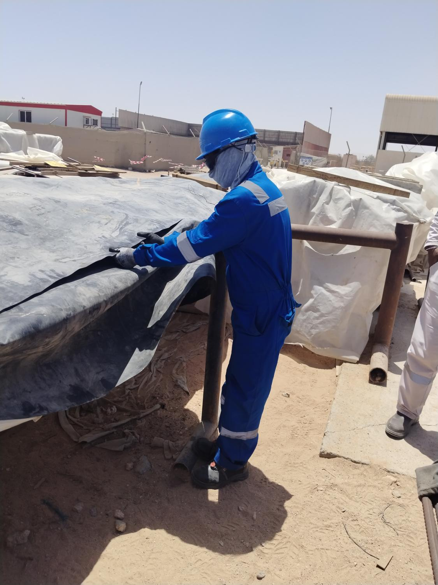
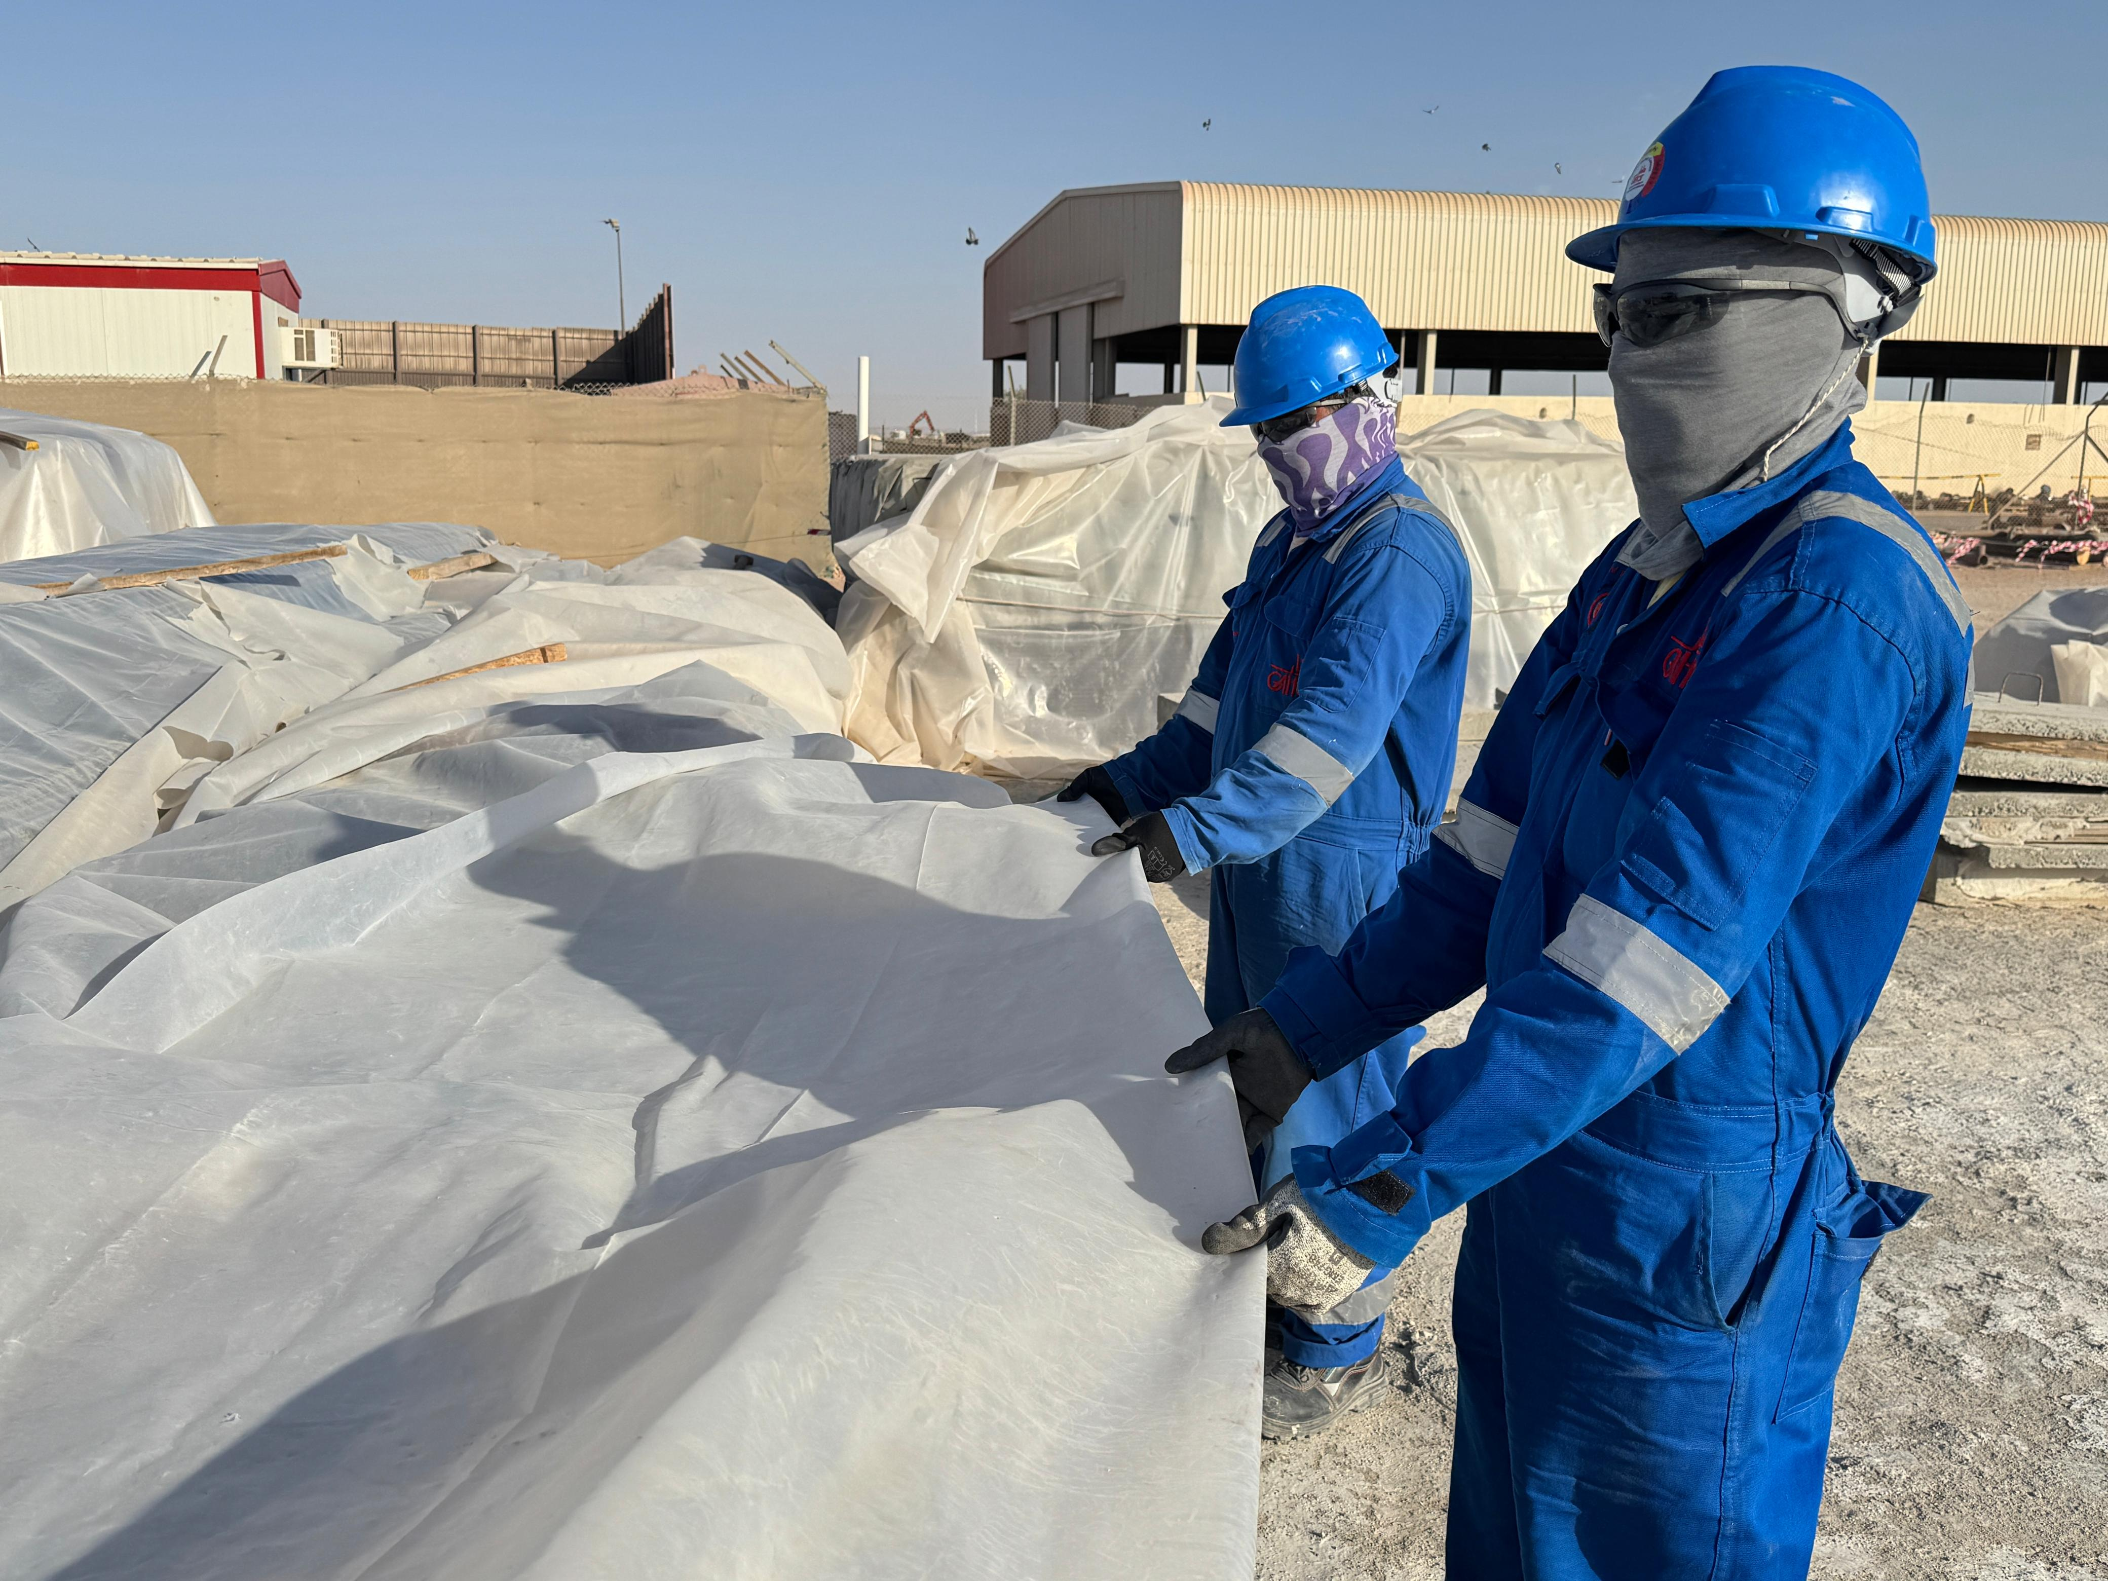
PDO Second Alert
Date: Time: | 11-05-2025 14:30 | Incident title: PIM# | LTI#07 1177759 | Risk Category: Injury / Asset Damaged: | Slips, Trips and Falls Arm Injury | Actual Severity: Potential severity: | 3P C3P | Activity: Location: | Covering Rebar Bundles Qarn Alam
Target Audience: Logistics, Operation & Construction
What happened?
A steel fixer was engaged in covering rebar bundles with an HDPE Sheet as part of routine activity. While attempting to pull the sheet into its correct position, he lost his balance, and fell onto the ground, landing heavily on his left wrist, resulting in a fracture on his left-hand forearm.
Why it happened/Finding :
HDPE sheets were placed over the plastic sheeting, which appears to be for extra protection of the steel rebars. HDPE sheets are typically not a standard requirement for this purpose.
A steel fixer was using worn-out hand gloves, which compromised their grip protection.
Supervision during task execution was ineffective.
The steel fixer has normalized the risk associated with the task, possibly due to its routine nature.
Reflective Questions:
Do you always use gloves with enhanced grip to minimize the risk of losing control of slippery materials?
Do you implement a mandatory two-person rule for heavy or difficult manual handling tasks?
Do charge-hands/supervisors know that they are responsible for verifying that the correct PPE and handling methods are employed based on the specific material being handled?
How do you ensure effective communication and coordination for safe teamwork?
Always replace worn or damaged PPE, even during low-risk activities.
Notes:
Ensure all dates and titles are input
A short description should be provided without mentioning names of contractors or individuals. You should include, what happened, to who (by job title) and what injuries this resulted in. Nothing more!
Four to five bullet points highlighting the main findings from the investigation. Remember the target audience is the front line staff so this should be written in simple terms in a way that everyone can understand.
The strap line should be the main point you want to get across
The images should be self explanatory, what went wrong (if you create a reconstruction please ensure you do not put people at risk) and below how it should be done.

Slide 2
Management Self-audit
As a learning from this incident and ensure continual improvement all contract managers must review their HSE risk management against the questions asked below
Confirm the following:
Are the risks associated with routine activities identified?
Are all hazards and controls communicated and understood by the workforce?
Is it ensured that the workforce uses the correct personal protective equipment (PPE) for the task at hand?
Are all activities within the industrial area effectively supervised?
Is there a regular inspection process in place to identify and correct risk normalization behaviour?
* If the answer is NO to any of the above questions, please ensure you take action to correct this finding
Notes:
Ensure all dates and titles are input
Make a list of closed questions (only ‘yes’ or ‘no’ as an answer) to ask others if they have the same issues based on the management or HSE-MS failings or shortfalls identified in the investigation.
Imagine you have to audit other companies to see if they could have the same issues.
These questions should start with: Do you ensure…………………?

