Slide 1
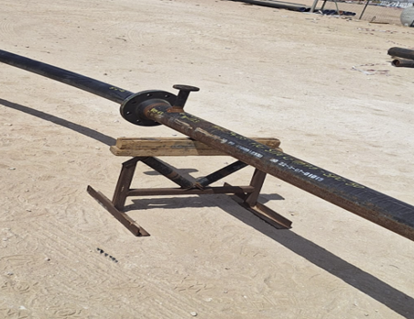

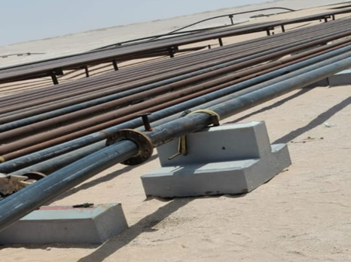

PDO Second Alert
Date: Time: | 13-05-2025 13:40 | Incident title: PIM# | LTI#08 1177808 | Risk Category: Injury / Asset Damaged: | Struck Hit by Leg Injury ( Struck by ) | Actual Severity: Potential severity: | 3P C3P | Activity: Location: | Flowline Construction Bahja
Target Audience: Logistics, Operation & Construction
What happened?
On 13 May 2025, at approximately 13:40 hours, a Mechanical crew were performing HDPE liner pulling for ANZ-61 the pipe shifted from the support and fell on the ground trapping worker left leg between the HDPE liner & the ground causing fracture to his left leg. Worker was oiling the liner before the liner entering the CS pipe. The IP rushed to PAC clinic where he got initial treatment & transferred to hospital for X-ray. The X-ray revealed that the IP has fracture.
Why it happened/Finding :
The CS pipe was not properly anchored, and the use of a wooden piece on top of a roller created an unstable setup.
The Permit Holder allowed work to proceed with unsafe equipment positioning.
The Involved Person was positioned in the line of fire while applying lubrication, exposing them to potential injury.
Inadequate planning for a unique task led to unclear instructions and gaps in hazard identification.
Reflective Questions:
Do you ensure that all equipment and materials used are fit for purpose and appropriately secured?
Do you ensure that method statements clearly cover all critical steps, including proper securing and anchoring of pipes?
Do you ensure that workers are positioned outside the line of fire during pulling or lifting operations?
Do you ensure that unique or first-time tasks are supported with detailed work methods and proper risk assessments to identify and control potential hazards.
Carbon Steel pipe kept on the wooden logs
Using elevated sleeper to compensate the height
Always plan properly, secure equipment, identify hazards, stay out of the line of fire, and never proceed with unsafe setups
Notes:
Ensure all dates and titles are input
A short description should be provided without mentioning names of contractors or individuals. You should include, what happened, to who (by job title) and what injuries this resulted in. Nothing more!
Four to five bullet points highlighting the main findings from the investigation. Remember the target audience is the front line staff so this should be written in simple terms in a way that everyone can understand.
The strap line should be the main point you want to get across
The images should be self explanatory, what went wrong (if you create a reconstruction please ensure you do not put people at risk) and below how it should be done.

Slide 2
Management Reflective Questions
As a learning from this incident and ensure continual improvement all contract managers must review their HSE risk management against the questions asked below
Confirm the following:
Do you ensure that Method Statements for HDPE Liner pulling activity is capturing about elevated sleepers & effective anchoring requirements.?
Do you ensure that workers are not exposed to the line of fire during the pulling activity.
Do you ensure that MOC is clearly understood and practiced by the filed team? the Permit Holders fully understand the scop?
Do you ensure that workers understand the importance of not taking shortcuts and strictly follow approved procedures?
Notes:
Ensure all dates and titles are input
Make a list of closed questions (only ‘yes’ or ‘no’ as an answer) to ask others if they have the same issues based on the management or HSE-MS failings or shortfalls identified in the investigation.
Imagine you have to audit other companies to see if they could have the same issues.
These questions should start with: Do you ensure…………………?

