Slide 1
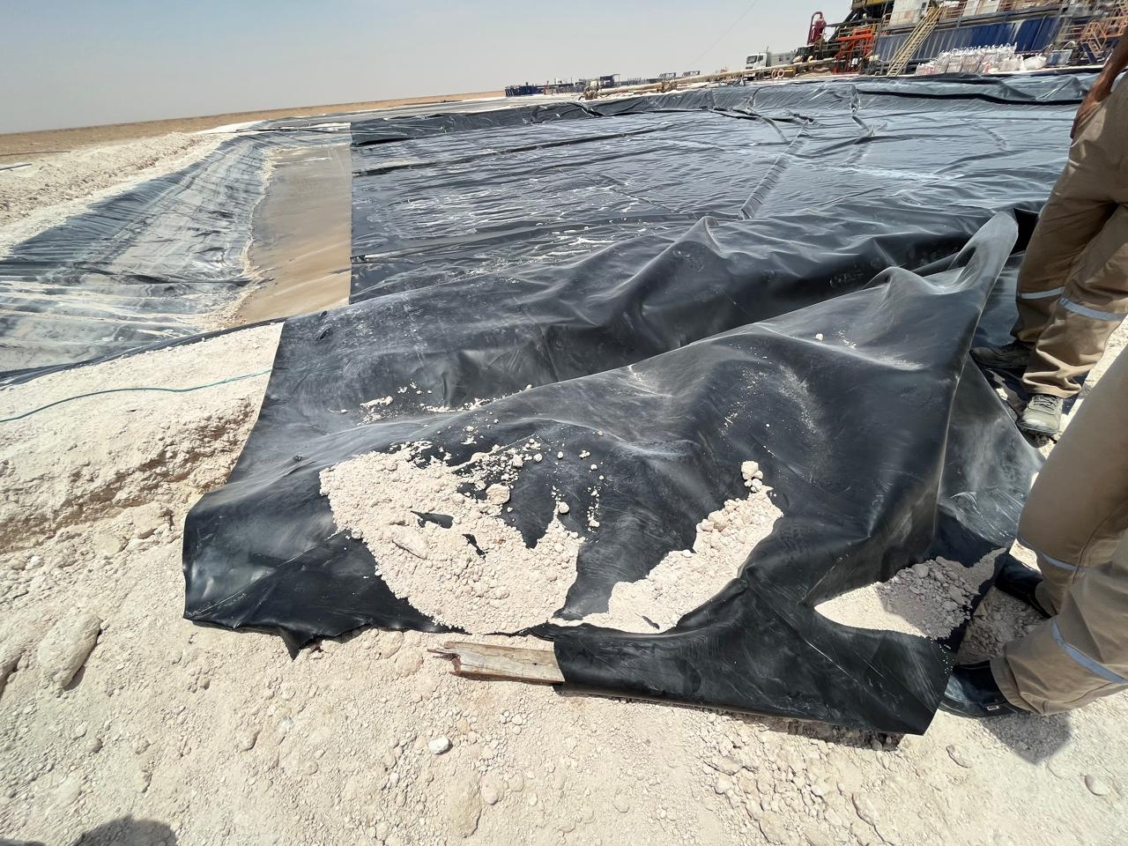



PDO Second Alert
Date: Time: | 28.05.2025 14:30 hrs | Incident title: PIM# | LTI 1178333 | Risk Category: Injury / Asset Damaged: | Released Energy Leg Injury | Actual Severity: Potential severity: | 3P C4P | Activity: Location: | Pulling HDPE Liner Yibal
Target Audience: Logistics, Operation & Construction
What happened?
On 28th May 2025 at approximately 14:30 hours, an incident occurred during the installation of HDPE liner in a water pit by a subcontractor crew. The non routine activity involved a combination of both manual handling techniques and the use of a backhoe loader to position and deploy the liner into water pit. During the pulling operation, a wooden anchor piece, which had been temporarily fastened at the one corner of the HDPE liner to assist with mechanical pulling, failed under tension. The sudden release of the wooden piece caused it to rebound violently, striking the permit holder on the right leg, resulting in a right leg fracture.
Why it happened/Finding :
Permit Holder was standing in the line of fire during the task.
The work is executed as a stopgap measure for installation of HDPE.
Permit holder failed to identify the hazards related to the task.
Sub standard & deteriorated tools are used for the task.
There was supervisor at the incident location, but no intervention took place.
Reflective Questions
Do you ensure to use the right tools for the task?
Do you ensure all the activities are well planned & risk assessed before commencing the task?
Do you ensure to intervene when observing unsafe acts and conditions?
Do you ensure to follow the SOP/Method statement for the task?
Do you ensure crew members are aware of line of fire for the engaged task?
HDPE liner attached to wooden anchor and pulled by JCP
Always be alert and ever place your self in the line of fire
Notes:
Ensure all dates and titles are input
A short description should be provided without mentioning names of contractors or individuals. You should include, what happened, to who (by job title) and what injuries this resulted in. Nothing more!
Four to five bullet points highlighting the main findings from the investigation. Remember the target audience is the front line staff so this should be written in simple terms in a way that everyone can understand.
The strap line should be the main point you want to get across
The images should be self explanatory, what went wrong (if you create a reconstruction please ensure you do not put people at risk) and below how it should be done.

Slide 2
Management Reflective Questions
As a learning from this incident and ensure continual improvement all contract managers must review their HSE risk management against the questions asked below
Confirm the following:
- Do you review your subcontractor's method statements and risk register for controls/mitigation prior to deployment? Yes
-Do you ensure your subcontractor’s employees HSE competency assessment is carried out? Yes
- Do you ensure the crew aware of empowerment to stop and intervene on unsafe act or condition? Yes
- Do you ensure there is adequate levels of supervision to ensure work is executed safely? Yes
- Do you ensure personnel in HSE critical roles are competent for their job? Yes
Notes:
Ensure all dates and titles are input
Make a list of closed questions (only ‘yes’ or ‘no’ as an answer) to ask others if they have the same issues based on the management or HSE-MS failings or shortfalls identified in the investigation.
Imagine you have to audit other companies to see if they could have the same issues.
These questions should start with: Do you ensure…………………?

