Slide 1
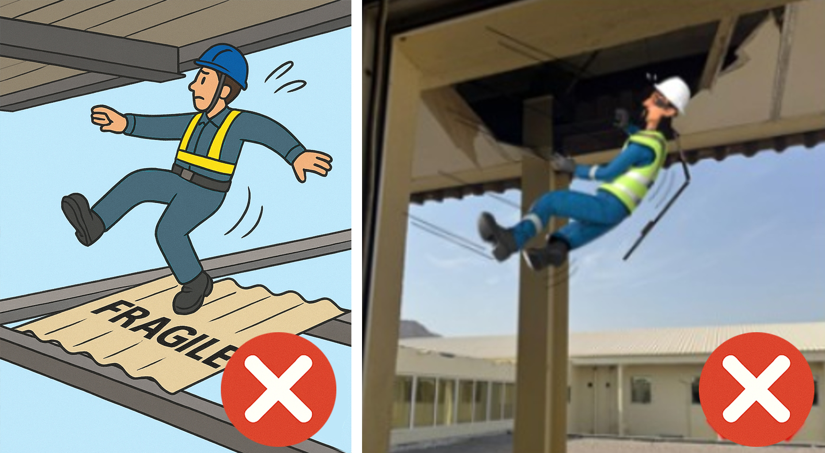
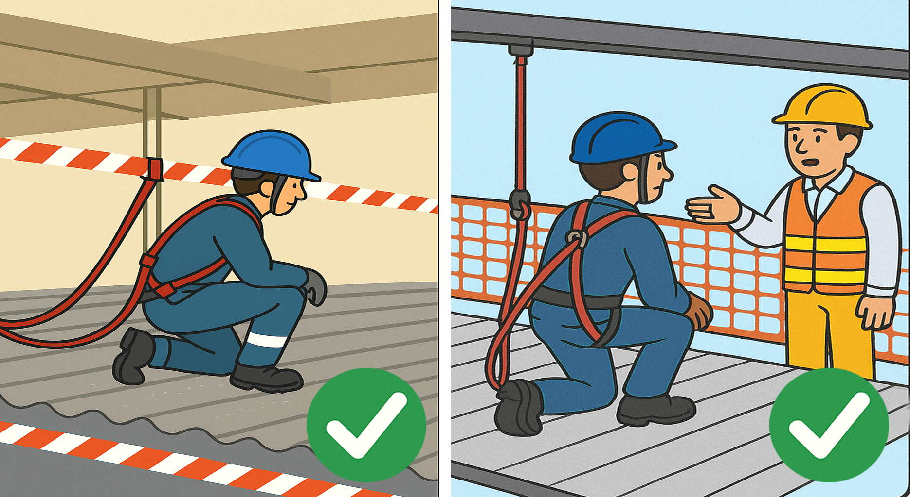
PDO Second Alert
Date: Time: | 25-06-2025 17:00 | Incident title: PIM# | LTI#11 11779100 | Risk Category: Injury / Asset Damaged: | Fell from height Hip Injury | Actual Severity: Potential severity: | 3P C4P | Activity: Location: | Housekeeping Redwing MAF
Target Audience: Logistics, Operation & Construction
What happened?
During renovation activities, a Helper was performing a house keeping task and attempted to remove a hanging cable from the top of a decking sheet/ceiling. In the process, he lost his balance and inadvertently stepped onto a gypsum board, causing him to fall from a height of six meters sustaining an injury to his left hip.
He was immediately transported to Badr Al Samaa Hospital, where a CT scan confirmed a fracture of the left hip.
Why it happened/Finding :
Electrical helper crossed caution tape and accessed a fragile decking edge, assuming cable removal was part of end-of-day housekeeping
The cable was installed without a documented temporary cable layout plan and got stuck between decking floor.
Task-specific risk assessments did not include temporary cable removal near fragile surfaces.
Fragile ceiling surface was not barricaded with rigid barriers or signposted as a fall risk.
Reflective Questions:
Are we clearly instructed on which tasks require supervision or permits before starting them?
Do we always treat caution tape as a boundary not to cross—especially near fragile or elevated surfaces?
If a task feels minor, do we pause to verify whether it requires a buddy or risk assessment update?
Do we have a practice of updating Job Risk Assessments when new or temporary activities arise—even if they appear routine?
Are fragile surfaces clearly identified in the site hazard register and effectively barricaded with rigid barriers and warning signage—not just caution tape?
Do not act alone to fix hazards—report them immediately
Notes:
Ensure all dates and titles are input
A short description should be provided without mentioning names of contractors or individuals. You should include, what happened, to who (by job title) and what injuries this resulted in. Nothing more!
Four to five bullet points highlighting the main findings from the investigation. Remember the target audience is the front line staff so this should be written in simple terms in a way that everyone can understand.
The strap line should be the main point you want to get across
The images should be self explanatory, what went wrong (if you create a reconstruction please ensure you do not put people at risk) and below how it should be done.

Slide 2
Management Reflective Questions
As a learning from this incident and ensure continual improvement all contract managers must review their HSE risk management against the questions asked below
Confirm the following:
Do we have a practice of updating Job Risk Assessments when new or temporary activities arise—even if they appear routine?
How can we make sure housekeeping tasks are done safely, especially near edges or fragile areas?
Do we have a system to ensure all temporary installations (such as electrical cables) are planned, approved, and included in risk assessments?
Are fragile surfaces clearly identified in the site hazard register and effectively barricaded with rigid barriers and warning signage—not just caution tape?
Do we verify that scaffolding tags are updated and reflect the real-time access restrictions—especially when access leads to incomplete or hazardous areas?
Is the buddy system enforced even during “minor” housekeeping or close-out tasks?
Are shift-closeout procedures robust enough to verify area safety, not just personnel headcount?
Notes:
Ensure all dates and titles are input
Make a list of closed questions (only ‘yes’ or ‘no’ as an answer) to ask others if they have the same issues based on the management or HSE-MS failings or shortfalls identified in the investigation.
Imagine you have to audit other companies to see if they could have the same issues.
These questions should start with: Do you ensure…………………?

