Slide 1
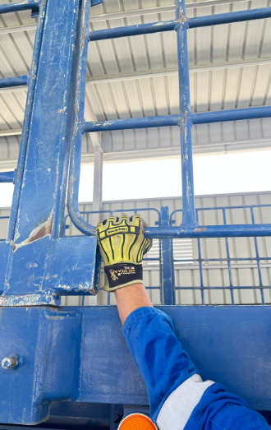
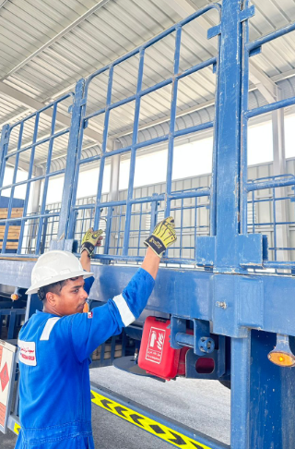
PDO Second Alert
Date: Time: | 25.08.2025 10:30 Am | Incident title: PIM# | LTI#14 181199 | Risk Category: Injury : | Hands & Fingers Finger Injury | Actual Severity: Potential severity: | 3P D3P | Activity: Location: | Trailer Securing MAF
Target Audience: Logistics, Operation & Construction
What happened?
While installing side grills and extensions on a trailer, a driver's left-hand ring finger was caught between the extension and the trailer bed, causing a fracture. The driver received first aid on site and was later treated at Sultan Qaboos Hospital in Muscat.
Why it happened/Finding :
Always assess the task before starting – Identify potential hazards such as pinch points and line of fire
Never place hands or body parts in pinch points – Use tools or safe positioning to avoid injury
Seek assistance when needed – Do not proceed with tasks alone if support is required
Follow proper communication protocols – Escalate if help is denied or unavailable
Stop work if conditions are unsafe – Empowerment to STOP is available to all
Reflective Questions
Is the pinch point hazard communicated in daily TBT?
Are you confident in stopping work if you feel it's unsafe?
Have you ever felt pressured to complete a task alone without proper support?
What would you do if your request for assistance was denied?
How do you ensure your hands and body are not in the line of fire during manual tasks?
Photo explaining what was done wrong
Photo explaining how it should be done right
Be aware of the risk when preforming a task and always know your hand position
Notes:
Ensure all dates and titles are input
A short description should be provided without mentioning names of contractors or individuals. You should include, what happened, to who (by job title) and what injuries this resulted in. Nothing more!
Four to five bullet points highlighting the main findings from the investigation. Remember the target audience is the front line staff so this should be written in simple terms in a way that everyone can understand.
The strap line should be the main point you want to get across
The images should be self explanatory, what went wrong (if you create a reconstruction please ensure you do not put people at risk) and below how it should be done.

Slide 2
Management Reflective Questions
As a learning from this incident and to ensure continual improvement, all contract managers must review their HSE risk management against the questions asked below
Confirm the following:
Are your employees aware that they can seek help when they are struggling to accomplish a simple task on their own?
Are drivers provided with proper support and assistance when handling equipment or performing physical tasks?
Are you aware about the task risk and hazards?
Do you ensure that ‘Empowerment To STOP’ is communicated to all employees?
Do you ensure that ‘PDO golden rules and LSR’ are communicated to all employees?
Is the vendor providing sufficient supervision during loading operation?
Do you ensure that no one works unsupervised in your facility?
Do you support other workers in your facility who are not your employees?
* If the answer is NO to any of the above questions please ensure you take action to correct this finding
Please refer to the notes section for guidance
Notes:
Make a list of closed questions (only ‘yes’ or ‘no’ as an answer) to ask others if they have the same issues based on the management or HSE-MS failings or shortfalls identified in the investigation.
Imagine you have to audit other companies to see if they could have the same issues.
These questions should start with: Do you ensure…………………?

