Slide 1
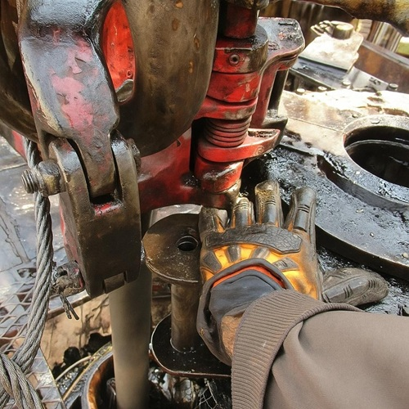
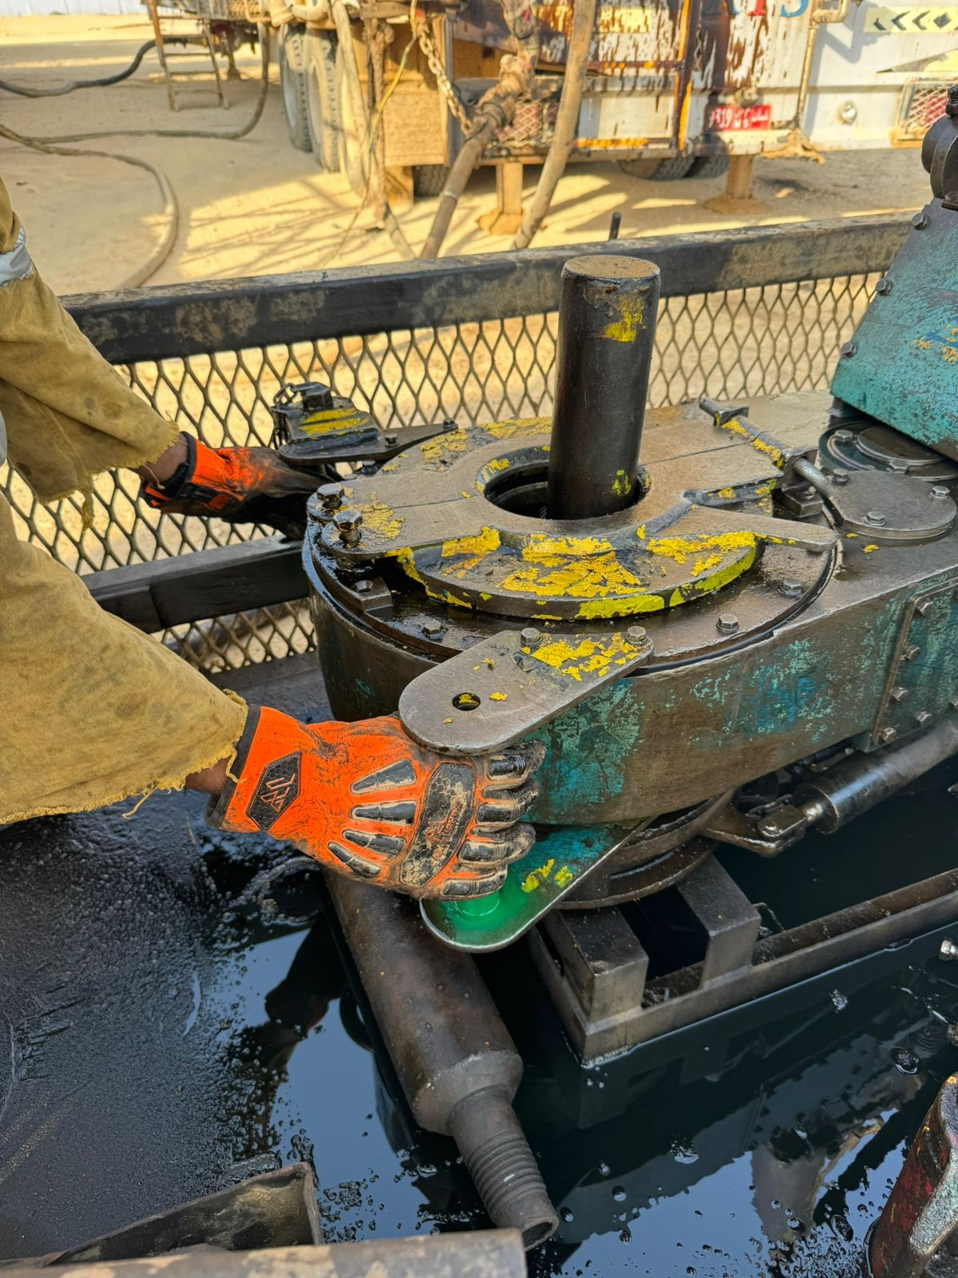
PDO Second Alert
Date: Time: | 05.09.2025 11:06 AM | Incident title: PIM# | LTI#15 1181428 | Risk Category: Injury/Damage : | Hand & Finger Finger Injury (LWC) | Actual Severity: Potential severity: | 2P C3P | Activity: Location: | Power tong Main Fahud
Target Audience: Floorman, Driller, Rig Manager
What happened?
While performing maintenance on the power tong at the rig floor, the mechanic lifted the tong hydraulically to create space to work on the backup assembly. At the same time, the floorman placed his hand on top of the tong. The floorman left-hand little finger caught between the tong and the elevator, resulting in a pinch injury on the little finger.
Why it happened/Finding :
FM kept his hands on top of the power tong instead of holding the handles.
There was no clear communication before operating the tong .
The Floorman was unaware his hand was in the crushing point (Line of Fire).
There is SOP in place, however the SOP does not fully cover all power tong maintenance activities.
No intervention from team, when FM was following wrong hand placements
Driller was not supervising the job. He went to check the line-up for next circulation job
Your learning from this incident..
Do you ensure crush points (Line of Fire) are effectively identified & discussed during pre job meetings?
Do you ensure to perform dynamic risk review whenever work changes?
Do you stop and reassess when something doesn’t feel safe?
How do we ensure all our equipment are secured & in safe condition to work on?
Photo explaining what was done wrong
Photo explaining how it should be done right
Always keep hands off pinch points & hold only on the handles
Notes:
Ensure all dates and titles are input
A short description should be provided without mentioning names of contractors or individuals. You should include, what happened, to who (by job title) and what injuries this resulted in. Nothing more!
Four to five bullet points highlighting the main findings from the investigation. Remember the target audience is the front line staff so this should be written in simple terms in a way that everyone can understand.
The strap line should be the main point you want to get across
The images should be self explanatory, what went wrong (if you create a reconstruction please ensure you do not put people at risk) and below how it should be done.

