Slide 1
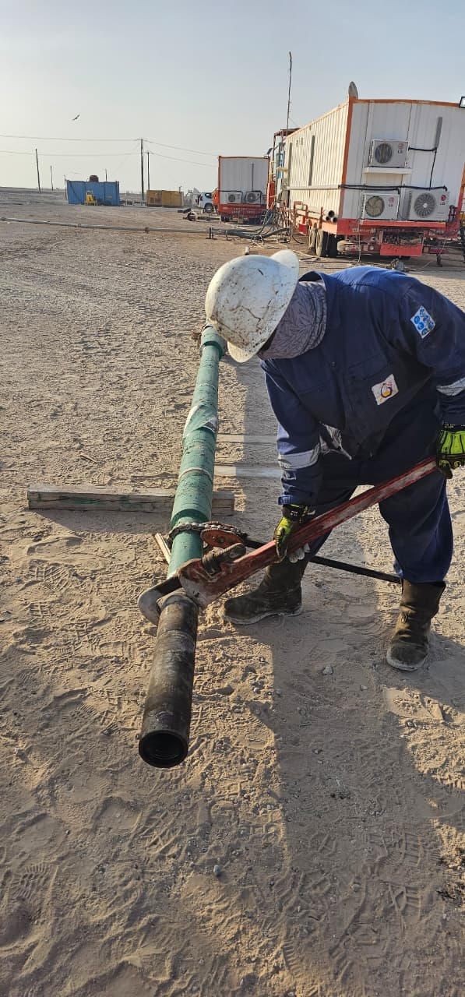
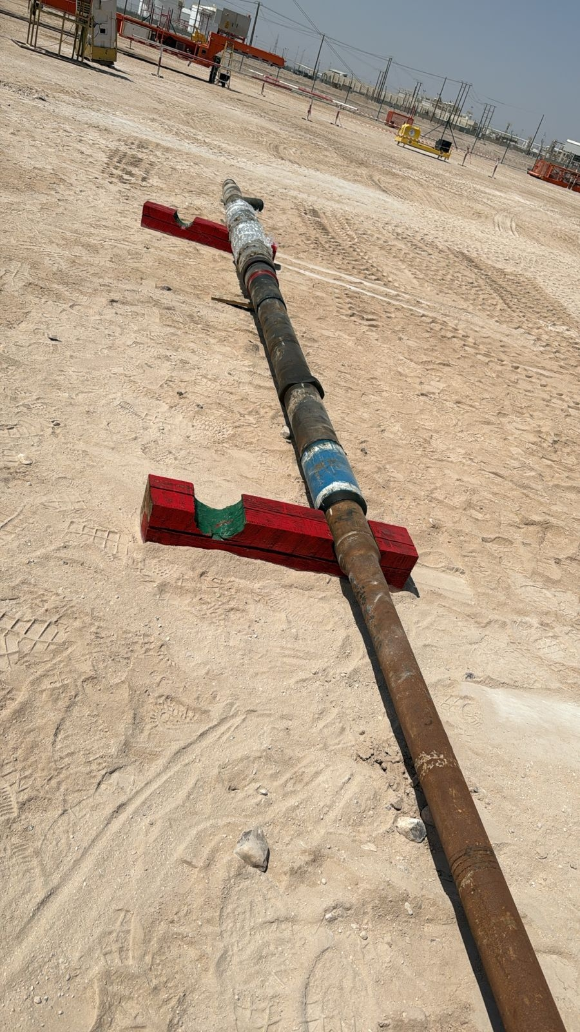
PDO Second Alert
Date: Time: | 16-09-2025 06:12 | Incident title: PIM# | LTI#16 25261703 | Risk Category: Injury / Asset Damaged: | Struck by Leg Injury | Actual Severity: Potential severity: | 2P C3P | Activity: Location: | Make up BHA on the ground Qarn Alam
Target Audience: Site employees
What happened?
During the make-up of the multi-cut MEB assembly with the float sub, the operation was being conducted offline at the ground. The crew were using a chain tong and pipe wrench to apply torque. While applying torque, the chain tong slipped, causing the entire assembly (which was placed on a piece of wood) to rotate and lose stability. Consequently, the float sub and assembly roll onto the right foot of a Roustabout, He was escorted to the clinic for further evaluation and medical attention. X-ray reveal a non-displaced fracture in the foot.
Why it happened/Finding :
The specific risk of assembly instability during torque application was not fully identified during the planning phase.
The chain tong and pipe wrench was in good condition, and no defects were reported.
The assembly was placed on a wooden base, which did not provide stable support on both sides.
The chain tong slipped, releasing uncontrolled energy, which caused the assembly to rotate and fall onto the roustabout’s leg.
A Toolbox Talk (TBT) was conducted before starting the job, and the Driller and Fishing Engineer supervised the task.
Stop Work Authority was not exercised when the roustabout was standing in the line of fire, and no intervention occurred until after the incident.
Reflective Questions:
Did supervisors adequately assess risks and ensure that all controls were in place before starting the activity?
Did supervisors ensure that STOP Work Authority was effectively implemented and that the crew intervened when someone was at risk?
Did supervisors ensure that the Out of Sight register was kept up to date and that activities were carried out in line with the identified controls?
Photo explaining what was done wrong
Photo explaining how it should be done right
Always secure the BHA is secured with appropriate timber stands—and keep all personnel out of the Line of Fire
Notes:
Ensure all dates and titles are input
A short description should be provided without mentioning names of contractors or individuals. You should include, what happened, to who (by job title) and what injuries this resulted in. Nothing more!
Four to five bullet points highlighting the main findings from the investigation. Remember the target audience is the front line staff so this should be written in simple terms in a way that everyone can understand.
The strap line should be the main point you want to get across
The images should be self explanatory, what went wrong (if you create a reconstruction please ensure you do not put people at risk) and below how it should be done.

Slide 2
Management Reflective Questions
As a learning from this incident and ensure continual improvement all contract managers must review their HSE risk management against the questions asked below
Confirm the following:
Do we have a practice of updating Job Risk Assessments when new or temporary activities arise—even if they appear routine?
How can we make sure housekeeping tasks are done safely, especially near edges or fragile areas?
Do we have a system to ensure all temporary installations (such as electrical cables) are planned, approved, and included in risk assessments?
Are fragile surfaces clearly identified in the site hazard register and effectively barricaded with rigid barriers and warning signage—not just caution tape?
Do we verify that scaffolding tags are updated and reflect the real-time access restrictions—especially when access leads to incomplete or hazardous areas?
Is the buddy system enforced even during “minor” housekeeping or close-out tasks?
Are shift-closeout procedures robust enough to verify area safety, not just personnel headcount?
Notes:
Ensure all dates and titles are input
Make a list of closed questions (only ‘yes’ or ‘no’ as an answer) to ask others if they have the same issues based on the management or HSE-MS failings or shortfalls identified in the investigation.
Imagine you have to audit other companies to see if they could have the same issues.
These questions should start with: Do you ensure…………………?

