Slide 1
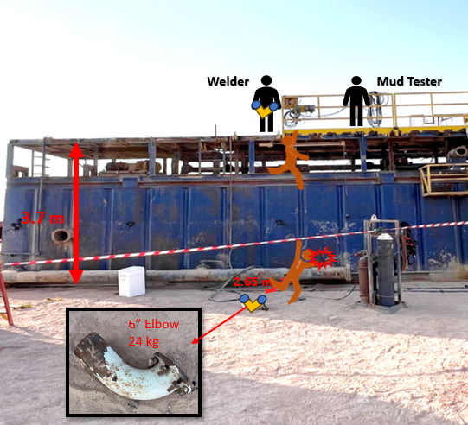

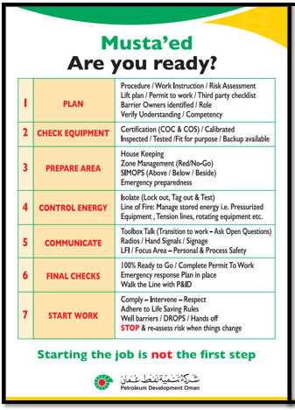

PDO Second Alert
Date: Time: | 23.10.2025 17:20 hrs | Incident title: IFADAH# | LTI#18 25553187 | Risk Category: Injury / Asset Damaged: | Fall From Height Fracture (LWC) | Actual Severity: Potential severity: | 3P C4P | Activity: Location: | Housekeeping Marmul
Target Audience: Drilling & Hoist Crews
What happened?
During a rig move operation, a welder was conducting housekeeping activities on top of a reserve mud tank located outside the rig boundary. While attempting to discard an elbow fitting, a flange nut snagged on his coverall, causing him to lose balance. He attempted to grasp the handrails but was unable to maintain his grip and fell from the tank. The individual sustained non-life-threatening facial injuries and was promptly evacuated to the nearest hospital for medical evaluation and treatment.
Why it happened/Finding :
Tank was not fully secured with handrails
Fall protection was not properly used
IP lost balance and fell from the top of tank to ground
Improper job planning & MOC implementation
Improper risk assessment & ineffective intervention to stop
Improper risk assessment & Lack of supervision
Your learning from this incident..
Rig management to always ensure proper planning, MOC and supervision for out of sight activities.
All employees are empowered to always intervene immediately to stop and correct any unsafe acts or conditions.
Rig Supervisors to always implement work-at-height controls (including safe use of safety harness & lanyard ) before commencing any task.
Accident reenactment
Follow Musta’ed STEPS
Don’t let out of sight be out of mind
Notes:
Ensure all dates and titles are input
A short description should be provided without mentioning names of contractors or individuals. You should include, what happened, to who (by job title) and what injuries this resulted in. Nothing more!
Four to five bullet points highlighting the main findings from the investigation. Remember the target audience is the front line staff so this should be written in simple terms in a way that everyone can understand.
The strap line should be the main point you want to get across
The images should be self explanatory, what went wrong (if you create a reconstruction please ensure you do not put people at risk) and below how it should be done.

Slide 2
Effective Learning
To make sure learning is translated to the site day to day activities , please answer the below questions :-
How learning can be implemented at site ?
Ensure proper planning, adequate supervision and MOC with effective risk management controls (PTW, JSA, TBT…etc.) are in place to manage out of sight activities during Rig move.
Always implement work-at-height controls including safe use of safety harness & ladder and proper engineering plans/HSE risk assessment before commencing any task.
How can you sustain the action ?
Rig move maintenance plan to be properly developed and discussed/approved with all stakeholders.
Work-at-height competency assessment to be conducted every year and documented it with an action plan for improvement.
Notes:
Guideline for Effective Learning & Sustainability
•Can be replicated across similar contractor / activities
•Shall be SMART- Specific ,Measurable , Achievable ,Realistic & Timebound
•Can be implemented in a months' time

