Slide 1
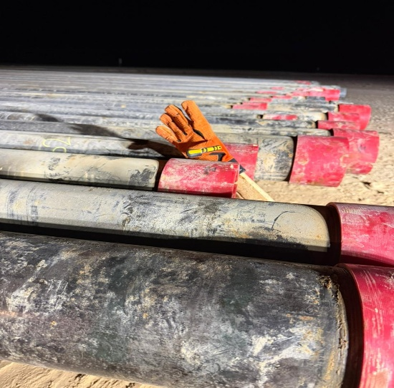
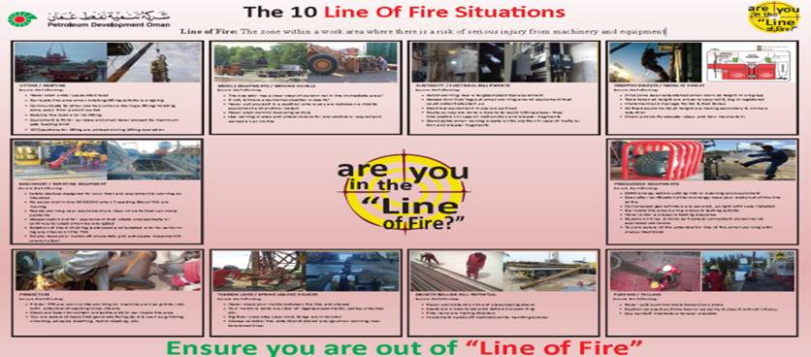
PDO Second Alert
Date: Time: | 12.12.2025 16:30 hrs | Incident title: IFADAH# | LTI#20 26017500 | Risk Category: Injury / Asset Damaged: | Hand & Finger Fracture (LWC) | Actual Severity: Potential severity: | 3P C3P | Activity: Location: | Measure Casing Marmul
Target Audience: Driller, AD, Floor hands, Derrick man
Photo explainig what was done wrong
What happened?
While that crew members were measuring 7" casing joints on the pipe racks. the measuring tape get stuck between two joints; in order to free the measuring tape, forklift was used to pick some casing joints and create a space on the rack (Rack was full of casing joints). While the Floorman was attempting to remove the tape, two casing joints unexpectedly slipped from the forklift's forks, causing it to roll back on the rack. Consequently, the Floorman's right hand was caught between two joints.
Why it happened/Finding :
Measuring 7” casing activity was carried out as per the plan until measurement tape stuck between two joints.
The team failed to stop and reassess the recovery plan when the task changed due to the measuring tape getting stuck.
Forklift was used to move the casing joint to free the tape. The forklift load 7 joints as per procedure however he was not in proper position leading 2 joints to roll out of forks.
Lack of communication among crew members.
Supervisor did not ensure personnel were clear of the temporary No-Go Zone.
Forklift operator started moving without confirming that all employees were positioned safely away from the Line of Fire.
The IP attempted to release the tape without consider the line of fire.
Reflective Questions :
How can we make Stop & Reassess as best practice rather than a perceived delay?
How do we define the "Line of Fire" when forklift is interacting with tubulars?
Supervisor and forklift operator, how do you verify that everyone is in a Safe Zone before moving machine?
How can supervisors maintain a 360” view to ensure his team in Safe Zone prior start work?
How do we ensure that mindset of site teams is able to identify and recognize the hazard of “Line of Fire“ ?
To what level, we can build the perception of positive sense of caution on the site team ?
Ensure you are out of line of fire.
Notes:
Ensure all dates and titles are input
A short description should be provided without mentioning names of contractors or individuals. You should include, what happened, to who (by job title) and what injuries this resulted in. Nothing more!
Four to five bullet points highlighting the main findings from the investigation. Remember the target audience is the front line staff so this should be written in simple terms in a way that everyone can understand.
The strap line should be the main point you want to get across
The images should be self explanatory, what went wrong (if you create a reconstruction please ensure you do not put people at risk) and below how it should be done.

