Slide 1
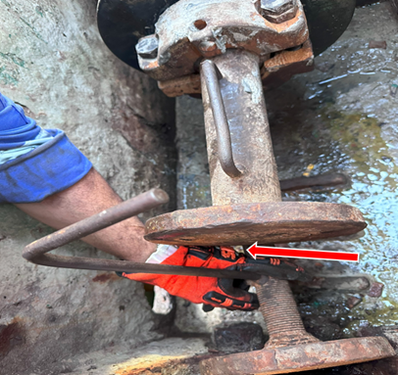
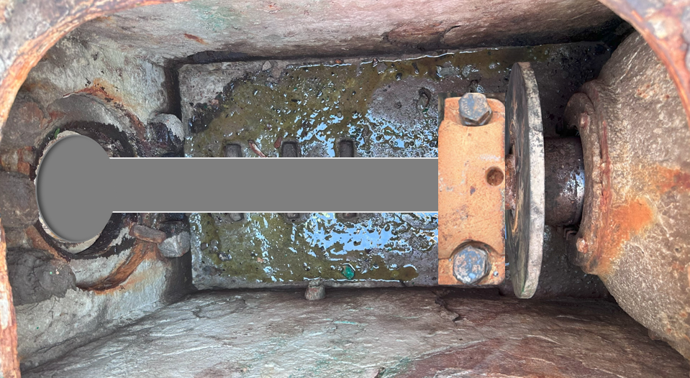
PDO Second Alert
Date: Time: | 15.12.2025 11:40 hrs | Incident title: IFADAH# | LTI#21 2602822 | Risk Category: Injury / Asset Damaged: | Hand & Finger Fracture (LWC) | Actual Severity: Potential severity: | 3P C3P | Activity: Location: | Removing liner Nimr
Target Audience: Driller, AD, Floor hands, Derrick man
Photo explainig what was done wrong
What happened?
During liner replacement on an F-1000 mud pump, a liner pusher tool was clamped to the pony rod to push the liner forward for removal. As the liner was still partially inside the fluid end, an extension tool was added between the pusher plate and the liner. The extension was held at the base of its handle; when the pony rod was manually cranked forward, the extension slid down and misaligned, and the momentum caused IP’s left index finger to be pinched between the extension tool & the pusher plate.
Why it happened/Finding :
The risks resulting from using an extension tool while the pony rod is in motion to push the remaining part of the liner were not fully assessed.
The crew failed to identify the hazards associated with using the extension tool to remove the remaining part of the liner from the mud pump.
The crew failed to identify the potential hazard resulting from unsafe hand positioning.
Reflective Questions :
What are the main hazards involved while removing the liner from mud pump?
Where are the pinch point during this activity?
Was the pusher and extension tool suitable for the task and properly risk assessed?
Where should hands and fingers be safely positioned when equipment or tools are in motion?
Use suitable (risk-assessed) tools for the task - keep Hands & Fingers away from moving parts
Notes:
Ensure all dates and titles are input
A short description should be provided without mentioning names of contractors or individuals. You should include, what happened, to who (by job title) and what injuries this resulted in. Nothing more!
Four to five bullet points highlighting the main findings from the investigation. Remember the target audience is the front line staff so this should be written in simple terms in a way that everyone can understand.
The strap line should be the main point you want to get across
The images should be self explanatory, what went wrong (if you create a reconstruction please ensure you do not put people at risk) and below how it should be done.

