Slide 1
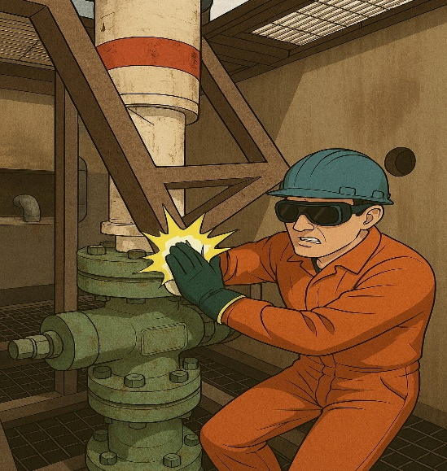
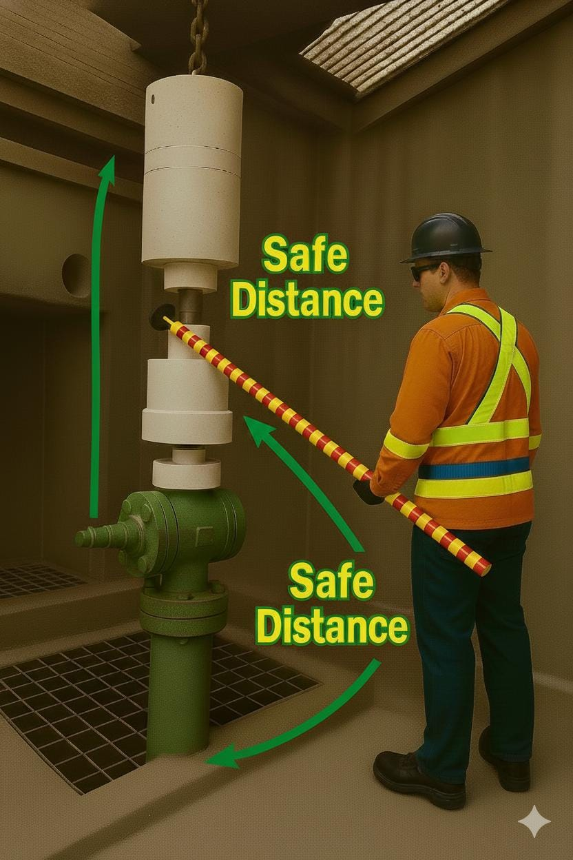
PDO Second Alert
Date: Time: | 30.12.2025 14:00 hrs | Incident title: IFADAH# | LTI#22 26176710 | Risk Category: Injury / Asset Damaged: | Struck By LWC | Actual Severity: Potential severity: | 3P C3P | Activity: Location: | Rig Up Fahud
Target Audience: Rig Operators, Driller, Assistant Driller
What happened?
During Slickline rig-up phase after lowering an assembled pressure control equipment (PCE) set by crane to align with the X-mass tree inside a deep cellar, the injured person was standing on a cellar platform trying to connect the PCE, he found difficulties to align the connection. He gave a signal to the banksman to lift the PCE , during this process the PCE touched cellar grating frame causing a dislodged of cellar grating frame and struck the IP right index finger against the PCE connection, resulting in Fracture Finger.
Why it happened/Finding :
SOP and risk assessment did not fully address rig up process in deep cellar.
Zone management was not managed properly.
The IP was in the line of fire.
The TBT covered the rig-up activity but did not emphasize on the Hands-off
Walk the line was not properly conducted to avoid touching the cellar grating frame.
Failed to identify abnormal situation during rig-up.
Your learning from this incident:
Ensure SOP and risk assessment address site-specific rig-up conditions such as rig up in deep cellars.
Ensure interaction risks like PCE contacting grating frames are considered during area preparation.
Ensure to get out of the cellar whenever there is a movement of load.
Ensure toolbox talks emphasize the hands-off rule.
Ensure final checks verify that grating frames cannot move or contact PCE during operation.
Ensure abnormal situations are identified early and work is stopped to reassess risk.
Proper zone management in workplace
Notes:
Ensure all dates and titles are input
A short description should be provided without mentioning names of contractors or individuals. You should include, what happened, to who (by job title) and what injuries this resulted in. Nothing more!
Four to five bullet points highlighting the main findings from the investigation. Remember the target audience is the front line staff so this should be written in simple terms in a way that everyone can understand.
The strap line should be the main point you want to get across
The images should be self explanatory, what went wrong (if you create a reconstruction please ensure you do not put people at risk) and below how it should be done.

Slide 2
Disclaimer
This document is made available for information only and on the condition that (i) it may not be relied upon by anyone, in the conduct of their own operations or otherwise; (ii) neither the [PDO] company issuing this document nor any other person or company concerned with furnishing information or data used herein (A) is liable for its accuracy or completeness, or for any advice given in or any omission from this document, or for any consequences whatsoever resulting directly or indirectly from any use made of this document by any person, even if there was a failure to exercise reasonable care on the part of the issuing company or any other person or company as aforesaid; or (B) make any claim, representation or warranty, express or implied, that acting in accordance with this document will produce any particular results with regard to the subject matter contained herein or satisfy the requirements of any applicable federal, state or local laws and regulations; and (iii) nothing in this document constitutes technical advice, if such advice is required it should be sought from a qualified professional adviser.

