Slide 1
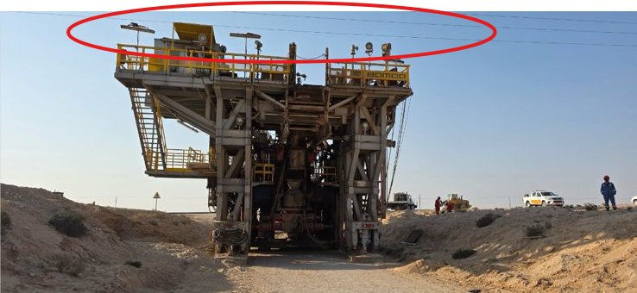
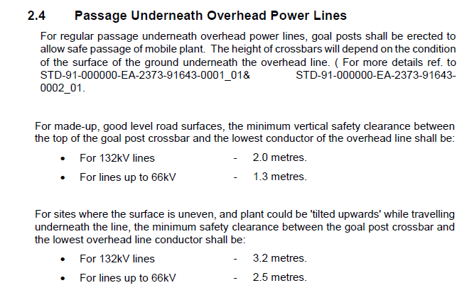
PDO Second Alert
Date: Time: | 23.10.2025 17:30 hrs | Incident title: IFADAH# | HiPo#32 25566322 | Risk Category: Injury / Asset Damaged: | OHL Oil Deferment | Actual Severity: Potential severity: | 0P C4P | Activity: Location: | Rig Move Marmul
Target Audience: Drilling, Logistics, Operation & Construction
What happened?
During Rig move activity of Rig main carrier along the graded road between Rahab and Ghanuq, the rigconvoy passed beneath an 33kV overhead power line (OHL) before the Rahab–Dhiab road junction. Due to a steep road gradient, the rig carrier was unable to proceed forward, and the team decided to reverse it to a safer position. While reversing, the rig carrier came to a halt directly beneath the OHL (12.08 mtrs). In an attempt to stabilize and realign the carrier on the slope, the crew activated the hydraulic jacks to support the carrier. While engaging the jacks , the rear top point of the carrier possibly entered in the electromagnetic field of the energized OHL and tripped the power resulting in a deferment.
Why it happened/Finding :
Rig move route survey and pre-move assurance verification; the associated risk related to the powerhead lines were clearly identified but the risk of interference with the powerline magnetic field due to low clearance was overlooked ( only 1.18 mtrs)
No physical barrier (goalpost/kicker bar) was installed to control proximity to the OHL.
The Overhead line was not deisolated while the rig was passing under the load.
No power-isolation confirmation was obtained prior to passing under OHL.
Unsafe decision to park and stabilize the carrier beneath energized lines without reassessment or updated risk controls.
Your learning from this incident..
Always ensure all pre-move hazards identified in surveys (especially OHL isolation and support-equipment readiness) are verified and closed before movement.
Always ensure dynamic risk assessment is conducted whenever conditions change, such as delayed equipment, darkness, or terrain deviation.
Always ensure goalposts or kicker bars are installed and physically checked at every OHL crossing and get necessary clearances.
Always ensure Stop-Work authority is exercised when safety barriers or conditions are compromised.
Rig main carrier parked underneath 33kV OHL without minimum clearance
Minimum clearance while passing underneath powerlines on even surface
Always Ensure to maintain minimum clearance while passing underneath an Overhead Line
Notes:
Ensure all dates and titles are input
A short description should be provided without mentioning names of contractors or individuals. You should include, what happened, to who (by job title) and what injuries this resulted in. Nothing more!
Four to five bullet points highlighting the main findings from the investigation. Remember the target audience is the front line staff so this should be written in simple terms in a way that everyone can understand.
The strap line should be the main point you want to get across
The images should be self explanatory, what went wrong (if you create a reconstruction please ensure you do not put people at risk) and below how it should be done.

Slide 2
Effective Learning
To make sure learning is translated to the site day to day activities , please answer the below questions :-
How learning can be implemented at site ?
Institutionalize a “Pre-Move Readiness Verification Walkdown” involving the Rig Manager, Rig Move Supervisor, and PDO Electrical team before every move, physically confirming OHL isolation, goalpost installation, and slope control readiness before release.
Embed dynamic risk assessment checkpoints during rig moves, at any change in terrain, light condition, or delay, the RMS must initiate a stop, reassess, and re-brief before proceeding.
Integrate electromagnetic induction awareness into daily toolbox talks and weekly safety meetings, using visual aids and past-incident references to reinforce crew understanding.
Adopt a “Barrier Confirmation Checklist” on site, each OHL crossing to be verified and signed off by both Rig Manager and Electrical Representative prior to movement.
How can you sustain the action ?
Include OHL-related assurance in the monthly inspection and PDO rig-move audit schedule, ensuring every move demonstrates physical validation evidence and closure of all identified risks.
Maintain continuous competency reinforcement by tracking attendance and performance in induction, refresher, and learning modules on OHL hazards and Stop-Work culture.
Ensure leadership verification through quarterly management field visits, verifying that Stop-Work authority is exercised and that physical barriers and risk reassessments are practiced consistently.
Notes:
Guideline for Effective Learning & Sustainability
•Can be replicated across similar contractor / activities
•Shall be SMART- Specific ,Measurable , Achievable ,Realistic & Timebound
•Can be implemented in a months' time

