Slide 1
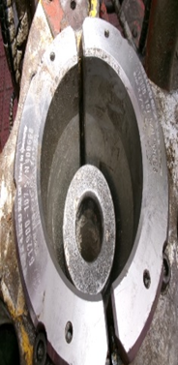
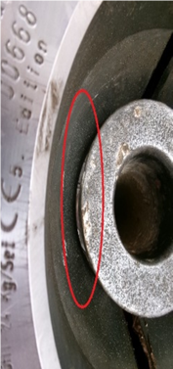
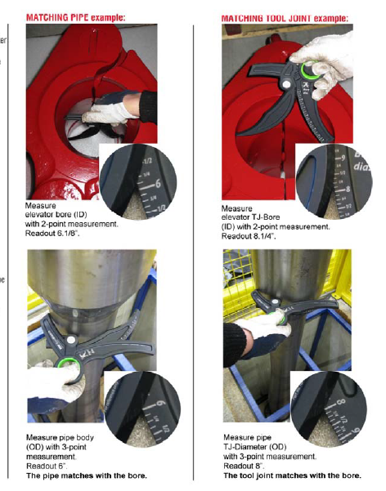
PDO Second Alert
Date: Time: | 25.06.2025 10:00 hrs | Incident title: PIM# | HiPo#19 1179077 | Risk Category: Injury / Asset Damaged: | Drop Near miss | Actual Severity: Potential severity: | 0P C4P | Activity: Location: | PU/RIH BHA Lekhwair
Target Audience:Drillers, Assistant Drillers, Rig Managers
What happened?
Operations were underway to make up the 6 1/8" directional BHA. At the time of the incident, the iCruise assembly was already suspended vertically on the rig floor. While attempting to lift the assembly to the rotary table, the lifting sub passed through the closed hydraulic elevators. As a result, the assembly lost stability, leaned toward the catwalk side, and ultimately fell to the ground in the designated “No-Go Zone.” Fortunately, there were no injuries to personnel, and no equipment damage was reported.
Why it happened/Finding :
During operations, a 4" EU insert was mistakenly used in place of the required 4" IU insert, which originated from incorrect parts being ordered several years ago and remaining in inventory without proper identification.
Although the Driller performed a fit check, the insert size was not verified against specifications, and no caliper measurement was conducted. The crew relied on the elevator’s “green” latch indicator.
Absence of physical measurement as a standard practice, due to the repetitive use of the same equipment across drilling programs. Lack of thorough insert inspection using calipers to confirm correct sizing.
Gaps in SOPs and JSAs, which do not explicitly require physical verification of elevator and lifting sub-sizes.
Reflective question :
The Rig Manager (RM) and Driller (DRL) shall ensure that the correct insert size is installed in the elevator before commencing any operation in the planning phase.
All inserts must undergo a comprehensive physical inspection, including precise measurement using a caliper, to confirm compatibility with the intended tools or Bottom Hole Assembly (BHA).
Strict zone management practices must be consistently applied to safeguard personnel and maintain a safe working environment throughout all operational phases.
Review to verify that the Material Requisition (MR) aligns with the correct part number and includes complete and detailed specifications to prevent procurement or installation errors.
Confirm equipment size using a caliper before beginning work
Notes:
Ensure all dates and titles are input
A short description should be provided without mentioning names of contractors or individuals. You should include, what happened, to who (by job title) and what injuries this resulted in. Nothing more!
Four to five bullet points highlighting the main findings from the investigation. Remember the target audience is the front line staff so this should be written in simple terms in a way that everyone can understand.
The strap line should be the main point you want to get across
The images should be self explanatory, what went wrong (if you create a reconstruction please ensure you do not put people at risk) and below how it should be done.

Slide 2
Disclaimer
This document is made available for information only and on the condition that (i) it may not be relied upon by anyone, in the conduct of their own operations or otherwise; (ii) neither the [PDO] company issuing this document nor any other person or company concerned with furnishing information or data used herein (A) is liable for its accuracy or completeness, or for any advice given in or any omission from this document, or for any consequences whatsoever resulting directly or indirectly from any use made of this document by any person, even if there was a failure to exercise reasonable care on the part of the issuing company or any other person or company as aforesaid; or (B) make any claim, representation or warranty, express or implied, that acting in accordance with this document will produce any particular results with regard to the subject matter contained herein or satisfy the requirements of any applicable federal, state or local laws and regulations; and (iii) nothing in this document constitutes technical advice, if such advice is required it should be sought from a qualified professional adviser.
Notes:
Make a list of closed questions (only ‘yes’ or ‘no’ as an answer) to ask others if they have the same issues based on the management or HSE-MS failings or shortfalls identified in the investigation.
Imagine you have to audit other companies to see if they could have the same issues.
These questions should start with: Do you ensure…………………?

