Slide 1
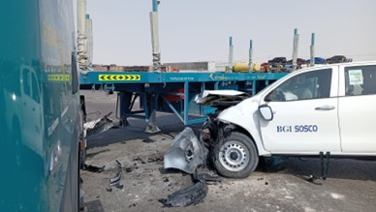
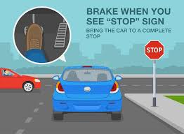
PDO Second Alert
Date: Time: | 30.08.2025 08:50 hrs | Incident title: PIM# | HiPo#23 1180382 | Risk Category: Injury / Asset Damaged: | MVI Third Party LTI | Actual Severity: Potential severity: | 1P/3A C4P | Activity: Location: | Driving Fahud
Target Audience: Driver
What happened?
An truck (returning empty from RIG) was involved in a side collision with a third-party Hilux pickup near the Oman Oil T-junction in Haima. At the time, the truck was exiting the Oman Oil fuel station to take a left turn onto the main road, while the Hilux pickup was approaching on the main road. According to the driver, the pickup had its right indicator on, showing/indicating the pickup would turn into the fuel station. Assuming the pickup would turn, the truck proceeded, but the Hilux continued straight and collided with the driver's side of the truck’s prime mover.
Why it happened/Finding :
The driver did not come to a full stop at the T junction
Driver relied on the third-party vehicle’s indicator without confirming its actual movement.
Reflective question :
Do you ensure drivers always make a full stop and perform a 180° visual check before entering a main road?
Do you ensure a full stop while approaching the T-Junction?
come to a full stop and check both left and right and when safe proceed with moving.
Notes:
Ensure all dates and titles are input
A short description should be provided without mentioning names of contractors or individuals. You should include, what happened, to who (by job title) and what injuries this resulted in. Nothing more!
Four to five bullet points highlighting the main findings from the investigation. Remember the target audience is the front line staff so this should be written in simple terms in a way that everyone can understand.
The strap line should be the main point you want to get across
The images should be self explanatory, what went wrong (if you create a reconstruction please ensure you do not put people at risk) and below how it should be done.

Slide 2
Management Reflective Questions
As a learning from this incident and to ensure continual improvement, all contract managers must review their HSE risk management against the questions asked below
Confirm the following:
Do you ensure that the drivers are properly trained on responding to unexpected situations like collisions?
Do you ensure drivers perform a complete stop and visual check before entering a main road from a junction or fuel station?
Do you ensure all drivers are briefed on safe exit procedures from fuel stations and junctions?
Do you ensure drivers maintain a clear line of sight before entering a main road?
Do you ensure Drivers are trained to accurately judge other vehicles’ speeds before merging or exiting?
* If the answer is NO to any of the above questions please ensure you take action to correct this finding
Disclaimer
This document is made available for information only and on the condition that (i) it may not be relied upon by anyone, in the conduct of their own operations or otherwise; (ii) neither the [PDO] company issuing this document nor any other person or company concerned with furnishing information or data used herein (A) is liable for its accuracy or completeness, or for any advice given in or any omission from this document, or for any consequences whatsoever resulting directly or indirectly from any use made of this document by any person, even if there was a failure to exercise reasonable care on the part of the issuing company or any other person or company as aforesaid; or (B) make any claim, representation or warranty, express or implied, that acting in accordance with this document will produce any particular results with regard to the subject matter contained herein or satisfy the requirements of any applicable federal, state or local laws and regulations; and (iii) nothing in this document constitutes technical advice, if such advice is required it should be sought from a qualified professional adviser.
Notes:
Make a list of closed questions (only ‘yes’ or ‘no’ as an answer) to ask others if they have the same issues based on the management or HSE-MS failings or shortfalls identified in the investigation.
Imagine you have to audit other companies to see if they could have the same issues.
These questions should start with: Do you ensure…………………?

