Slide 1
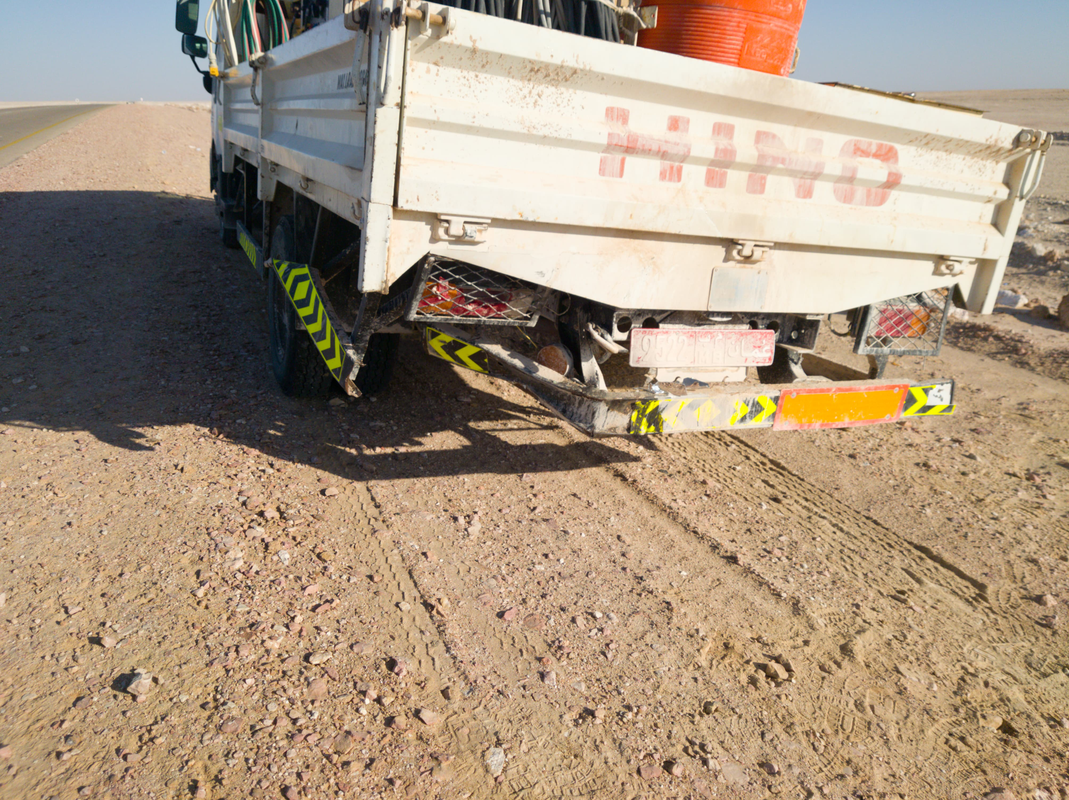
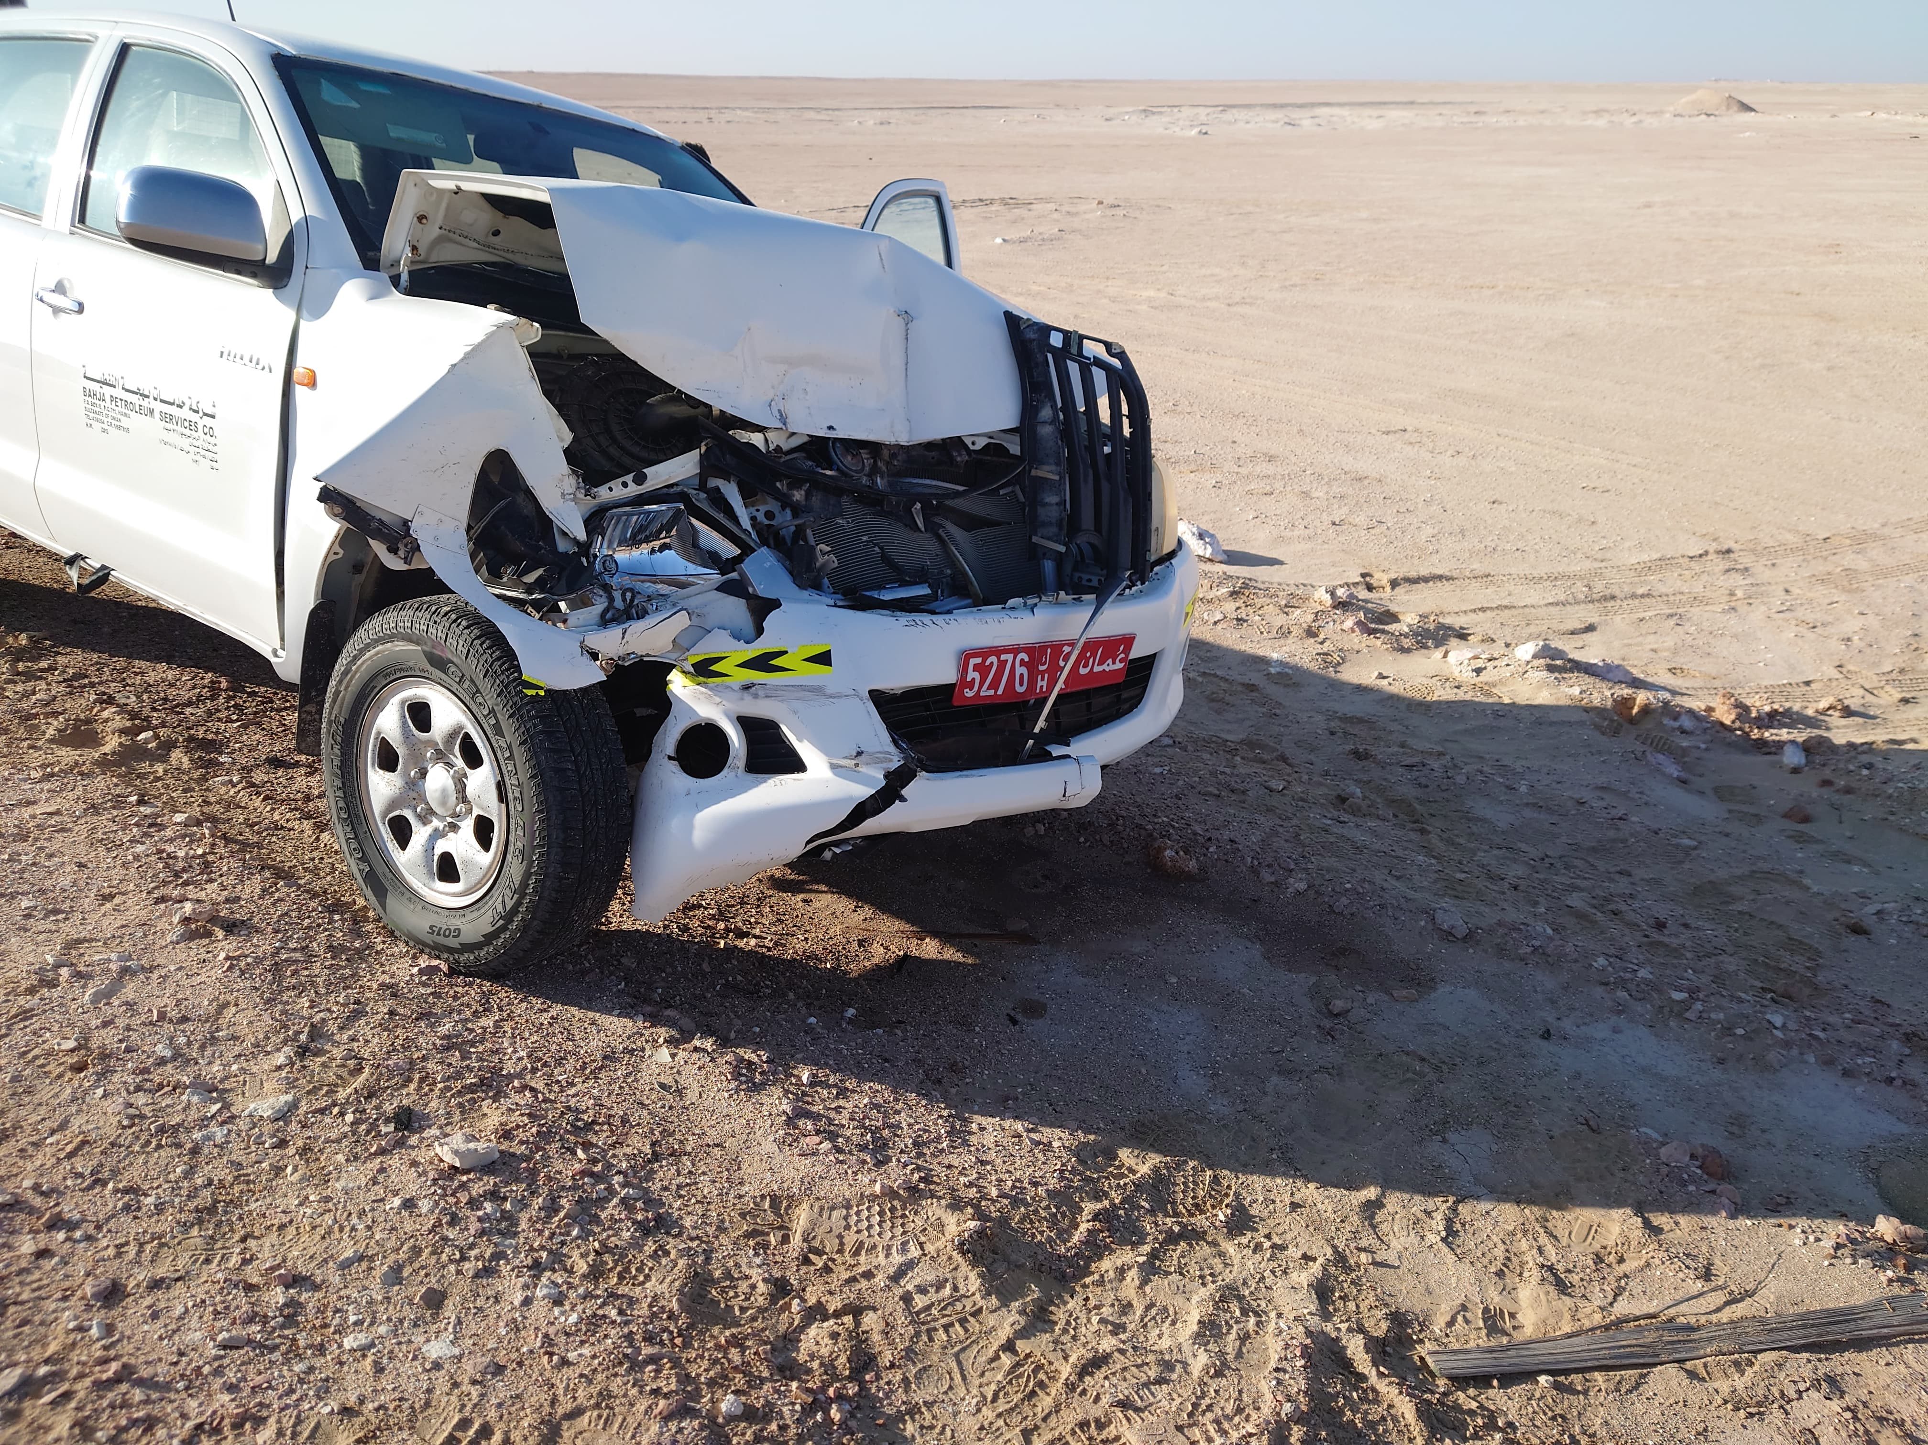

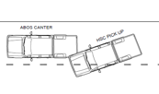



PDO Second Alert
Date: Time: | 12/01/2025 08:08 | Incident title: PIM# | MVI 1173896 | Risk Category: Injury / Asset Damaged: | Medium potential Minor vehicle damage | Actual Severity: Potential severity: | 2A C3P | Activity: Location: | Driving Bahja
Target Audience: Logistics, Operation & Construction
What happened?
On 12th January 2025, at approximately 08:08 hrs, a Canter, carrying three passengers, was traveling from Al Baraka Bahja yard towards Adeela. Approximately four kilometers from the Bahja roundabout, a pickup traveling on the same direction, carrying two passengers, hit the left rear corner of the Canter. Both vehicles sustained minor damages. There were no injuries reported for any of passengers in both vehicles.
Why it happened/Finding :
The driver failed to maintain safe distance.
The driver did not Apply 3 second rule
The driver was fatigued.
The driver was not informed in advance about the trip.
Reflective Questions :
How do you ensure that drivers are aware of keep safe distance while driving?
How do you know that drivers are well rested and not distracted before commencing a journey?
what steps do you take to ensure your safety while driving?
Always Apply 3 Second Rule while Driving
Notes:
Ensure all dates and titles are input
A short description should be provided without mentioning names of contractors or individuals. You should include, what happened, to who (by job title) and what injuries this resulted in. Nothing more!
Four to five bullet points highlighting the main findings from the investigation. Remember the target audience is the front line staff so this should be written in simple terms in a way that everyone can understand.
The strap line should be the main point you want to get across
The images should be self explanatory, what went wrong (if you create a reconstruction please ensure you do not put people at risk) and below how it should be done.

Slide 2
Management Reflective Questions
As a learning from this incident and ensure continual improvement all contract managers must review their HSE risk management against the questions asked below
Confirm the following:
Do you ensure the drivers are informed well in advanced about the trip?
Do We Ensure the drivers are aware of the safe distance (3s Rule).?
Do you ensure employees are aware of the importance of fatigue management?
Notes:
Ensure all dates and titles are input
Make a list of closed questions (only ‘yes’ or ‘no’ as an answer) to ask others if they have the same issues based on the management or HSE-MS failings or shortfalls identified in the investigation.
Imagine you have to audit other companies to see if they could have the same issues.
These questions should start with: Do you ensure…………………?

