Slide 1
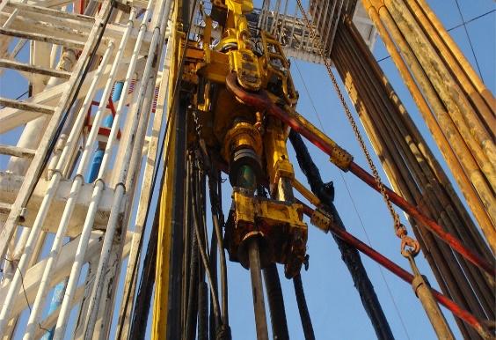
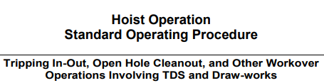
PDO Second Alert
Date: Time: | 29/06/2025 11:47 Hrs | Incident title: PIM# | HiPo#17B 1179195 | Risk Category: Injury / Asset Damaged: | Released energy Near Miss /No damage | Actual Severity: Potential severity: | 0A C4P | Activity: Location: | POOH Qarn Alam
Target Audience: Drillers, Assistant Drillers, Rig Managers and Derrickmen
What happened?
While racking back a stand of 3 ½” drill pipe during POOH operations, the driller activated the elevator bails tilt function to assist the derrickman. This triggered the safety feature of the shear bolt, designed to prevent the bails tilt system from exceeding safe load limit. As a result, the elevator and bails, swung back towards well center, with the stand contacting the rig floor handrail, which then hit a floorman. He lost balance and fell. The floorman was sent to Qarn Alam clinic, examined, and released without treatment.
Why it happened/Finding :
All documents in place. SOP clearly stated that tilting the bails at monkey board level should be avoided.
The equipment inspected. No hard control to limit the tilt function of a stand above monkey board.
Good housekeeping performed prior starting the operation, safe zone area identified.
Swing of the stand introduced uncontrolled energy.
The decision to tilt the bails at the monkey board level was made without proper discussion or MOC
No final verification was done to ensure critical steps in the SOP were being followed.
The unsafe act of tilting the bail links was not identified or stopped during execution
Your learning from this incident..
Rig Managers to always ensure the SOP for the task is reviewed and clearly understood by all crew members before starting work.
Rig Managers to always ensure any deviation from the task is discussed, properly assessed, and a Management of Change (MOC) is in place.
Drillers to always ensure hard barrier controls are implemented where possible and maintained to prevent human error or unintended activation.
Always ensure SOPs are followed — shortcuts can lead to incidents
Notes:
Ensure all dates and titles are input
A short description should be provided without mentioning names of contractors or individuals. You should include, what happened, to who (by job title) and what injuries this resulted in. Nothing more!
Four to five bullet points highlighting the main findings from the investigation. Remember the target audience is the front line staff so this should be written in simple terms in a way that everyone can understand.
The strap line should be the main point you want to get across
The images should be self explanatory, what went wrong (if you create a reconstruction please ensure you do not put people at risk) and below how it should be done.

Slide 2
Effective Learning
To make sure learning is translated to the site day to day activities , please answer the below questions :-
How learning can be implemented at site ?
Supervisors to ensure all rig crew members are briefed on the correct procedure for using the link tilt system and the associated risks of improper operation.
HSE Advisors to regularly observe critical operations and provide real-time coaching and feedback on compliance with safety procedures.
Supervisors to verify that all workers understand and can demonstrate Stop Work Authority (SWA) usage through periodic role-play scenarios.
How can you sustain the action ?
Ensure that link tilt system procedures are reviewed during pre-job safety meetings for tripping operations, and that crew members confirm their understanding before starting.
Log any deviations, near misses, or incidents related to the link tilt system in Aegis tracking system, and review trends during monthly HSE meetings for continuous improvement.
Rig Managers and Night Tool pushers to actively engage with crews about the importance of following critical SOP steps and reinforce learning through safety recognition or intervention where needed.
All proposed changes or deviations involving link tilt operations should trigger an MOC process, and its effectiveness reviewed post-implementation.
Notes:
Guideline for Effective Learning & Sustainability
•Can be replicated across similar contractor / activities
•Shall be SMART- Specific ,Measurable , Achievable ,Realistic & Timebound
•Can be implemented in a months' time

