Slide 1
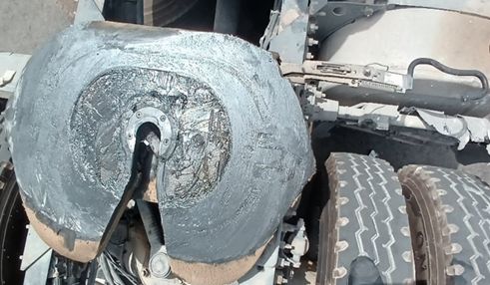
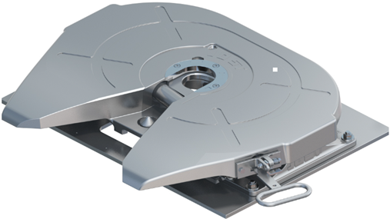
PDO Second Alert
Date: Time: | 20/07/2025 07:00 Hrs | Incident title: PIM# | HiPo#22 1179972 | Risk Category: Injury / Asset Damaged: | MVI Near Miss /No damage | Actual Severity: Potential severity: | 1 A C5P | Activity: Location: | Driving MAF
Target Audience: Drivers
What happened?
Prime mover detached from the trailer due to unproper coupling. 0n 17th July 2025 at 10:00 am the prime mover and trailer were inspected and then dispatched to a nearby vendor location to load. After loading completed, the driver was enroute for load security check and issue of journey plan but stopped to refuel his truck. the driver noticed that the rear air suspension of the prime mover was deflated. The driver reported the issue to the vehicle owner and parked the vehicle. Repair was carried out over the weekend and on Sunday 20th July 2025, the driver returned to continue his journey. Immediately after the vehicle started to move the trailer detached, and the front end fell to the ground. Ther were no injuries or damage to the loaded.
Why it happened/Finding :
Driver did not undertake vehicle checks, specifically he did not check the 5th wheel locking mechanism had engaged.
Improper coupling and decoupling process carried out by incompetent person.
Improper communication to report the vehicle failure to the concerned person/department.
Pre-start vehicle checklist was not carried out proper connection between the fifth wheel and the king pin properly.
Reflective Question :
Do you carry out a physical test for the 5th wheel locking mechanism to assure that it is properly locked and secured?
Do you conduct pull test and visual inspection on locking mechanism, prior to move ?
Do you ensure the vehicle daily inspection checklist conducted ?
Do you communicate the failure to the concerned person / department?
Always ensure 5th wheel and kingpin are fitted properly
Notes:
Ensure all dates and titles are input
A short description should be provided without mentioning names of contractors or individuals. You should include, what happened, to who (by job title) and what injuries this resulted in. Nothing more!
Four to five bullet points highlighting the main findings from the investigation. Remember the target audience is the front line staff so this should be written in simple terms in a way that everyone can understand.
The strap line should be the main point you want to get across
The images should be self explanatory, what went wrong (if you create a reconstruction please ensure you do not put people at risk) and below how it should be done.

Slide 2
Management Reflective Questions
As a learning from this incident and to ensure continual improvement, all contract managers must review their HSE risk management against the questions asked below
Confirm the following:
Do you physically ensure that the 5th wheel and kingpin are fitted properly after coupling?
Do you ensure the coupling and decoupling is carried out in a safe area?
Is the pull test carried out after coupling the trailer?
Do you ensure the vehicle daily inspection checklist carried out?
Have you communicated the vehicle failure issue with the concerned person / department?
* If the answer is NO to any of the above questions please ensure you take action to correct this finding
Please refer to the notes section for guidance
Notes:
Make a list of closed questions (only ‘yes’ or ‘no’ as an answer) to ask others if they have the same issues based on the management or HSE-MS failings or shortfalls identified in the investigation.
Imagine you have to audit other companies to see if they could have the same issues.
These questions should start with: Do you ensure…………………?

