Slide 1
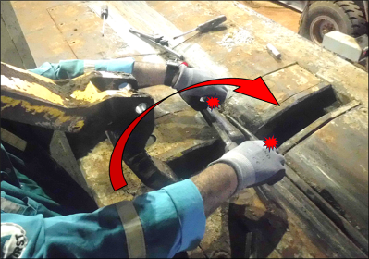
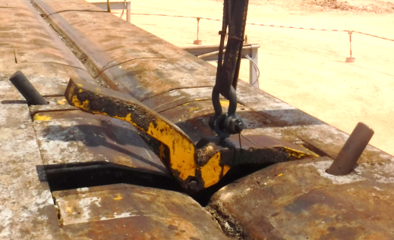
PDO Second Alert
Date: Time: | 06/08/2025221:55 hrs | Incident title: PIM# | LTI#12 1180491 | Risk Category: Injury / Asset Damaged: | Hand & Finger Lost Work Case | Actual Severity: Potential severity: | 3P C3P | Activity: Location: | kicker Cylinder Marmul
Target Audience: Maintenance and Drilling Crew
What happened?
While Chief Mechanic and Senior Mechanic were working on fixing the kicker cylinder on the trough of pipe-cat, after facing difficulties to install the cylinder pin manually.Chief Mechanic decided to extend the cylinder hydraulically while senior mechanic was holding the cylinder using prybar aligning the cylinder piston with kicker arm (to avoid the cylinder from swinging down), suddenly the cylinder retracted, and senior mechanic fingers trapped between the bar and pipe-cat trough. (left hand ring finger and right-hand index finger).
First aid was administered to IP by rig medic and then referred to PAC clinic and later to Salalah Hospital
Why it happened/Finding :
Senior Mechanic was holding the prybar, and his hands were exposed to pinch points
Chief Mechanic was distracted while discussing with Sr. mechanic and lost grip on overridden button, allowing kicker to be activated.
This job was conducted for first time. JSA and OEM guideline was not followed while fixing pipe cat kicker pin
Supervisors failed to follow the PTW requirements, especially isolation procedure and normalized the risk
Reflective Questions
Are you satisfied with implementation of isolation requirements?
Are work orders for pipe cat kicker covering all required instructions?
Do you have specific JSA to work on pipe-cat kickers?
Never perform maintenance on energized equipment. Isolation and SOP compliance are non-negotiable
Notes:
Ensure all dates and titles are input
A short description should be provided without mentioning names of contractors or individuals. You should include, what happened, to who (by job title) and what injuries this resulted in. Nothing more!
Four to five bullet points highlighting the main findings from the investigation. Remember the target audience is the front line staff so this should be written in simple terms in a way that everyone can understand.
The strap line should be the main point you want to get across
The images should be self explanatory, what went wrong (if you create a reconstruction please ensure you do not put people at risk) and below how it should be done.

