Slide 1
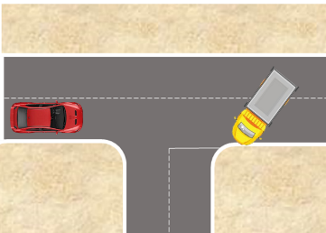
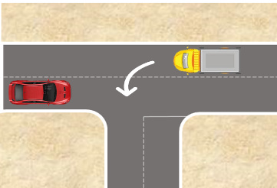
PDO Second Alert
Date: 09/08/2024 Incident title: 3rd Party Fatality Pattern: MVI Potential severity: C4P Activity: Driving
Target Audience: Drilling, Logistics, Operation & Construction
What happened?
On the 9th of August 2024, at about 08:15hrs, a hired tipper was traveling from Nimr borrow pit to Amin site location via the Bahja-Marmul blacktop road. While the driver was attempting to turn left, he collided with a third-party vehicle traveling toward Nimr in the opposite direction. This incident resulted in one immediate fatality, and multiple injuries to other vehicle occupants in the third-party vehicle. The tipper driver escaped unharmed.
Why it happened/Finding :
Tipper Driver misjudged the speed of the 3rd Party Driver, and the amount of time required to make the turn from the black top.
Tipper Driver was taking a left turn before reaching the middle of the junction.
The road was devoid of any signages to warn 3rd Party Drivers of the numerous junctions and other road hazards.
There was no route survey assessment conducted in the area, thus risk of multiple junctions joining the main road nor covered in HEMP.
Your learning from this incident:
Drivers: Do you ensure to come to complete stop at a T-junction when there is oncoming traffic?
Journey Managers: Do you communicate the safest routes in your work locations to your Drivers?
All Personnel: Are you aware of the PDO recommended route to Salalah and ensure you follow the same?
Always come to a stop at junctions with oncoming traffic
Notes:
Ensure all dates and titles are input
A short description should be provided without mentioning names of contractors or individuals. You should include, what happened, to who (by job title) and what injuries this resulted in. Nothing more!
Four to five bullet points highlighting the main findings from the investigation. Remember the target audience is the front line staff so this should be written in simple terms in a way that everyone can understand.
The strap line should be the main point you want to get across
The images should be self explanatory, what went wrong (if you create a reconstruction please ensure you do not put people at risk) and below how it should be done.

Slide 2
Management self-audit
Date: 09/08/2024 Incident title: 3rd Party Fatality Pattern: MVI Collision Potential severity: C4P Activity: Driving
As a learning from this incident and ensure continual improvement all contract managers must review their HSE risk management against the questions asked below
Confirm the following:
Have you assessed the routes your crew drive to work, to identify and mitigate the risks that may be present?
Do your Drivers know the safest route(s) for their routine and non-routine journeys?
Do you ensure Drivers are made aware of the risks of turning at junctions and intersections?
* If the answer is NO to any of the above questions, please ensure you take action to correct this finding
Notes:
Ensure all dates and titles are input
Make a list of closed questions (only ‘yes’ or ‘no’ as an answer) to ask others if they have the same issues based on the management or HSE-MS failings or shortfalls identified in the investigation.
Imagine you have to audit other companies to see if they could have the same issues.
These questions should start with: Do you ensure…………………?

