Slide 1
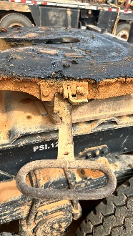
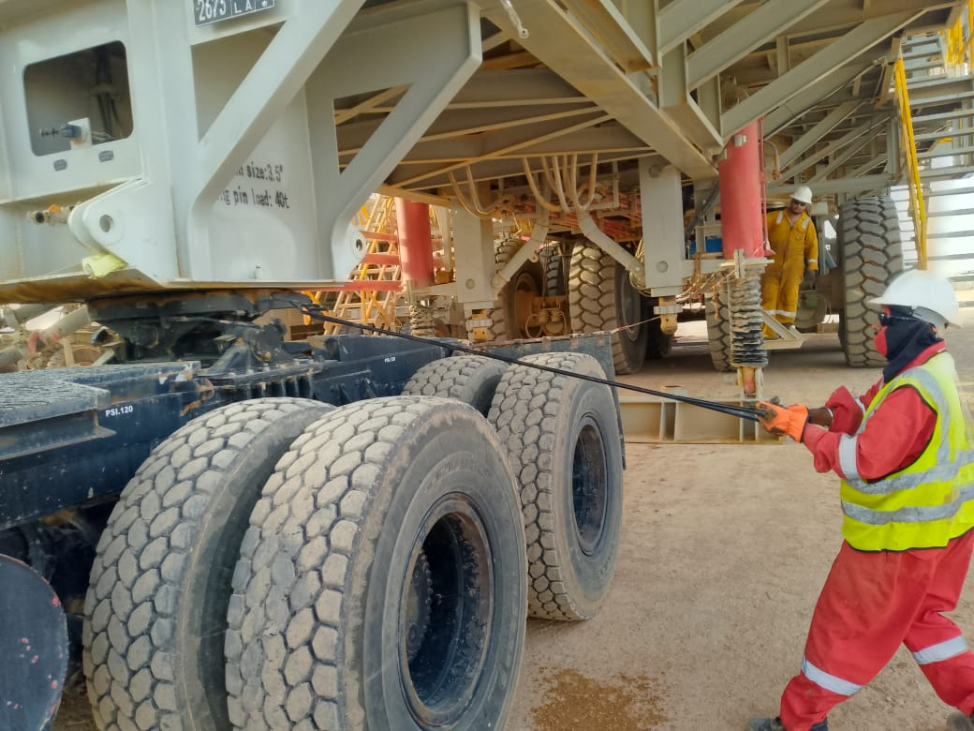
PDO Second Alert
Date: 31/03/2024 Incident title: Fatality #01 Pattern: Struck by Potential severity: C4P Activity: Rig Move
Target Audience: Drilling, Logistics, Operation & Construction
Pulling the Fifth wheel release handle by hand
Fatality during offloading of Diesel Tank
What happened?
At approximately 18:50hrs on 31st of March 2024, a Rig was in the process of moving to its next location. In order to offload the diesel tank at the new location, a Rig Move Helper attached wire-rope slings on the trailer lifting lugs to suspend from the crane for uncoupling the Prime Mover. After the Helper disengaged the lock of the Fifth wheel, he gave a signal to the Prime Mover driver to move forward. When the Prime Mover moved, the load came off the Fifth wheel, jerked and fatally struck the Helper’s head.
Why it happened/Finding:
The risk of ‘line of fire’ was not considered by the work party, in addition to not having a Lift Plan for suspending the load.
The Helper remained in position under the load, holding the Fifth wheel release handle after pulling it. He believed it was safe to remain under the load as it was accepted practise for some personnel to do so.
When an unplanned event occurred elsewhere on the Rig move, the dynamic change in planning arrangements did not factor in leaving the work party without a Supervisor (coordination of critical staff).
None of the work party intervened or used Stop Work Authority when unsafe practices were observed.
Your learning from this incident..
Supervisors: Ensure effective supervision during loading and unloading activities.
Drivers: Coupling and uncoupling activities shall be carried out by the Driver (SP2000v.5).
Drivers: Ensure an ‘Extension arm’ (avoiding you being in the ‘line of fire’) is used for operating the Fifth wheel release handle.
Drivers: In case Fifth wheel release arm does not lock, stop and report it.
Drivers: Ensure all personnel are away from the line of fire before coupling/uncoupling of load.
All Personnel: Do not deviate from the approved loading/offloading methods without obtaining authorization.
Releasing the Fifth wheel handle using an ‘extension arm’
Never place yourself in the line of fire during coupling/uncoupling activities
Notes:
Ensure all dates and titles are input
A short description should be provided without mentioning names of contractors or individuals. You should include, what happened, to who (by job title) and what injuries this resulted in. Nothing more!
Four to five bullet points highlighting the main findings from the investigation. Remember the target audience is the front line staff so this should be written in simple terms in a way that everyone can understand.
The strap line should be the main point you want to get across
The images should be self explanatory, what went wrong (if you create a reconstruction please ensure you do not put people at risk) and below how it should be done.

Slide 2
Management self-audit
Date: 31/03/2024 Incident title: Fatality #01 Pattern: Struck by Potential severity: C4P Activity: Rig Move
As a learning from this incident and ensure continual improvement all contract managers must review their HSE risk management against the questions asked below
Confirm the following:
When there are unplanned changes during rig move activities, how do you ensure these changes are managed, communicated and understood by the work party?
When your work party are at different work locations, how do you ensure there is adequate levels of Supervision to ensure work is executed safely?
Do you ensure rig move activities are part of your out of sight register/management?
Do you have a process to identify loads that require specific lifting plans. If yes, how are the work parties made aware of these requirements?
Do you ensure Fifth wheel coupling/uncoupling activities are part of Driver’s responsibilities?
Do you ensure an ‘Extension arm’ (to operate the Fifth wheel release handle) is available with each Prime Mover and used?
Do you ensure rig move activities are monitored as part of your L2/L3 audits?
* If the answer is NO to any of the above questions, please ensure you take action to correct this finding
Notes:
Ensure all dates and titles are input
Make a list of closed questions (only ‘yes’ or ‘no’ as an answer) to ask others if they have the same issues based on the management or HSE-MS failings or shortfalls identified in the investigation.
Imagine you have to audit other companies to see if they could have the same issues.
These questions should start with: Do you ensure…………………?

