Slide 1
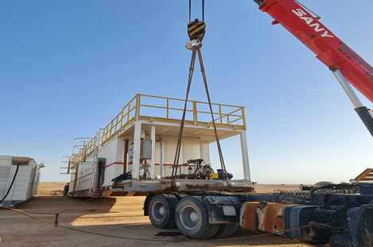
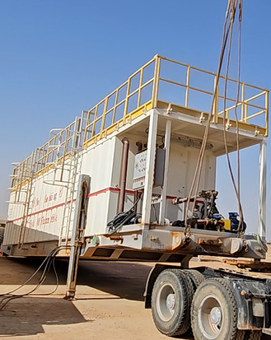
Learning From Incident Awareness Alert
Alert NO: PIM # | FATALITY #01 1164473 | Pattern: | STRUCK BY
Incident Date: | 31/03/2024 | Target Audience: | Well Engineering, Infrastructure, Project Delivery & Finance Directorates
Offloading of Diesel Tank
Description of the incident:
At approximately 18:50 hrs on 31st of March 2024, a Rig was in the process of moving to its next location. In order to offload the diesel tank at the new location, a Rig Move Helper attached wire-rope slings on the trailer lifting lugs to suspend from the crane for uncoupling the Prime Mover. After the Helper disengaged the lock of the fifth wheel, he gave a signal to the Prime Mover driver to move forward. When the Prime Mover moved, the load came off the fifth wheel, jerked and fatally struck the Helper’s head.
Why it Happened/Finding:
His body position reaching under the load, when pulling the fifth wheel release arm, placed him in the ‘line of fire’.
A crane was used to suspend the diesel tank load instead of using the correct method of utilising the load’s hydraulic jack supports, creating an unsecured load.
Key personnel required to safely operate the hydraulic jack support were not available at the time.
There was no Supervisor at the incident location due to an unforeseen change in work plans.
Investigation is In progress
Notes:
Target audience for this alert
List the position names or roles that are the target audience for this alert. Wherever possible, the target audience should be limited to those in positions or roles or locations for which the lesson learnt are relevant, or who are required to take action upon receiving this Alert.
Position or role name
Position or role name
Description of the incident:
This should be free text writing and include the relevant facts explaining. what happened to all the relevant parties in a short sharp factual paragraph that describes the incident. Without mentioning names of contractors or individuals. You should include, what happened, to who (by job title) and what injuries this resulted in. Nothing more!
The description should be in sufficient detail to allow a person who does not know anything about the incident to imagine it.
It should only be about what happened and not why it happened.
DO NOT include investigation findings here, simply describe the incident as the investigation has shown it happened.
DO NOT give us a sequence of events here.

Slide 2
Learning From Incident Awareness Alert
Management Reflective Questions
When there are dynamic unplanned changes to work activities, how do you ensure these changes are communicated and understood by the work crew?
When your work crew are at different work locations, how do you ensure there is adequate levels of supervision to ensure work is executed safely?
Do you ensure you have specific lifting plans and PTWs for relevant lifting activities?
Actions Going Forward:
Contractor/Sub-contractor Management: Review ALL lifting plans to ensure they are available to personnel, fit-for-purpose and up-to-date.
Contractor/Sub-contractor Management: Ensure there is an approved alternative method for de-coupling trailers when Jacks are unavailable.
Contractor/Sub-contractor Management: Ensure effective work planning via adequate work resources, clear communication and risk assessment .
Supervisors: Ensure there are extension arms available for operating the 5th wheel handles, minimizing line of fire risks.
Supervisors: Ensure there is clear communication to all crew members when there are any changes to work plans.
Heavy Vehicle Drivers: Ensure all personnel are outside the line of fire before decoupling from load.
All Personnel: Do not deviate from the approved lifting method without obtaining authorization.
Investigation is In progress
Notes:
Why it happened
Describe here the:
Immediate causes of the incident; and
Underlying causes of the incident
Lessons Learned: Four to five bullet points highlighting the main findings from the investigation. Remember the target audience is the front line staff so this should be written in simple terms in a way that everyone can understand.
Contract managers: Must review their risk assessment for this task capturing all points raised as a minimum and provide assurance to Contract Holders
Actions
Describe mandatory actions here. Actions must be signed off by Business Leaders before the Alert is issued. When describing actions focus on what, by whom and by when.
Post action verifier is giving the assurance that the action has been addressed and learnings imbedded.
(actions from RAM4 plus incident reported to MDIRC and MDC fortnightly)

