Slide 1

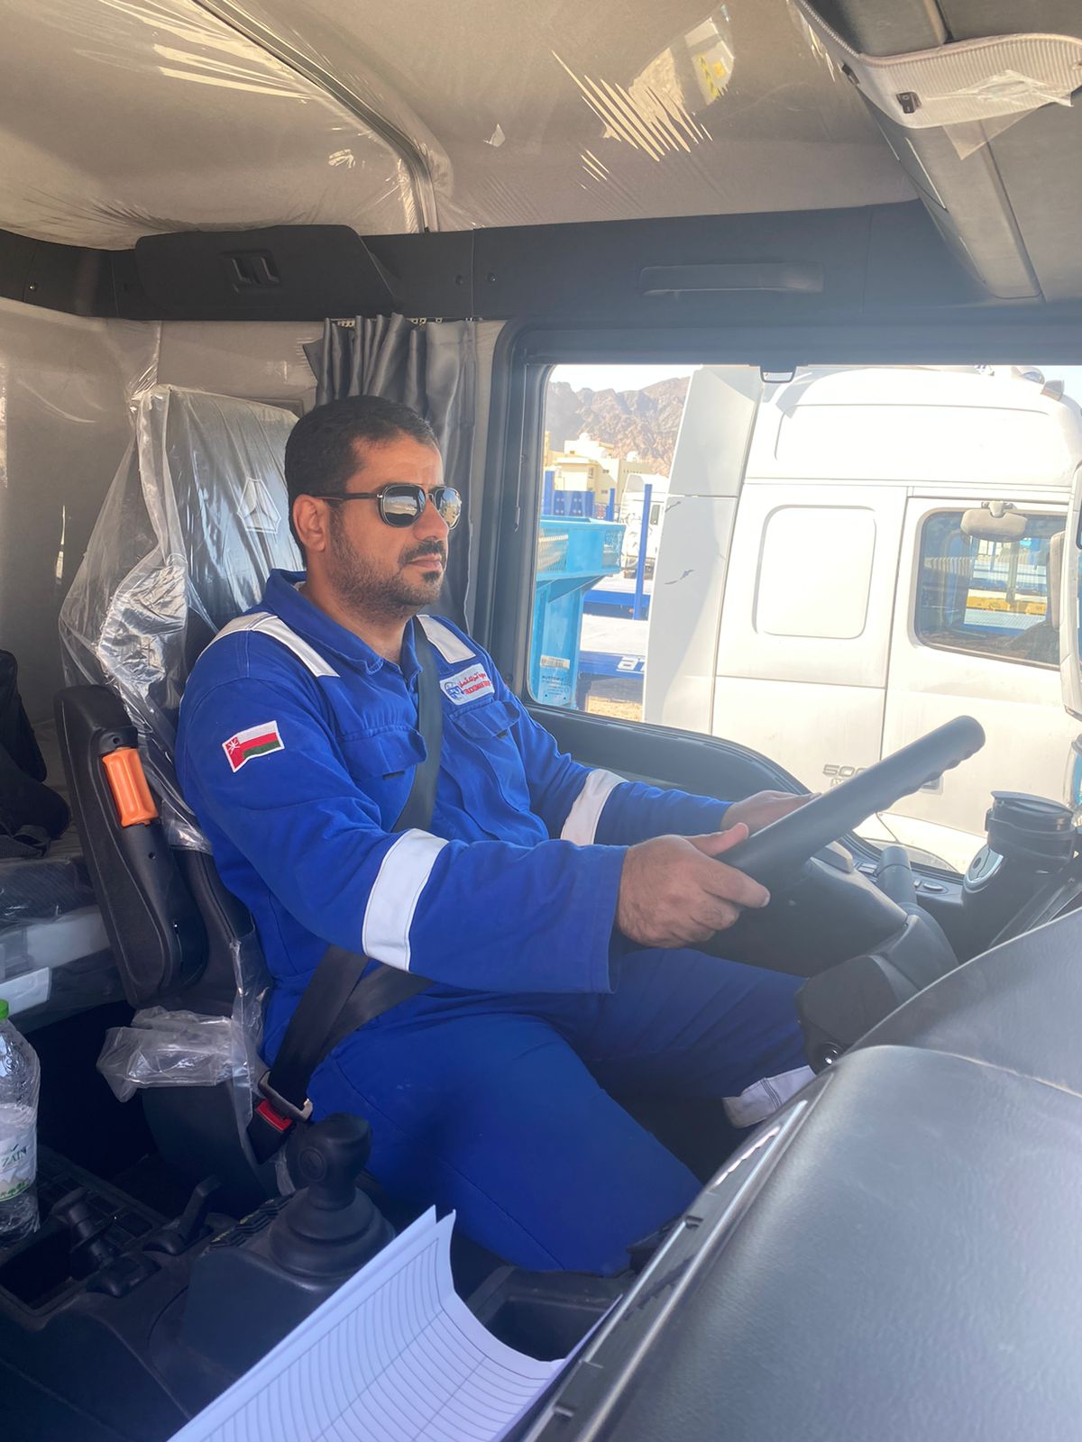

Learning From Incident
Awareness Alert
Alert NO: PIM # | FATALITY #02 (LTI#20) 1171734 | Pattern: | MVI RO
Incident Date: | 21/10/2024 | Target Audience: | All
Transporting chemical
Description of the incident:
On 21st October 2024 at around 17:07, a Heavy Goods Vehicle (HGV) and trailer enroute to Harweel from Muscat, carrying a loaded ISO tank with 20,000 liters of non-hazardous Triethylene Glycol (TEG) veered off the main blacktop dual carriageway around 60 kms south of Adam. The HGV driver attempted to rejoin the blacktop road but lost control and rolled over, resulting in both the driver and an unauthorized passenger sustaining fatal injuries.
Why it Happened/Finding:
The driver failed to maintain control of the vehicle, it veered off the road and onto an embankment.
Both deceased (driver and passenger) were found ejected outside the vehicle due to not wearing seat belts.
Driver Fatigue Management System (DFMS) was tampered with/covered.
The vehicle was carrying liquid load in a skid tank and has high center of gravity.
The driver has carried similar load multiple times before this event.
The driver deviated from the journey plan and carried an unauthorized passenger.
Investigation is In progress
Notes:
Target audience for this alert
List the position names or roles that are the target audience for this alert. Wherever possible, the target audience should be limited to those in positions or roles or locations for which the lesson learnt are relevant, or who are required to take action upon receiving this Alert.
Position or role name
Position or role name
Description of the incident:
This should be free text writing and include the relevant facts explaining. what happened to all the relevant parties in a short sharp factual paragraph that describes the incident. Without mentioning names of contractors or individuals. You should include, what happened, to who (by job title) and what injuries this resulted in. Nothing more!
The description should be in sufficient detail to allow a person who does not know anything about the incident to imagine it.
It should only be about what happened and not why it happened.
DO NOT include investigation findings here, simply describe the incident as the investigation has shown it happened.
DO NOT give us a sequence of events here.

Slide 2
Learning From Incident
Awareness Alert
Management Reflective Questions
Do you ensure your drivers understand the importance of wearing seat belts?
Do you ensure the DFMS is in good working condition and checked prior journey?
Do you have a process in place to prevent unauthorized passengers in your journeys ?
Do you ensure your drivers are regularly briefed on following defensive driving techniques specifically for liquid loads?
Do you ensure empowerment to stop system in place when it feels unsafe?
Do you ensure all employees are involved in TBT’s/safety briefings?
Do you ensure your journey managers are proactively analyzing IVMS, DFMS and TPMS data to identify driver’s behaviors?
Actions Going Forward:
Vehicle condition: Review vehicles are fit-for-purpose and up-to-date in compliance to SP-2000 latest version.
Contractor/Sub-contractor Management: Ensure effective work planning via adequate work resources, clear communication and risk assessment .
Safe journey managers: Ensure to escalate when the need arises
Heavy Vehicle Drivers: Ensure to take rest and avoid distraction during your journey.
All Personnel: Do not deviate from the approved safe journey plan.
Investigation is In progress
Notes:
Why it happened
Describe here the:
Immediate causes of the incident; and
Underlying causes of the incident
Lessons Learned: Four to five bullet points highlighting the main findings from the investigation. Remember the target audience is the front line staff so this should be written in simple terms in a way that everyone can understand.
Contract managers: Must review their risk assessment for this task capturing all points raised as a minimum and provide assurance to Contract Holders
Actions
Describe mandatory actions here. Actions must be signed off by Business Leaders before the Alert is issued. When describing actions focus on what, by whom and by when.
Post action verifier is giving the assurance that the action has been addressed and learnings imbedded.
(actions from RAM4 plus incident reported to MDIRC and MDC fortnightly)

