Slide 1
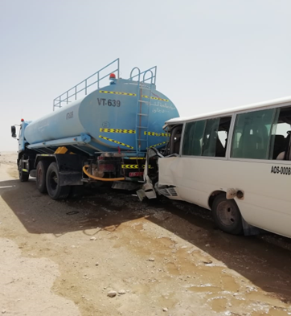



Learning From Incident
Awareness Alert
Alert NO: PIM # | PDO_LFI_20220530_Fatality#1 (Initial) 1138563 | Pattern: | MVI
Date: | 15/05/2022 | Target Audience: | Well Engineering, Infrastructure, Operations, Engineering, Project Delivery & External Affairs
Description of the incident:
On 15th May 2022 @ 09:22 hrs while WPH70 moved from Al-Ghubar to Raba area in Qarn Alam field, on graded road, a coaster bus with 1 driver and 5 passengers collided with a stationary water tanker which was parked on the right side of the road. This resulted in the driver’s fatality. Three passengers were injured, two passengers unharmed. All passengers were sent to the PDO Qarn Alam clinic for medical consultation.Simulation Video Next slide.
Why it Happened/Finding :
Driver lost control of the bus.
Tanker was not fully parked off the road.
Defensive Driving Techniques were not applied by all drivers.
Position of the vehicle on the road - including non-placement of safety triangle/flashing of hazard light behind the parked Tanker
Notes:
Target audience for this alert
List the position names or roles that are the target audience for this alert. Wherever possible, the target audience should be limited to those in positions or roles or locations for which the lesson learnt are relevant, or who are required to take action upon receiving this Alert.
Position or role name
Position or role name
Description of the incident:
This should be free text writing and include the relevant facts explaining. what happened to all the relevant parties in a short sharp factual paragraph that describes the incident.
Without mentioning names of contractors or individuals. You should include, what happened, to who (by job title) and what injuries this resulted in. Nothing more
The description should be in sufficient detail to allow a person who does not know anything about the incident to imagine it.
It should only be about what happened and not why it happened.
DO NOT include investigation findings here, simply describe the incident as the investigation has shown it happened.
DO NOT give us a sequence of events here.

Slide 2
Learning From Incident
Awareness Alert
Lessons Learned:
Always ensure the authorized drivers are following Defensive Driving techniques: Drive Defensively and always prepare to anticipate mistakes.
Always be vigilant & aware of potential road hazards; Do not be distracted and keep eyes on the road.
Always ensure that you park your vehicles (in case of emergency) completely outside of the road
Always ensure all drivers use the safety triangle and flashing the hazard lights during emergency stoppage.
As a learning from this incident and ensure continual improvement all contract managers must review their HSE risk management against the questions asked below
Management Confirm the following:
Do you ensure that drivers identify all road hazards and drive accordingly?
Do you always ensure that drivers apply defensive driving techniques?
Do you ensure that drivers drive according to the road conditions?
Do you ensure that drivers park the vehicles outside the road during an emergency and put warning signs?
Do you ensure that drivers are effectively learning from incidents?
* If the answer is NO to any of the above questions please ensure you take action to correct this finding.
**As a learning from this incident and ensure continual improvement review risk management ( HEMP) against the questions
Notes:
Why it happened
Describe here the:
Immediate causes of the incident; and
Underlying causes of the incident
Lessons Learned: Four to five bullet points highlighting the main findings from the investigation. Remember the target audience is the front line staff so this should be written in simple terms in a way that everyone can understand.
Contract managers: Must review their risk assessment for this task capturing all points raised as a minimum and provide assurance to Contract Holders

Slide 3
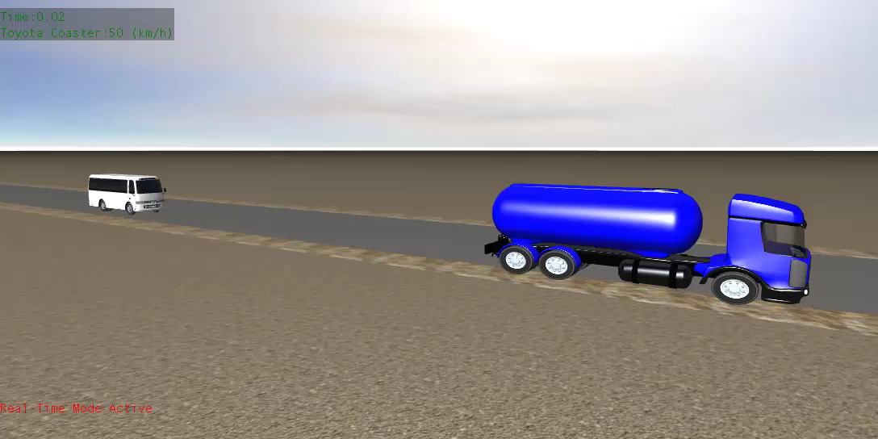
Learning From Incident
Simulation Video

