Slide 1
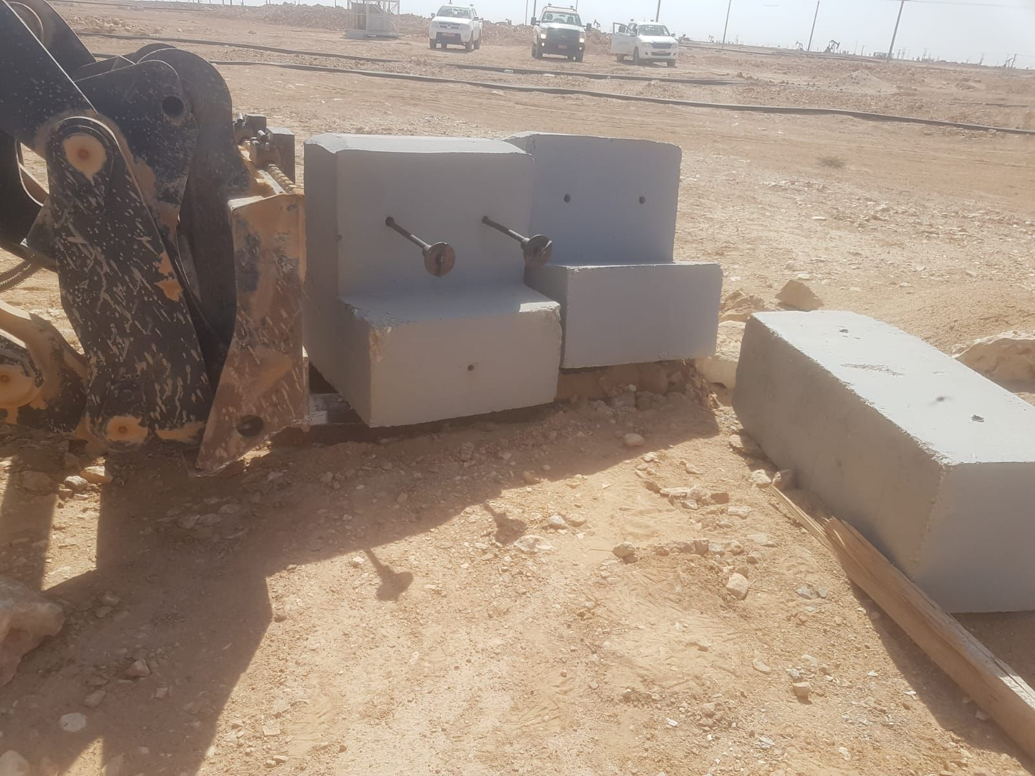
PDO Incident First Alert
Incident Type | LTI#33 | Pattern | Hands & Fingers | In case of an emergency please call PDO Emergency Number (Toll Free): 2467-5555
Date / Time | 03.09.2022@11:35hrs | Directorate
Location | Construction site, Nimr | Dept
Target Audience: Well Engineering, Infrastructure, Operations, Engineering, Project Delivery & External Affairs
What happened
During shifting of the sleeper foundation for flowline construction using the tool carrier with fork, the Banksman was attempting to remove a stone trapped between the fork and sleeper base. Suddenly, the sleeper foundation moved crushing his right-hand thumb and causing fracture.
Mr. Musleh asks the questions of can it happen to you?
Do you ensure you keep your hands and fingers away from pinch points?
Do you ensure you identify all hazards before starting a task?
Do you ensure proper supervision during the task?
Do you ensure you follow procedure and avoid shortcuts?
Please disseminate this LTI notification to your teams and use it in your tool box talks and HSE meetings and notice boards.

