Slide 1
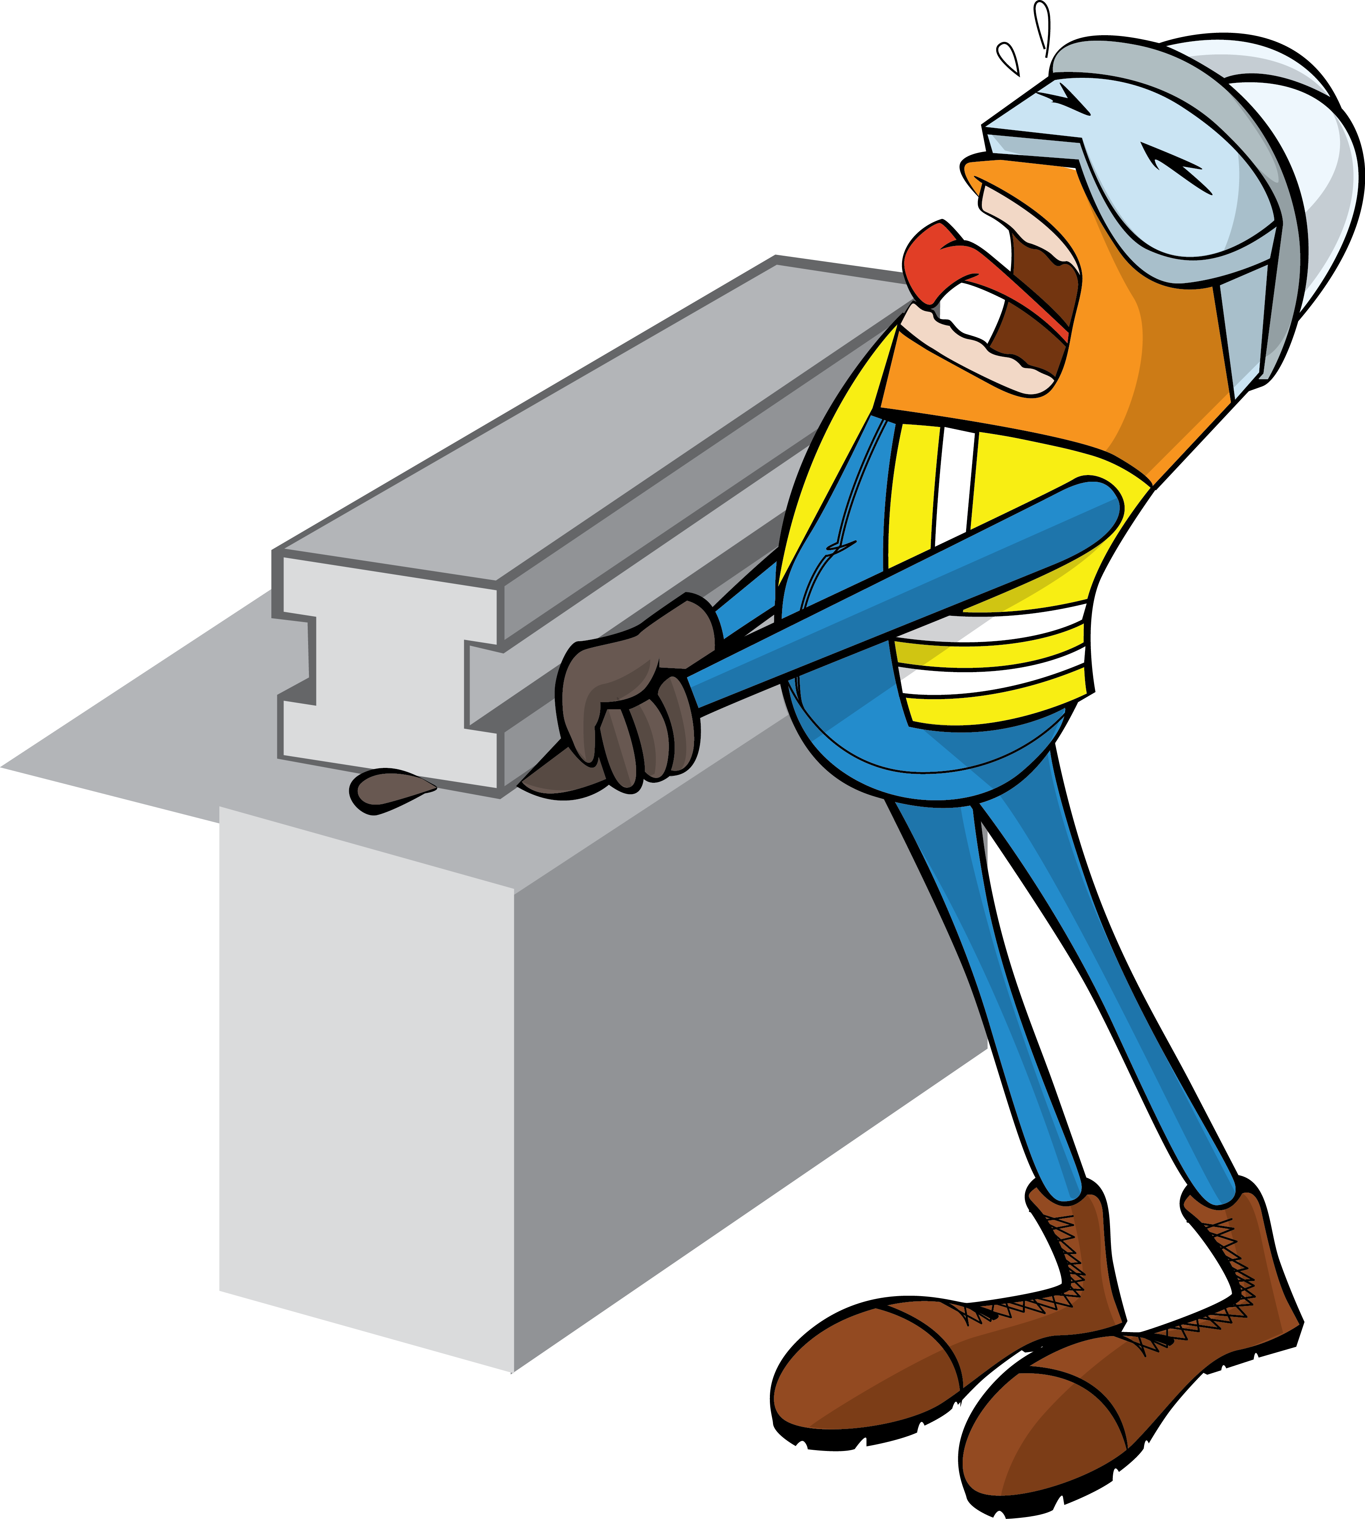
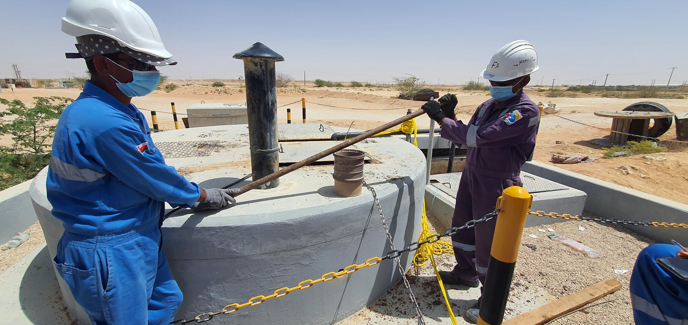
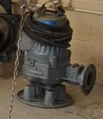


PDO Incident First Alert
Incident Type | LTI#09 | Pattern | Hands & Fingers
Date / Time | 29.03.2022@10:26hrs | Directorate
Location | Rig Camp site, Marmul | Dept
Target Audience
Drilling, Operations, Engineering & Construction
What happened
While the Plumber was assisting his team to fix a sewage tank pump in Marmul rigs camp area, his right-hand fingers got crushed between the steel pipe used for handling the pump and concreate structure causing fracture of middle and index finger.
Mr. Musleh asks the questions of can it happen to you?
Do you ensure you keep your hands and fingers away from line of fire?
Do you ensure you identify all hazards before starting a task?
Do you ensure you have the right tool before performing the task?
Do you ensure proper supervision while carrying out the task?
Do you ensure to intervene and correct unsafe act/condition?
Please disseminate this LTI notification to your teams and use it in your tool box talks and HSE meetings and notice boards.

