Slide 1
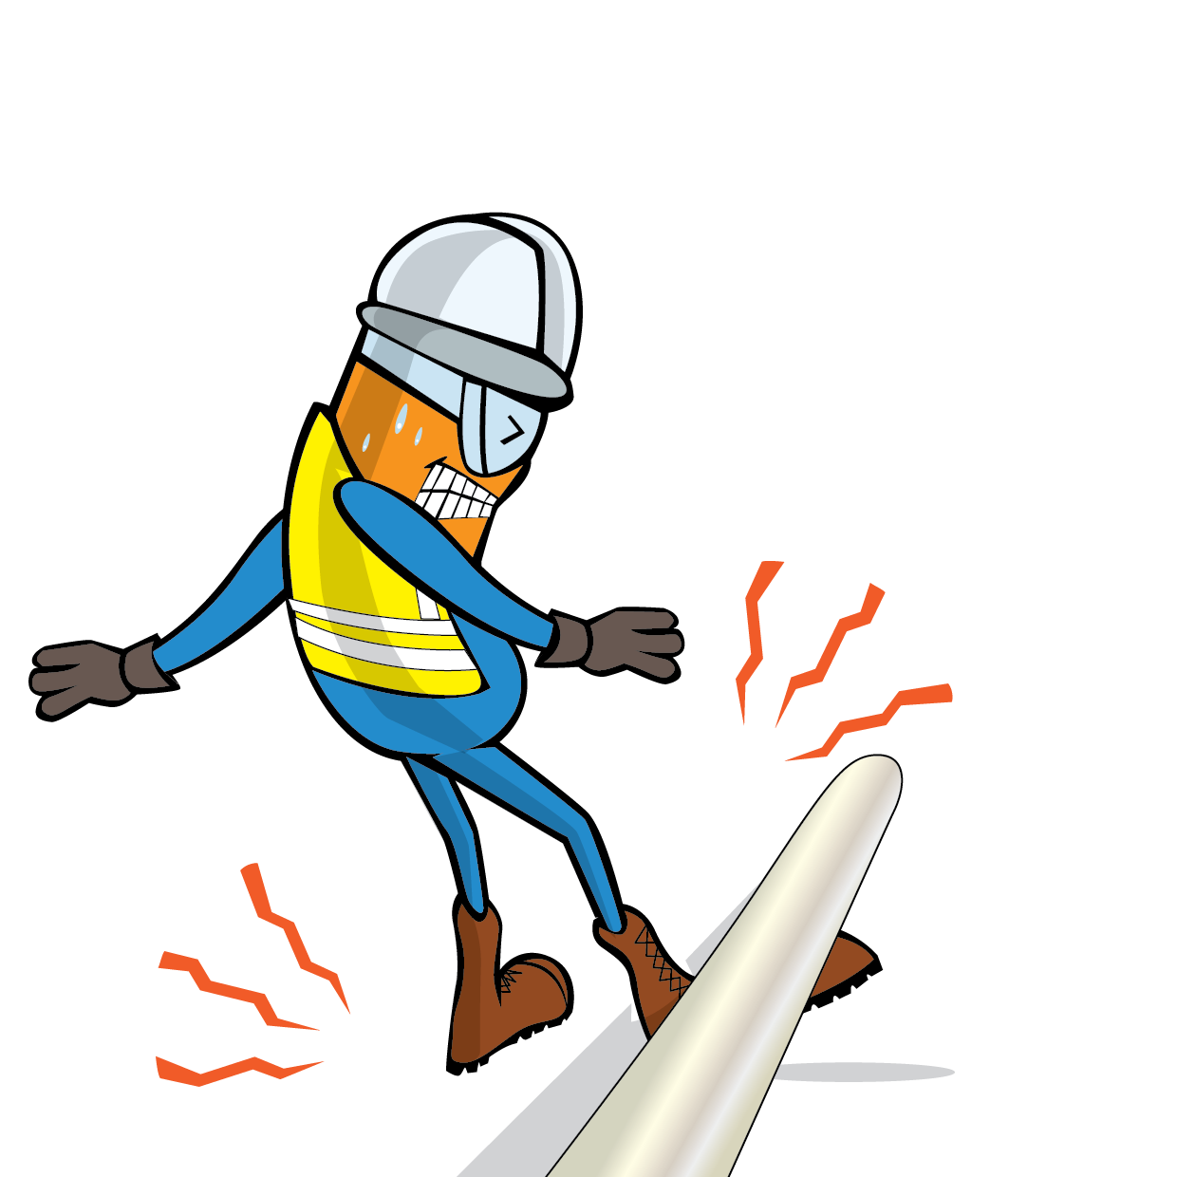
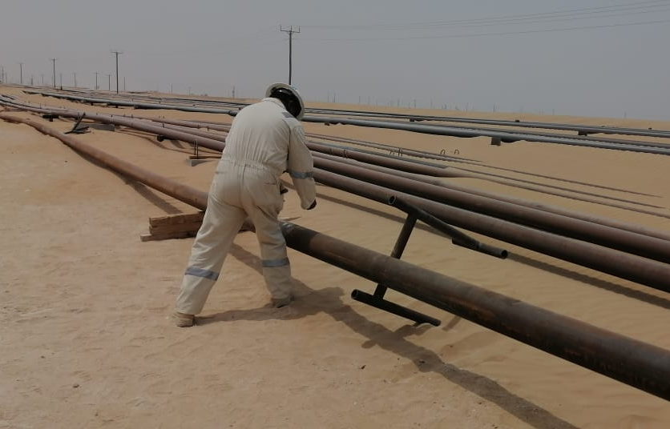
PDO Incident First Alert
Incident Type | LTI#10 | Pattern | Released Energy
Date / Time | 09.04.2022@11:30hrs | Directorate
Location | Wadi Musallam construction site, Qarn Alam | Dept
Target Audience
Drilling, Operations, Projects, Engineering & Construction
What happened
While the Pipe Grinder was involved in grinding activity, a pipe rolled off from the supporting frame and hit the grinder right leg causing fracture to his right leg.
Mr. Musleh asks the questions of can it happen to you?
Do you ensure you keep yourself away from line of fire?
Do you ensure you identify all hazards before starting a task?
Do you ensure proper supervision while carrying out the task?
Do you ensure to intervene and correct unsafe act/condition?
Please disseminate this LTI notification to your teams and use it in your tool box talks and HSE meetings and notice boards.

