Slide 1
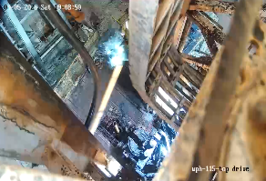
Date: | 09/05/2026 | Incident title: | HiPo#11 | Risk Category: | Dropped Object | Actual Severity: | 0P | Activity: | Lay down
Time: | 04: 30 hrs | Ifadah#: | 27280189 | Injury/Asset Damaged: | Pampa barrel parted | Potential severity: | C4P | Location: | Amal 285
Drilling, Workover, Well Intervention Operations.
What happened?
The Operation was laying down 3.5” EU Tubing Completion-Pamp Barrel (joint # 9). After breaking out the connection, the Crew member guided the joint through the V-door while Driller was lowering the TDS and then returned to his designated safe zone while the joint was being lowered with the Elevator. While lowering the Pump Barrel, it parted below the top Coupling connection and the Barrel slid through the V-door to ground level, leaving a Pup joint connected to the Elevator. At the time of the incident, the Floorman had moved out of the Line of Fire.
Why it happened/Finding:
The Pump Barrel experienced an internal structural failure at the bimetallic connection, causing it to separate while under normal laydown loads.
The degradation occurred beneath the coupling and could not be identified through routine visual inspection on the rig floor.
The completion assembly contained dissimilar metals, making the connection susceptible to long-term galvanic corrosion and loss of structural integrity.
No engineered secondary containment or physical barrier was available to arrest the tubular once the connection failed.
The task required personnel to manually guide the load through the V-door, creating line-of-fire exposure during a dynamic lifting operation
The travelling block continued moving while personnel were returning to the designated safe zone.
Historical failures and potential integrity concerns associated with similar completion assemblies were not highlighted within the work instructions or well program.
Reflective questions to discuss with your Team:
What indicators should make us treat a retrieved completion assembly as potentially weakened, even when no visible damage is observed?
How do we verify that everyone is fully outside the line of fire before moving a suspended load?
How can we ensure that historical equipment failures and previous lessons learned are considered during task planning?
How effective are our current dropped-object controls if a connection suddenly parts during handling?
Parted Pampa Barrel During Lay Down Operation
Equipment can fail without visible warning. Ensure all connected equipment are secured during lay down and keep people outside line of fire

Slide 2
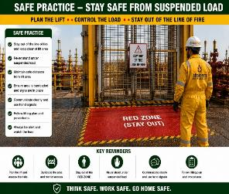
How learning can be sustained at site?
Are work instructions requiring web slings, secondary retention, and exclusion zones consistently implemented and verified in the field?
How does supervision confirm that all personnel are clear of the line of fire before authorizing movement of the travelling block?
What process ensures previous incidents and equipment failure history are incorporated into well programs and risk assessments?
How will this learning be incorporated into pre-job meetings, toolbox talks, and crew competency assessments?

