Slide 1
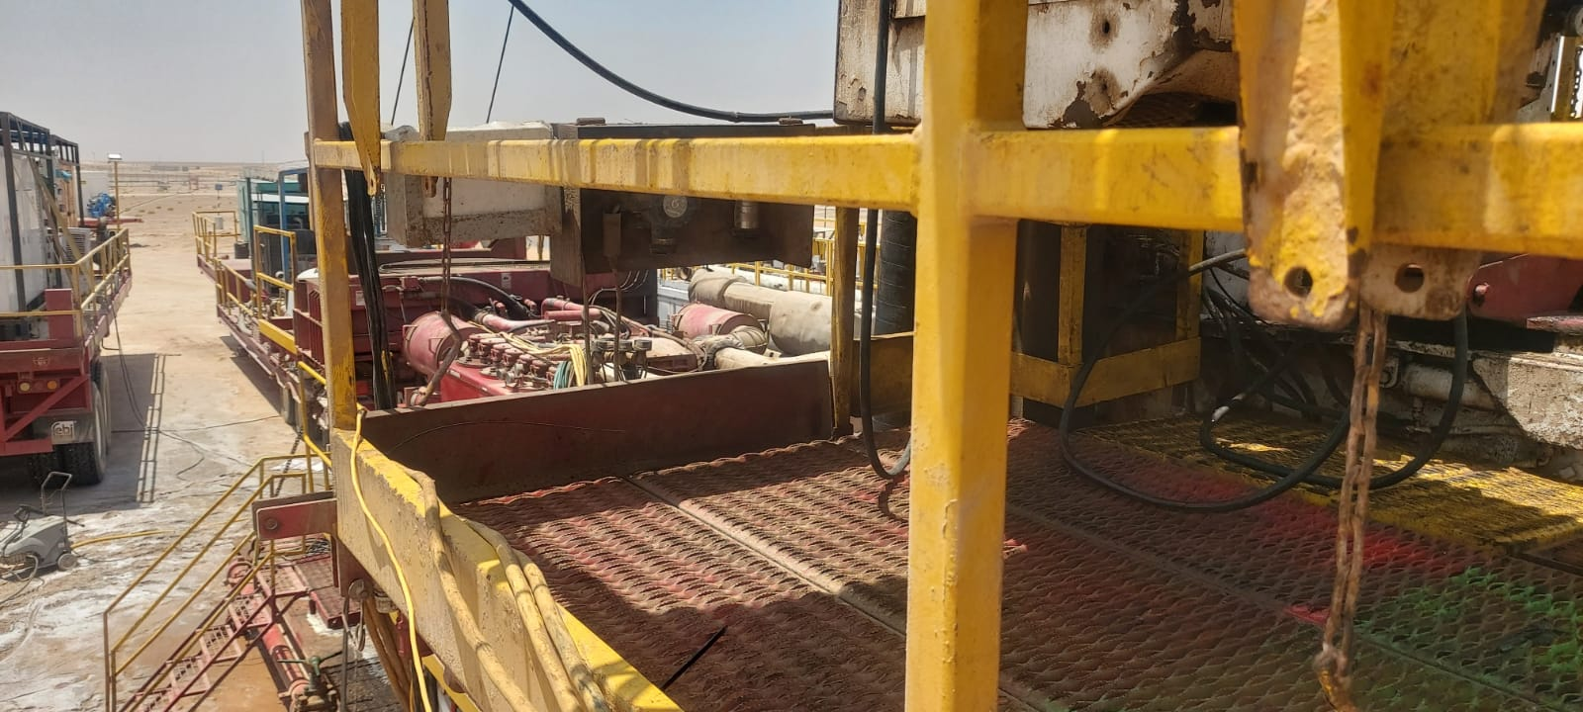

Date: Time: | 21/052026 13:59 Hrs | Incident title: Ifadah#: | HiPo 27414927 | Risk Category: Injury / Asset Damaged: | DROPS HiPo No injury/No damage | Actual Severity: Potential severity: | 0A C4P | Activity: Location: | Mast down ABT WSW 78
Drilling, Logistics, Operation & Construction
What happened?
During Rig-down operations on Rig 141, the driller's console shade, weighing approximately 20 kg, became detached from the rig floor handrails and fell approximately 4 meters to the ground. The incident occurred when strong winds acted on the unsecured shade, causing it to become dislodged and fall. Prior to the incident, the floor man had removed the securing pin from the console shade in preparation for a planned lifting activity, leaving the shade unsecured and vulnerable to the prevailing wind conditions. Review of CCTV footage confirmed that a person was located approximately 2 meters from the point of impact. Although no contact occurred, the incident had the potential to result in a serious injury or fatality.
Why it happened/Finding:
The driller console shade became a dropped object hazard after its primary securing pin was removed before it was connected to lifting equipment and placed under positive control.
Wind conditions were not adequately reassessed before continuing the rig-down activity, increasing the likelihood of unintended movement of the unsecured shade.
The task sequence and controls for removing securing devices were not effectively discussed during pre-job planning and toolbox talks.
The DROPS risk associated with the unsecured overhead equipment was not adequately recognized or managed.
Supervision did not identify or intervene when the shade was left unsecured prior to the lifting activity.
The driller console shade arrangement had not been formally assessed through the Management of Change (MOC) process.
Reflective questions to discuss with your Team:
When should securing pins or retaining devices be removed during a lifting activity?
What could happen if an overhead item is left unsecured, even for a short period?
How do changing weather conditions affect dropped-object risks on the rig?
How do you verify that a load is under positive control before removing any securing device?
What overhead equipment in your work area could become a dropped-object hazard if released unexpectedly?
How do we ensure DROPS hazards are discussed during toolbox talks and pre-job planning?
If you observed someone removing a securing device (pins) prematurely, what action would you take?
Secure first, release second. Positive load control and effective DROPS management prevent serious incidents

Slide 2
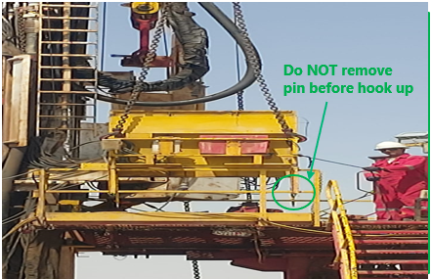
How learning can be sustained at site?
How do supervisors verify that lifting readiness is confirmed before any securing device is removed?
How are changing weather conditions monitored and incorporated into dynamic risk assessments?
What field assurance activities verify compliance with DROPS prevention requirements?
How are exclusion zones established, communicated, and maintained during rig-up and rig-down activities?
What evidence demonstrates that pre-job toolbox talks adequately address task sequence and dropped-object hazards?
What process ensures modified, or non-standard equipment arrangements are subjected to MOC review and approval?
How frequently are workplace inspections conducted to identify unsecured overhead objects?
How are previous DROPS incidents and lessons learned being discussed with crews and contractors?
What leading indicators are being monitored to confirm that DROPS controls remain effective across all rig operations?

