Slide 1
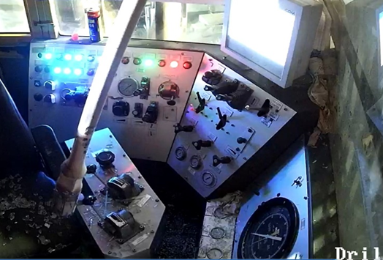

Date: Time: | 08/06/2026 03:44 am | Incident title: Ifadah#: | HiPo#13 27530645 | Risk Category: Injury / Asset Damaged: | C4P broke the driller cabin glass | Actual Severity: Potential severity: | 2A C4P | Activity: Location: | RIH SR Nimr
Drilling, Logistics, Operation & Construction
What happened?
At approximately 03:44 hrs., the operation was running a 1” sucker rod from the hydraulic catwalk when a sudden wind gust caused unexpected movement of the traveling block. The traveling block subsequently struck the monkey board support, resulting in a sudden jerk of the block. consequently, the sucker rod abruptly wobbled, hit and broke the driller cabin glass and entered the top of the cabin.
Why it happened/Finding:
The changing weather conditions, including sudden wind gusts, were not effectively reassessed before continuing the operation.
Dynamic risk assessment was not actively updated to reflect the increased risk created by the changing environmental conditions.
Situational awareness of changing operating and environmental conditions was not effectively maintained during the task.
Communication between the Assistant Driller and floor crew was not sufficiently effective to ensure a shared understanding of the risks and controls.
Load control was not adequately maintained, allowing the sucker rod to deviate from its intended path following the sudden block movement.
Red-zone control and verification of safe operating conditions were not effectively maintained throughout the operation.
Signs of fatigue and reduced vigilance may have affected the ability to identify and respond to changing conditions in a timely manner.
Reflective questions to discuss with your Team:
What controls should be verified before lifting sucker rods in windy condition?
What indicators would tell you to stop the job and reassess the risk?
How do you control movement of Tubing and Sucker Rod from Catwalk to Work Platform?
How do you manage fatigue in routine tasks and during shift changes?
How do you manage Red zone/No-Go zone area?
What triggers changes to routine tasks to become non routine?
Always stay alert and apply dynamic risk assessment throughout operations

Slide 2
How learning can be sustained at site?
How do supervisors verify that dynamic risk assessments are being updated when weather or site conditions change?
What assurance activities confirm that crews stop work when conditions exceed operational limits?
How is compliance with red-zone management being monitored and verified?
What process is in place to ensure effective communication between the driller, AD, and floor crew during lifting operations?
How are supervisors identifying and managing fatigue risks, particularly during night shifts and shift transitions?
What evidence demonstrates that crews understand when a routine task becomes non-routine?
How are weather conditions monitored, communicated, and incorporated into operational decision-making?
What field observations are conducted to verify that load control barriers remain effective throughout the task?
How are lessons learned from previous lifting and line-of-fire incidents incorporated into crew engagements and toolbox talks?
What leading indicators are being reviewed to confirm that situational awareness and dynamic risk assessment expectations are consistently applied across all hoist operations?

