Slide 1
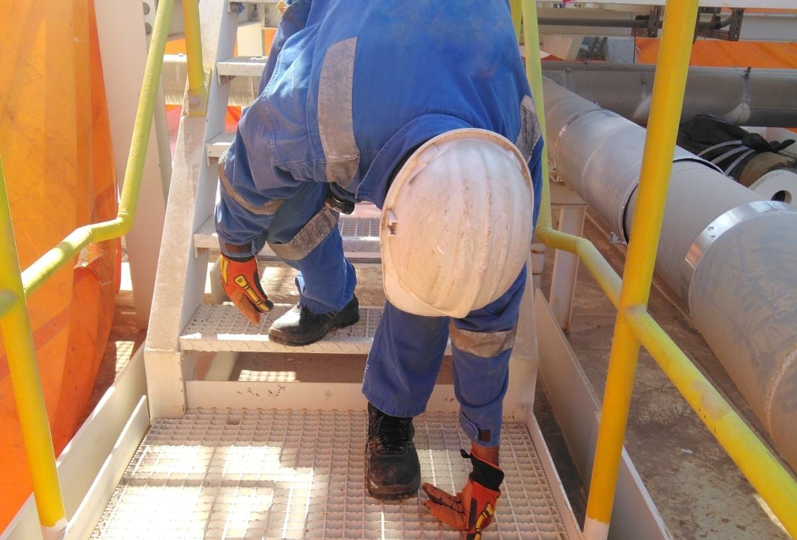
Date: | 26/01/2026 | Incident title: | LWC#01 | Risk Category: | Slip, Trip & Fall | Actual Severity: | 3P | Activity: | Staircase Descending
Time: | 09: 40 | Ifadah#: | 26952095 | Injury/Asset Damaged: | Fractured Wrist | Potential severity: | C3P | Location: | Qarn Alam
Station Operators , PTW holder , Worker , Visitor.
What happened?
On 26 January 2026, at approximately 09:40 hours, a Fitter was descending a five-step staircase at the Qarn Alam Steam Plant. As he stepped onto the second-to-last step, his right foot twisted, causing him to lose balance. He fell forward and landed on his left hand, resulting in a left wrist fracture.
Why it happened/Finding:
The fitter released the handrail too early, assuming the last few steps were safe to take without support.
He was in a hurry, intending to quickly verify a fit-up level before joining his colleagues for a break.
He was not paying full attention to his footing, leading to misplacement of his foot on the step.
Risk normalization had occurred – repeated routine use of the stairs without previous incidents led him to underestimate the hazard.
The use of handrails and footing hazards was not discussed in the TRIC/TBT, which reduced risk awareness.
Reflective questions to discuss with your Team:
How do you highlight everyday risks like stair use during Toolbox Talks discussions?
In what ways do you check that crew members understand and apply three‑point contact requirements?
How do you encourage your team to challenge risk normalization—the mindset of “I’ve always done it this way, and nothing ever happened”?
How can we create a culture where “small tasks” are treated with the same attention as high-risk activities?
Always hold the handrail until you’re fully on the ground

Slide 2
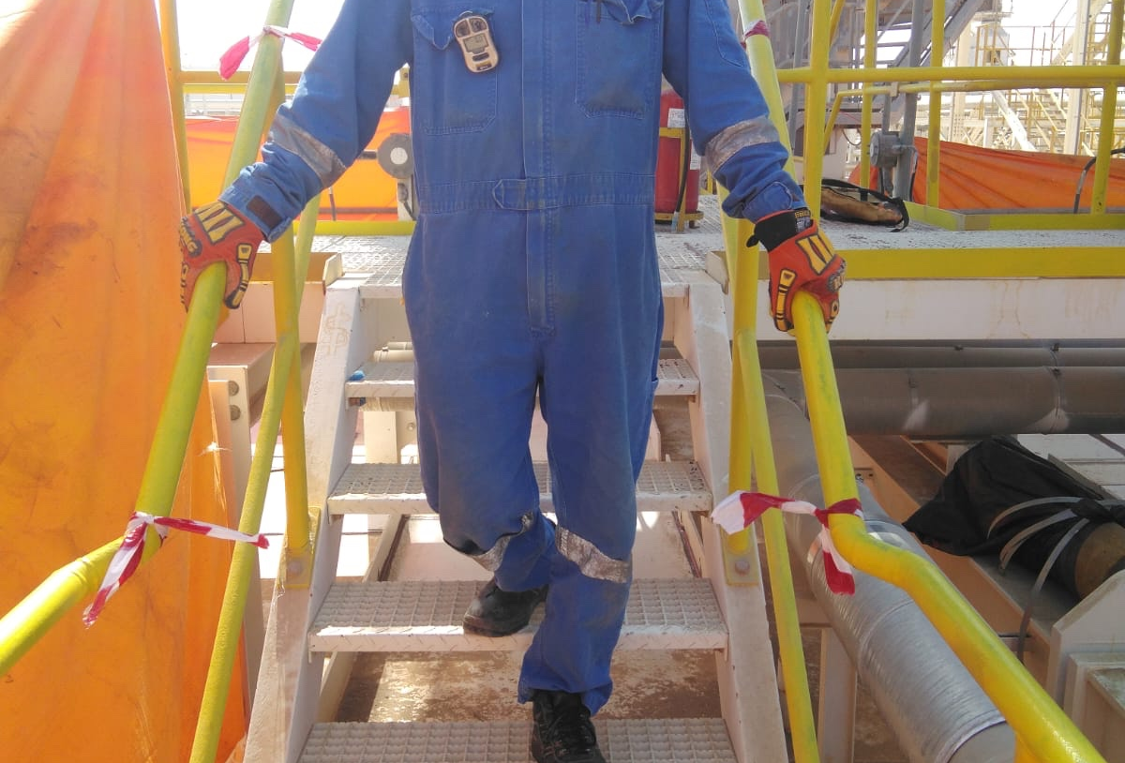
How learning can be sustained at site?
How do you verify that workers clearly understand the requirement to use three‑point contact and always hold handrails?
What signs do you look for that indicate the crew has internalized the learning rather than just hearing it?
How do you confirm that routine tasks—such as stair usage—are treated with the same seriousness as higher‑risk activities?
How are supervisors ensuring that handrail use and attentive footing are being reinforced during daily worksite interactions?
How do supervisors are ensuring that TRIC discussions include everyday hazards like stairs, footing, and body positioning?

