Slide 1
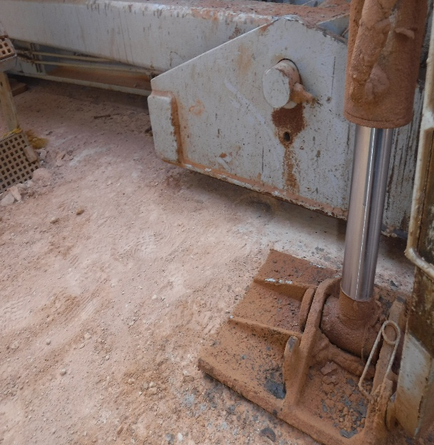
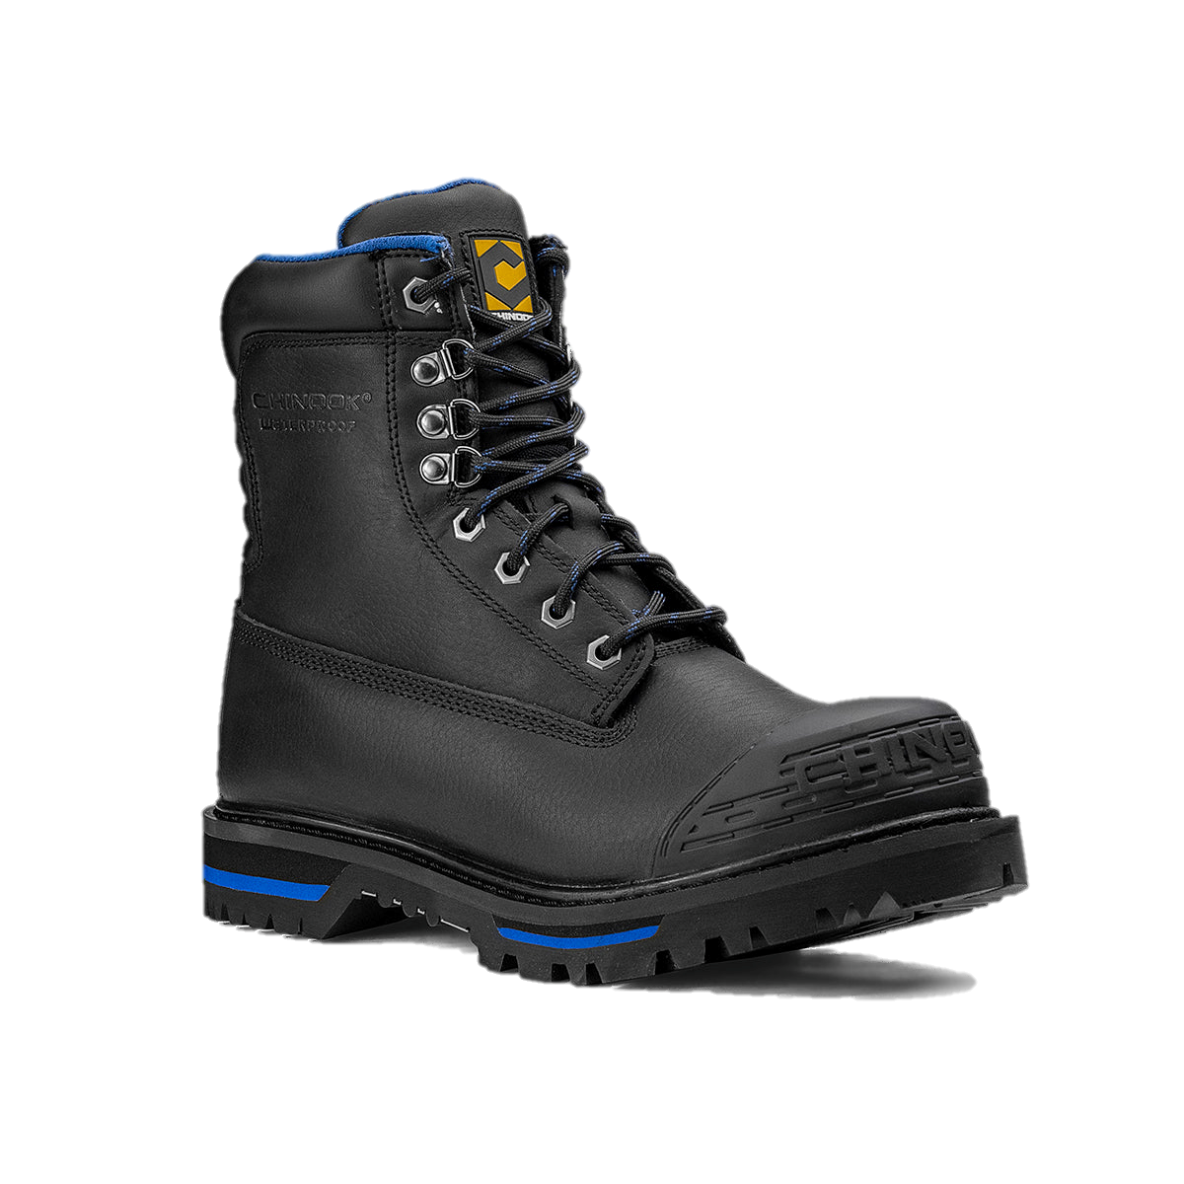
Date: | 15/03/2026 | Incident title: | LWC#04 | Risk Category: | Struck by | Actual Severity: | 3P | Activity: | Running in the hole
Time: | 05: 30 am | Ifadah#: | 26767236 | Injury/Asset Damaged: | Fractured toe | Potential severity: | C3P | Location: | Marmul
Drilling, Workover, Well Intervention Operations.
.
What happened?
operations was Run in Hole 8.5” section. After adding stands on pipe cat from the pipe bin, floorman was operating the pipe bin from control panel to lower the pipe bin. Roustabout entered between pipe cat and pipe bin to remove the separation bars from the pipe bin. While doing so he his right foot was positioned under the moving hydraulic cylinder bed of the pipe bin. His right foot trapped between ground and cylinder bed. First Aid was administrated to IP by Rig Medic and then referred to PAC clinic and later to Salalah Hospital.
Why it happened/Finding:
The pinch point created by the moving hydraulic cylinder bed was not recognized as a Line of Fire hazard before the task was performed.
The hazard of personnel entering the space between the pipe cat and pipe bin was not adequately controlled through physical segregation or barriers.
The task of removing separation bars was not clearly defined within the operating procedure, resulting in inconsistent work practices.
he Job Safety Analysis and Toolbox Talk did not specifically identify the trapping hazard associated with removing separation bars during pipe bin operations.
The pipe bin was operated without positive confirmation that all personnel were clear of the danger zone
Repeated exposure to the task may have led to normalization of risk and reduced awareness of the potential consequences.
Reflective questions to discuss with your Team:
What hazards could develop when a person works near moving pipe handling equipment?
How would you identify a Line of Fire exposure before entering the pipe cat or pipe bin area?
What indicators would tell you that the area is not safe to enter?
How can communication between workers and equipment operators be improved before work starts?
What barriers or controls should be in place to prevent personnel from entering a No-Go Zone?
How do routine tasks sometimes create a false sense of safety?
How can we verify that all personnel are clear before operating equipment?
Never enter a No-Go Zone or Line of Fire area unless authorization and controls are in place.

Slide 2
How learning can be sustained at site?
How have No-Go Zones around pipe handling equipment (moving equipment) been physically identified and communicated to the workforce?
Can workers clearly explain the Line of Fire hazards associated with the pipe cat and pipe bin?
Have all access routes into hazardous areas been reviewed for potential bypass opportunities?
Are physical barriers installed, maintained, and effective in preventing unauthorized access?
How is positive communication verified before equipment operation begins?
Have JSAs and Toolbox Talks been updated to address separation bar removal and associated trapping hazards?
How do supervisors verify that workers understand the hazards rather than simply attending the TBT?
Are operators routinely confirming that personnel are clear before equipment movement?
During recent site inspections, what conditions or behaviors have been identified that could recreate this incident, and what actions were taken to eliminate them?

