Slide 1
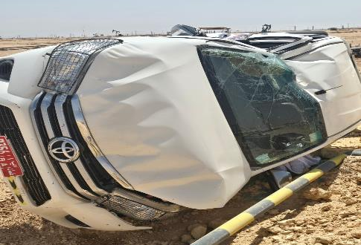
Date: | 01/03/2026 | Incident title: | HiPo#05 | Risk Category: | MVI rolled over | Actual Severity: | 2A | Activity: | Driving
Time: | 11:30 | Ifadah#: | 26665530 | Injury/Asset Damaged: | Vehicle damaged | Potential severity: | C4P | Location: | AlBurj
Logistics, Operation & Construction
What happened?
A third‑party driver was returning from Rig 102 after completing a passenger drop‑off. During the journey to Marmul, the driver lost control of the vehicle, and it rolled over. The vehicle sustained significant damage; no injuries were reported.
Why it happened/Finding:
The driver became distracted while driving, resulting in a loss of focus on the road ahead.
DFMS records identified repeated distraction events and unsafe body movements during the journey.
The driver failed to take corrective action despite multiple DFMS in-cab audio warnings.
Reduced situational awareness led to vehicle departure from the roadway near a sharp road-edge drop-off.
Loss of vehicle control at the road edge resulted in the rollover incident.
Reflective questions to discuss with your Team:
What are the common distractions that can affect drivers during long journeys, and how can they be managed?
How would you recognize when your attention is no longer fully focused on driving?
What actions should a driver take immediately after receiving a DFMS distraction alert?
In what situations should a driver stop the journey and reassess their fitness to drive?
What responsibilities do drivers have in always maintaining full control of their vehicle?
How can defensive driving techniques help prevent a rollover or road departure incident?
Stay focused on driving, respond immediately to DFMS alerts, and stop the journey whenever you are unable to maintain full attention on the road.
Notes:
Risk Categories
Fire & Explosion
Exposure to Chemical, Thermal, Biological, Noise, Radiation hazard
Exposure to Electrical hazard
Falls from Height
Slips and Trips
DROPs & Lifting
Hit /Struck by
Released Energy (Pressure)
Caught Btw/In
Motor Vehicle Incidents
OHL/Underground Services
Man Lost
Non-Accidental Deaths
Suicide
Confined Space
Animal Bites
Overexertion/Strain
Cut, Puncture, Scrape
Others
Activity Category
Drilling Operations
Well Intervention & Workover
Rig Up/Down/Move
Construction & Civil Works
Lifting & Hoisting
Transportation & Logistics
Production Operations
Pipeline & Flowline Installation
Mech & Electrical Maintenance
Hot Work
Confined Space Entry
Chemical Handling
Marine Operations
Environmental/Waste Management
Emergency Response & Drills
Inspection & Testing
Catering
Office Operations

Slide 2


How can this learning be sustained at site?
How do you verify that drivers are completing and understanding the "Fitness to Drive" assessment before every journey?
How frequently are DFMS reports reviewed, and what actions are taken for repeated distraction events?
What process is in place to identify and coach drivers with recurring unsafe driving behaviors?
How do supervisors confirm that journey management plans are reviewed and validated before departure?
What evidence demonstrates that drivers understand their responsibility to respond to DFMS warnings?
How are critical DFMS alerts escalated to supervisors and management for timely intervention?
What assurance activities are conducted to verify compliance with safe driving requirements?
How do supervisors encourage drivers to report reduced alertness, distractions, or fitness-to-drive concerns without fear of consequences?

