Slide 1
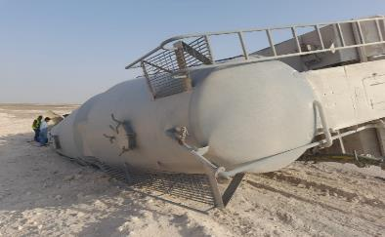
Date: | 19/03/2026 | Incident title: | HiPo#07 | Risk Category: | MVI Rolled over | Actual Severity: | 1P | Activity: | Driving
Time: | 16:19 | Ifadah#: | 26805034 | Injury/Asset Damaged: | Minor injury / Asset damaged | Potential severity: | C4P | Location: | Yibal
Logistics, Operation & Construction
What happened?
On 19 March 2026 at 16:19 hours, a road traffic incident occurred involving a cement bulker unit assigned for transit from Adam to Rig 116. After driving 300 km from Adam base, the driver lost control after a sharp turn and tipped over onto its left side. The driver was the sole occupant of the vehicle. Emergency response was initiated by the PDO Emergency Team and safely rescued the driver from the vehicle and transported him to the nearest medical facility for initial assessment ( PDO Yibal clinic ).
Why it happened/Finding:
The driver did not sufficiently reduce speed when approaching a sharp curve, resulting in loss of vehicle control.
Defensive driving principles were not effectively applied considering the road geometry, vehicle load, and high centre of gravity of the cement bulker.
Driver attention was diverted from the road for several seconds, reducing the ability to respond to the changing road conditions.
The stability of the fully loaded bulker was adversely affected during the turn, increasing rollover potential.
Journey management and monitoring controls were not effectively utilized to identify, intervene, and escalate driving risks in a timely manner.
Reflective questions to discuss with your Team:
What hazards should a driver identify before entering a curve with a loaded bulker?
How should vehicle speed be adjusted when approaching bends, uneven surfaces, or changing road conditions?
What effect does a high centre of gravity have on vehicle stability during turning?
What distractions can affect driving performance, and how can they be eliminated?
How would you recognize that your driving speed is inappropriate for the road conditions even if it is below the posted speed limit?
What defensive driving techniques can prevent a rollover on curved roads?
How should drivers respond when they encounter an unfamiliar road, blind corner, or reduced visibility?
What journey management controls must be verified before starting a long-distance trip?
What actions should a Journey Manager take if a driver becomes unresponsive or abnormal driving events are detected?
Always ensure to adjust driving speed according to road conditions
Notes:
Risk Categories
Fire & Explosion
Exposure to Chemical, Thermal, Biological, Noise, Radiation hazard
Exposure to Electrical hazard
Falls from Height
Slips and Trips
DROPs & Lifting
Hit /Struck by
Released Energy (Pressure)
Caught Btw/In
Motor Vehicle Incidents
OHL/Underground Services
Man Lost
Non-Accidental Deaths
Suicide
Confined Space
Animal Bites
Overexertion/Strain
Cut, Puncture, Scrape
Others
Activity Category
Drilling Operations
Well Intervention & Workover
Rig Up/Down/Move
Construction & Civil Works
Lifting & Hoisting
Transportation & Logistics
Production Operations
Pipeline & Flowline Installation
Mech & Electrical Maintenance
Hot Work
Confined Space Entry
Chemical Handling
Marine Operations
Environmental/Waste Management
Emergency Response & Drills
Inspection & Testing
Catering
Office Operations

Slide 2
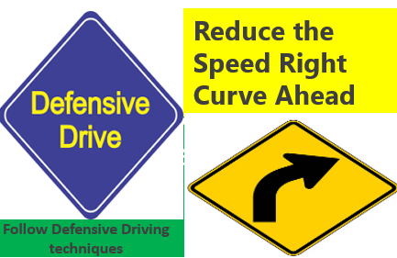
How can this learning be sustained at site?
How do you verify that drivers understand rollover risks associated with bulk transport and high centre of gravity loads?
What evidence confirms that defensive driving and rollover prevention coaching are regularly conducted and assessed?
How are IVMS and DFMS alerts actively monitored, escalated, and closed out by responsible personnel?
How do supervisors verify compliance with journey management requirements before vehicle deployment?
What assurance activities are conducted to confirm that drivers are not using mobile phones, headsets, or other distractions while driving?
How are high-risk routes, curves, road conditions, and lessons learned communicated during journey planning and pre-trip briefings?
What intervention process is followed when unsafe driving behavior, harsh braking, speeding, or distraction events are identified?
How does management verify that previous road transport incidents and LFIs have been reviewed, understood, and implemented by the workforce?
What periodic inspections, audits, and field verifications are performed to confirm journey management controls remain effective?
What measurable indicators (leading and lagging KPIs) are reviewed by management to ensure driving-related risks are continuously reduced?

