Slide 1
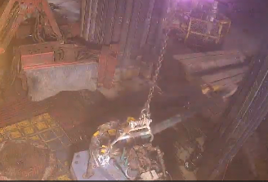
Date: | 08/04/2026 | Incident title: | HiPo#08 | Risk Category: | DROPs | Actual Severity: | 0P | Activity: | Drilling Operation
Time: | 00:56 | Ifadah#: | 26974535 | Injury/Asset Damaged: | NM | Potential severity: | C4P | Location: | Yibal
Drilling & Workover Operations, Logistics & Supply Chain Personnel
What happened?
While picking up and running in hole the first joint of 4½” casing, as the driller lifted the joint and it reached a vertical position, the tubing slipped from the elevator and fell onto the rig floor (V-door side). After the initial impact, it continued moving and fell into the pipe cat area. At the time incident Red zone was managed in both Rig floor and pipe cat area and No injuries or equipment occurred.
Why it happened/Finding:
The correct 4½" side-door elevator was unavailable at the rig, resulting in the decision to source an elevator from another rig.
The change in equipment and work plan was not formally assessed, communicated to line management, or subjected to a Management of Change (MoC) process.
Pre job checks were ineffective in identifying the equipment mismatch (the incorrect size elevator)
Verification focused on completing the task rather than confirming the effectiveness of critical controls..
Pipe rack area not fully barricaded / controlled and Two FMs positioned near V-door / pipe cat area.
Reflective questions to discuss with your Team:
How do we verify that lifting equipment is the correct size and specification before use?
What could have happened if personnel had been present in the pipe cat area when the casing fell?
What are the risks of relying solely on paperwork without physically inspecting equipment?
What should trigger a Stop Work Intervention before lifting begins?
How do we ensure critical checks are effective and not just completed on a checklist?
What controls should be applied when equipment is borrowed or transferred from another location?
How would you identify equipment compatibility issues before starting the task?
What actions should be taken when the required equipment is unavailable on site?
How can supervisors verify that all critical controls are in place before authorizing the job?
4 1/’2 tubing slipped from elevator and fall on the rig floor
STOP - VERIFY - CONFIRM: Ensure lifting equipment is the correct size, certified, and fit for purpose before every lift
Effective supervision is not confirming that a task starts; it is confirming that all critical controls are in place before the task starts
Notes:
Risk Categories
Fire & Explosion
Exposure to Chemical, Thermal, Biological, Noise, Radiation hazard
Exposure to Electrical hazard
Falls from Height
Slips and Trips
DROPs & Lifting
Hit /Struck by
Released Energy (Pressure)
Caught Btw/In
Motor Vehicle Incidents
OHL/Underground Services
Man Lost
Non-Accidental Deaths
Suicide
Confined Space
Animal Bites
Overexertion/Strain
Cut, Puncture, Scrape
Others
Activity Category
Drilling Operations
Well Intervention & Workover
Rig Up/Down/Move
Construction & Civil Works
Lifting & Hoisting
Transportation & Logistics
Production Operations
Pipeline & Flowline Installation
Mech & Electrical Maintenance
Hot Work
Confined Space Entry
Chemical Handling
Marine Operations
Environmental/Waste Management
Emergency Response & Drills
Inspection & Testing
Catering
Office Operations

Slide 2
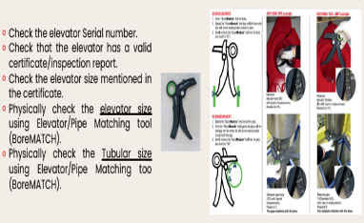
How can this learning be sustained at site?
How do you personally verify that critical equipment compatibility checks have been completed before work starts?
What evidence demonstrates that supervisory field assurance is effective rather than administrative?
Are equipment transfers between locations subject to a documented verification process?
How is Management of Change applied when equipment, plans, or work methods change?
What controls prevent crews from relying solely on manifests, certificates, or assumptions?
Are critical lifting equipment inspections witnessed and verified by supervisors?
How do supervisors confirm that all personnel understand the hazards associated with equipment mismatch?
Are stop-work expectations routinely discussed and demonstrated during toolbox talks

