Slide 1
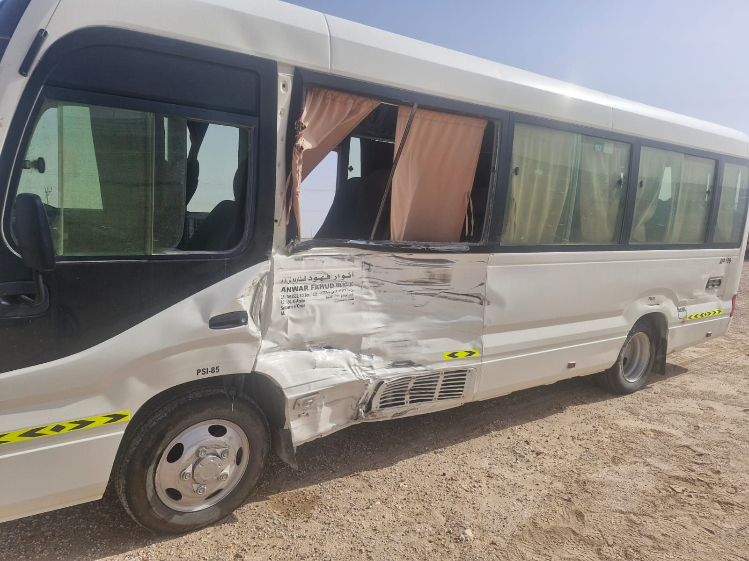
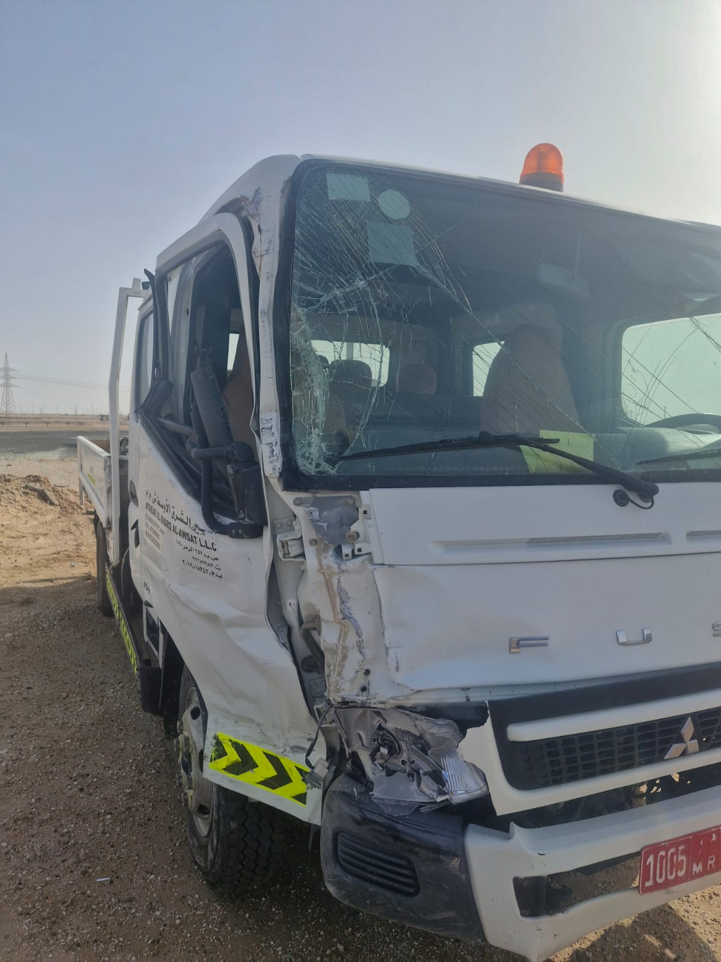
Date: | 20/04/2026 | Incident title: | HiPo#09 | Risk Category: | MVI side collision | Actual Severity: | 1A | Activity: | Transportation
Time: | 07:40 | Ifadah#: | 27091389 | Injury/Asset Damaged: | Vehicles damaged | Potential severity: | C4P | Location: | Yibal
All driving
What happened?
A subcontractor canter was traveling from a contractor yard in Yibal to the Yibal GGP station. While approaching the T-junction at the Y-454 well, the canter attempted to overtake another contractor minibus, which was moving ahead and intending to take a left turn. During this maneuvering, the Canter right side brushed against left side of the bus, causing minor damage to both vehicles and no injury.
Why it happened/Finding:
The driver knowingly carried out an overtaking maneuver on a solid line and near a T-junction, contrary to PDO and ROP road safety requirements.
Unsafe driving behaviors had become normalized through repeated non-compliance with speed limits and traffic rules on the route.
The driver failed to adjust vehicle speed to the road conditions, warning signs, and approaching junction.
Passengers observed the unsafe driving behavior but did not intervene or report the unsafe act, indicating a weak intervention culture.
IVMS geofence settings were not updated to the revised speed limit, reducing the effectiveness of monitoring and speed violation detection.
Reflective questions to discuss with your Team:
What warning signs or conditions should have alerted the driver not to overtake at this location?
How can repeated exposure to the same route lead drivers to underestimate the risks they face?
How do you determine a safe speed when approaching a junction, intersection or turning vehicle?
What would you do if you were a passenger and observed a driver speeding or attempting an unsafe overtake?
What challenges prevent workers from intervening when they see unsafe acts, and how can these barriers be overcome?
How does familiarity with a route sometimes contribute to unsafe decisions?
What defensive driving techniques should be applied when following another vehicle approaching a junction?
How do we verify that safety-critical controls such as IVMS and geofencing remain effective?
Never overtake near junctions, intersections, or on solid line road markings.
Notes:
Risk Categories
Fire & Explosion
Exposure to Chemical, Thermal, Biological, Noise, Radiation hazard
Exposure to Electrical hazard
Falls from Height
Slips and Trips
DROPs & Lifting
Hit /Struck by
Released Energy (Pressure)
Caught Btw/In
Motor Vehicle Incidents
OHL/Underground Services
Man Lost
Non-Accidental Deaths
Suicide
Confined Space
Animal Bites
Overexertion/Strain
Cut, Puncture, Scrape
Others
Activity Category
Drilling Operations
Well Intervention & Workover
Rig Up/Down/Move
Construction & Civil Works
Lifting & Hoisting
Transportation & Logistics
Production Operations
Pipeline & Flowline Installation
Mech & Electrical Maintenance
Hot Work
Confined Space Entry
Chemical Handling
Marine Operations
Environmental/Waste Management
Emergency Response & Drills
Inspection & Testing
Catering
Office Operations

Slide 2
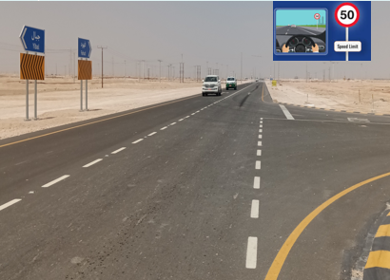
How can this learning be sustained at site?
How are supervisors verifying that drivers consistently comply with posted speed limits and overtaking restrictions?
Are IVMS alerts, speeding reports, and geofence configurations regularly reviewed and validated?
How is driver behaviour being monitored for repeat violations and unsafe driving trends?
What evidence demonstrates that defensive driving principles are being actively applied in the field?
What controls prevent crews from relying solely on manifests, certificates, or assumptions?
What actions are taken when unsafe driving behaviours are identified before an incident occurs?
How do supervisors confirm that lessons learned from previous MVIs have been communicated and understood by drivers?

