Slide 1
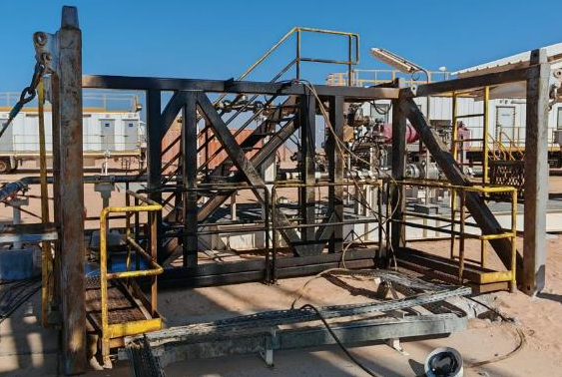
Date: | 13/02/2026 | Incident title: | LWC #02&03 | Risk Category: | Fall From Hight | Actual Severity: | 3P | Activity: | Rig down Coil Tubing
Time: | 22:04 | Ifadah#: | 26518282 | Injury/Asset Damaged: | Multiple fractures | Potential severity: | C4P | Location: | Harweel
Banksman, Operators, Crance Operator, Supervisor & Operation Manager.
What happened?
During Coiled Tubing Unit (CTU) rig down operations using crane, following removal of the top section of the track stack, the two Operators climbed onto the intermediate section to disassemble it. After removing the securing pins and while preparing to attach the crane slings, the intermediate section entangled with the sling and caused it to topple down. Both Operators fell with the structure, sustaining multiple fractures.
Why it happened/Finding:
A four‑leg sling was used to lift the intermediate section, even though the load had only two lifting points, significantly increasing the potential for sling entanglement.
Securing pins were removed before connecting the crane slings, leaving the intermediate section unstable and vulnerable to toppling.
The activity was performed during nighttime, reducing visibility for the crane operator and spotters.
The SOP, Risk Assessment, and lifting procedure used were generic and did not reflect the actual site conditions or lifting configuration, resulting in gaps in control measures.
Reflective questions to discuss with your Team:
How do you currently verify that your crew is complying with approved SOPs during work execution?
What specific controls do you apply to safely manage rig‑up and rig‑down operations conducted at night?
When actual work practices differ from the SOP, what actions do you take to address the deviation and restore safe operations?
How do you utilize existing CCTV systems to monitor and review high‑risk tasks on site?
How effective are your hazard hunts in identifying risks associated with nightshift rig‑up/rig‑down activities?
TOPPLED INTERMEDIATE SECTION – POST INCIDENT
Never Assume , VERIFY SOP contents and implementation!
Notes:
Risk Categories
Fire & Explosion
Exposure to Chemical, Thermal, Biological, Noise, Radiation hazard
Exposure to Electrical hazard
Falls from Height
Slips and Trips
DROPs & Lifting
Hit /Struck by
Released Energy (Pressure)
Caught Btw/In
Motor Vehicle Incidents
OHL/Underground Services
Man Lost
Non-Accidental Deaths
Suicide
Confined Space
Animal Bites
Overexertion/Strain
Cut, Puncture, Scrape
Others
Activity Category
Drilling Operations
Well Intervention & Workover
Rig Up/Down/Move
Construction & Civil Works
Lifting & Hoisting
Transportation & Logistics
Production Operations
Pipeline & Flowline Installation
Mech & Electrical Maintenance
Hot Work
Confined Space Entry
Chemical Handling
Marine Operations
Environmental/Waste Management
Emergency Response & Drills
Inspection & Testing
Catering
Office Operations

Slide 2
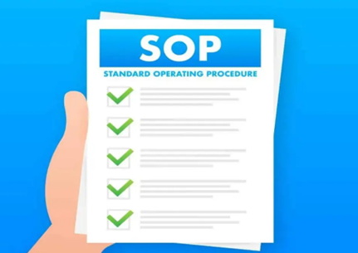

How can this learning be sustained at site?
Operation Manager: Does the SOP explicitly state the critical sequence for removing intermediate CT tower sections (e.g. sling attachment before pin removal)?
Operation Manager: What mechanisms do you use to independently verify that supervision is effective during high‑risk activities such as lifting and work at height?
Operation Manager: How do you satisfy yourself that ‘work as done’ in the field matches ‘work as planned’ in work packs and procedures?
Supervisor: Are you physically present and ensure effective supervisor in all critical lifting and rig-up/rig-down activities?
Supervisor: What on‑site checks do you personally carry out to confirm that identified controls are implemented, rather than relying solely on desk‑based approvals?
Supervisor: Has the lifting plan been validated to confirm: Correct number of slings, correct lifting points, Control of redundant/free slings etc.?
Supervisor: Can the crew correctly explain the safe sequency for carrying the task e.g., for this incident safe sequences for the removal of CTU sections?
Supervisor: Are deviations from procedures captured, discussed, and corrected, not normalized?
Supervisor: Are Toolbox Talks focused on critical task steps, not only generic hazards?
IS THE WORK PACK CONTENT FIT FOR PURPOSE?
DOES THE WORK CREW KNOW THEIR ROLE?

