Slide 1
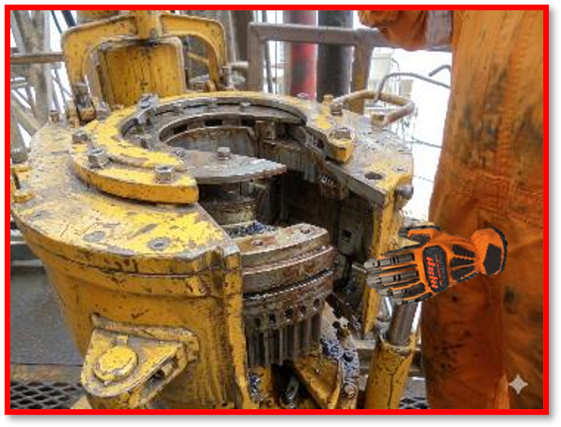
Date: | 31/05/2026 | Incident title: | LWC#06 | Risk Category: | Caught in between | Actual Severity: | 3P | Activity: | Handling power tong
Time: | 07:50 | Ifadah#: | 27467260 | Injury/Asset Damaged: | Finger injury | Potential severity: | C3P | Location: | Marmul
Drilling & Well Services Personnel, Frontline Supervisors, Maintenance Teams
What happened?
After making up the final tubing connection, the Floorman was racking back the Power tong from the Well center to its resting position. During this movement, the Tong lever struck the Handrail. This contact accidentally activated the tong while the Floorman's left hand was positioned in a pinch point, causing injuries to his 3rd and 4th fingers.
Why it happened/Finding:
The power tong was operated without a safety guard, resulting in a missing critical safety barrier.
The floor person’s hand was positioned in the pinch-point (Line of Fire) during movement.
The equipment was unintentionally activated due to an unprotected control lever
The equipment integrity was not verified before use.
Supervision failed to enforce start-work controls and did not stop unsafe conditions.
Reflective questions to discuss with your Team:
What warning signs would indicate that this equipment is not safe to operate?
How would you verify that all critical safety guards and protections are in place before starting work?
What could happen if a power tong (equipment) remains energized while being moved or repositioned?
What Line of Fire hazards exist during tong operation and rack-back activities?
If you noticed a missing/damaged guard, what actions would you take before allowing the task to continue?
How could the DRA or toolbox talk have better identified the risks present in this task?
Hand position on Pinch point area
Keep hands clear of pinch points (Line of Fire) and never operate equipment with missing or damaged safety guards
Notes:
Risk Categories
Fire & Explosion
Exposure to Chemical, Thermal, Biological, Noise, Radiation hazard
Exposure to Electrical hazard
Falls from Height
Slips and Trips
DROPs & Lifting
Hit /Struck by
Released Energy (Pressure)
Caught Btw/In
Motor Vehicle Incidents
OHL/Underground Services
Man Lost
Non-Accidental Deaths
Suicide
Confined Space
Animal Bites
Overexertion/Strain
Cut, Puncture, Scrape
Others
Activity Category
Drilling Operations
Well Intervention & Workover
Rig Up/Down/Move
Construction & Civil Works
Lifting & Hoisting
Transportation & Logistics
Production Operations
Pipeline & Flowline Installation
Mech & Electrical Maintenance
Hot Work
Confined Space Entry
Chemical Handling
Marine Operations
Environmental/Waste Management
Emergency Response & Drills
Inspection & Testing
Catering
Office Operations

Slide 2
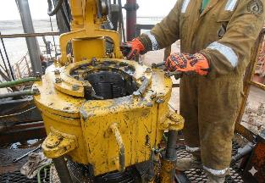

How can this learning be sustained at site?
How do you verify that safety-critical guards are installed and functional before equipment is released for use?
What process prevents equipment with missing or damaged safety components from returning to service?
When was the last formal inspection of the Power Tong, and were all safeguards confirmed present?
How do you confirm that Dynamic Risk Assessments adequately address Line of Fire and pinch-point hazards?
What evidence demonstrates that Stop Work Authority is actively practiced and supported on site?
How do you verify that workers are using designated handles and maintaining safe hand positions?
How are defects, missing guards, or compromised equipment reported, tracked, and closed out?
How to confirm that routine tasks are not leading to complacency, normalization of risk, or acceptance of unsafe conditions?
Correct Hand Position on Handle

