Slide 1
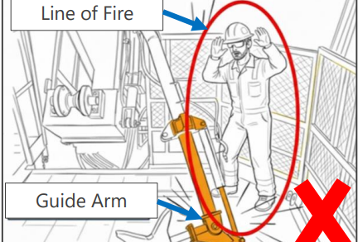
Date: | 06/01/2026 | Incident title: | HiPo#01 | Risk Category: | Struk By | Actual Severity: | 2P | Activity: | Lay down
Time: | 02:11 hrs | Ifadah#: | 26206007 | Injury/Asset Damaged: | Minor Asset Damage | Potential severity: | C4P | Location: | Amal
Floorman, Roustabout Manager, Welder, Maintenance Supervisor
What happened?
On 06.01.2026 at approximately 02:11 Am during laydown of 4.5" tubing containing a 7/8" sucker rod, the 8th joint slipped out of the catwalk groove. While the Roustabout attempted to reposition, it using the Guide Arm, the Driller instructed the Floorman to signal ‘STOP’ to the Roustabout. As the Floorman approached the handrail area to convey the message, the Guide Arm suddenly fractured and fell towards the Floorman. The hydraulic hose brushed the Floorman’s shoulder. Fortunately, no injury was sustained.
Why it happened/Finding:
The Guide Arm had a pre-existing structural weakness due to excessive wear and tear following local maintenance of a repair - that did not follow OEM requirements.
Excessive force was applied to the Guide Arm while trying to reposition a stuck tubing section.
The Guide Arm was designed such that it could be used outside its intended operational envelope, exceeding its load capacity.
The Supervisor coming onto shift was informed the Guide Arm was now available for use and re-introduced it back into the operation
without a TBT or dynamic risk assessment, changing the previous workflow that the Crew had been used to.
The Floorman, inadvertently, entered the Line of Fire while the Guide Arm had started to become operational again.
Never enter the Line of Fire — equipment under load can fail without warning

Slide 2
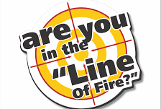
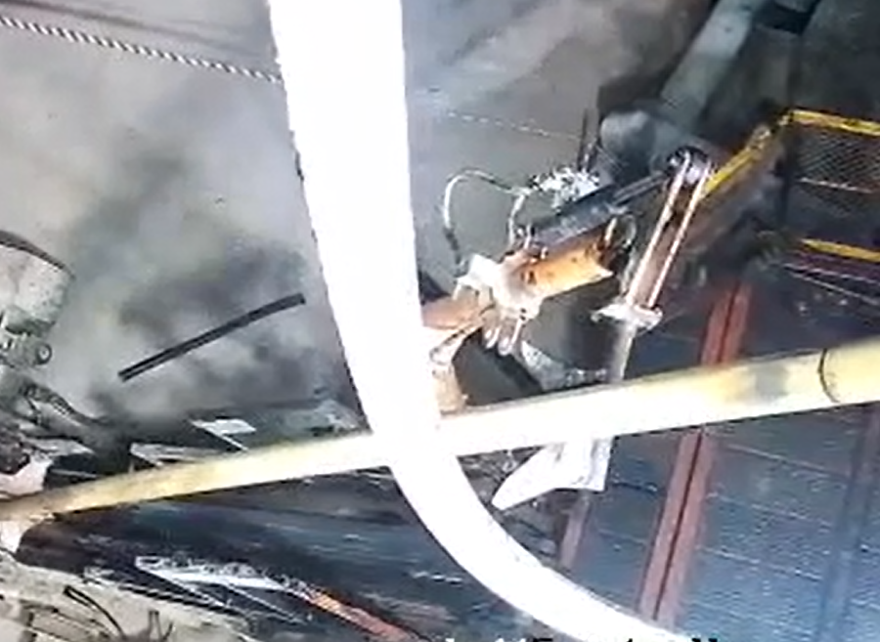
Reflective questions to discuss with your Team:
For equipment that has load limitations – how do you know when it is close to its safe working limit?
What process is used for determining which ‘maintenance route’ is selected for OEM supplied equipment and how do you determine it is fit for purpose to be reinstated back into routine operations?
When changing a workflow mid-operation – what process do you use to highlight any new changes or risks?
What protocols are in place to identify when to use remote communication (radio/mic) instead of approaching equipment in motion?
If you recognize equipment is behaving abnormally, what process do you follow at your location – is every crew member aware of it?
How learning can be sustained at site?
How do you ensure that any change in workflow or tools (e.g., reintroducing repaired equipment) triggers a mandatory Dynamic Risk Assessment?
How do you ensure that all Crews are formally briefed on equipment status changes during shift handover?
How do you ensure that structural repairs are only carried out with OEM authorization when necessary?
How do you ensure maintenance procedures are followed and available to all Crew members?
How do you ensure repaired equipment undergoes integrity verification/NDT before being returned to service?
How do you ensure operators and supervisors understand the safe working limits of all equipment used in lifting/laydown operations?
NO GO zone – avoid Line of Fire
Guide Arm

