Slide 1
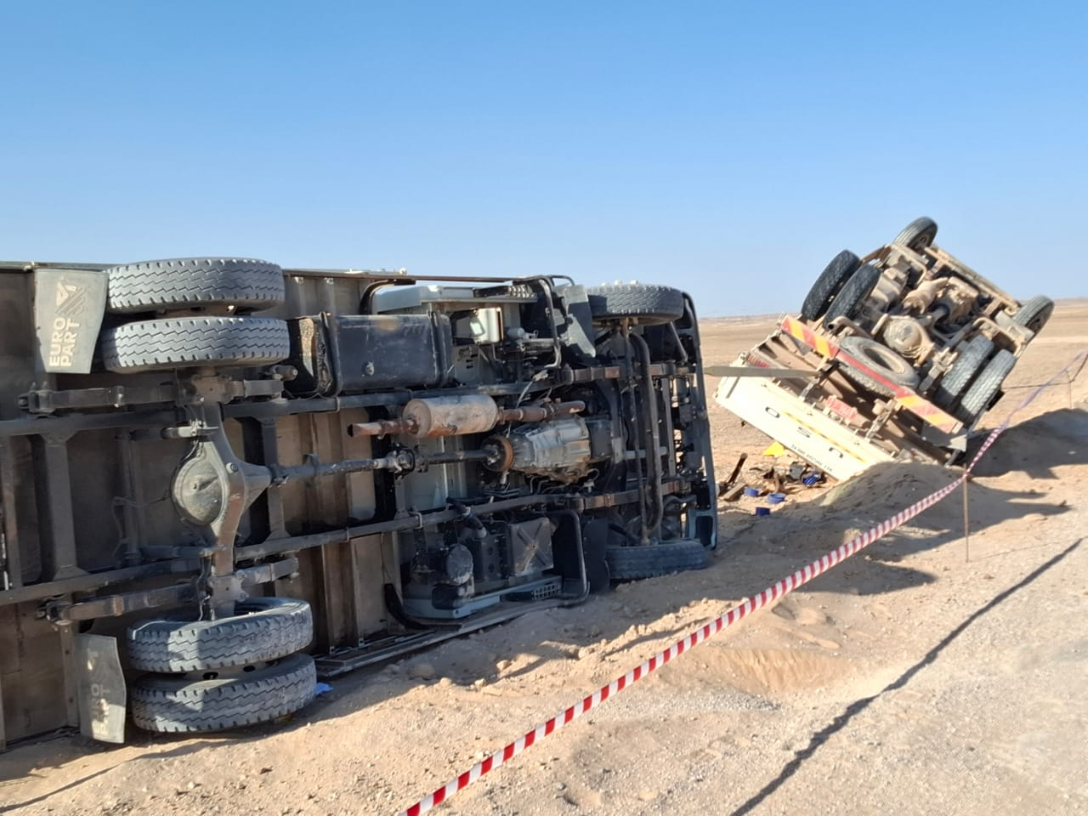
Date: | 18/01/2026 | Incident title: | HiPo#02 | Risk Category: | MVI | Actual Severity: | 2A | Activity: | Driving
Time: | 15:00 | Ifadah#: | 26292800 | Injury/Asset Damaged: | Vehicle Damage | Potential severity: | D5P | Location: | Qurn Alam
Divers
What happened?
After completing the assigned work, two mechanical crews were traveling from Wadi Umairi to Makarem. At approximately 14:45 hrs., Crew 1’s Canter vehicle broke down on the graded road near Wadi Umairi. Crew 2’s Canter arrived to assist, and towing was attempted using a webbing belt.
During towing, Crew 1’s vehicle brakes failed, and while avoiding a collision, the driver steered left, causing Crew 2’s vehicle to lose control and overturn around 15:00 hrs. Due to the towing connection, Crew 1’s Canter was also pulled and subsequently overturned.
Why it happened/Finding:
Crew 1’s vehicle (towed vehicle) brake system had a worn component which caused it to fail.
Poor maintenance culture resulted in worn components on an active vehicle.
The crew relied on their knowledge as there was no documented Safe Towing operating procedure.
Reflective questions to discuss with your Team:
What documented process do we have in place to guide recovery of broken-down vehicles?
How do we ensure our maintenance schedules are rigorously followed?
Drivers: How do you ensure you are familiar with the risks associated with vehicle towing (eg: checking brakes/steering of towed vehicle)?
Crew 1 Canter
Crew 2 Canter
Never tow a vehicle without knowing the risks!

Slide 2
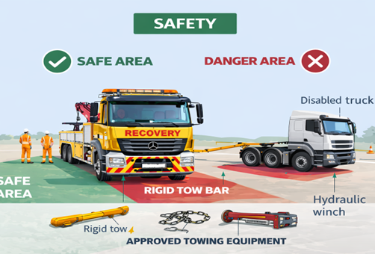
How learning can be sustained at site?
Journey Managers: Have all potential vehicle breakdown and towing hazards been identified and assessed before commencing operations?
Supervisors: Are proper towing methods clearly defined and communicated to the entire crew before initiating towing activities?
Road safety Manager : Is suitable towing equipment (e.g., tow bars or chains) available and used instead of non-certified materials such as webbing belts?
Road safety Manager : Is there active monitoring of towing operations to ensure compliance with the Emergency Response Plan (ERP) and Standard Operating Procedures (SOPs)?
* If the answer is NO to any of the above questions, please ensure you take action to correct this finding

