Slide 1
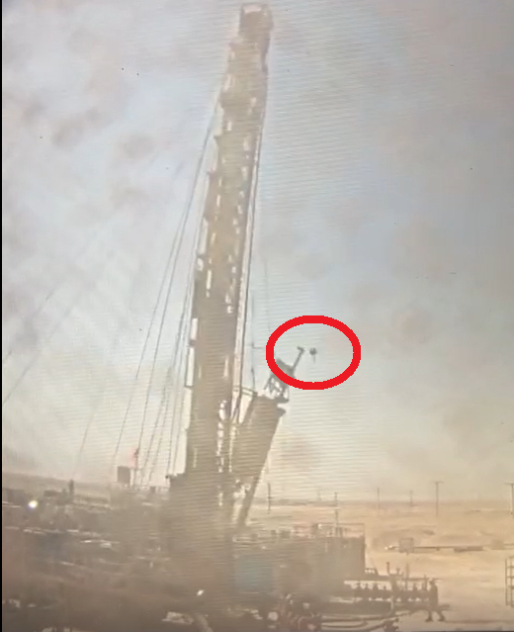
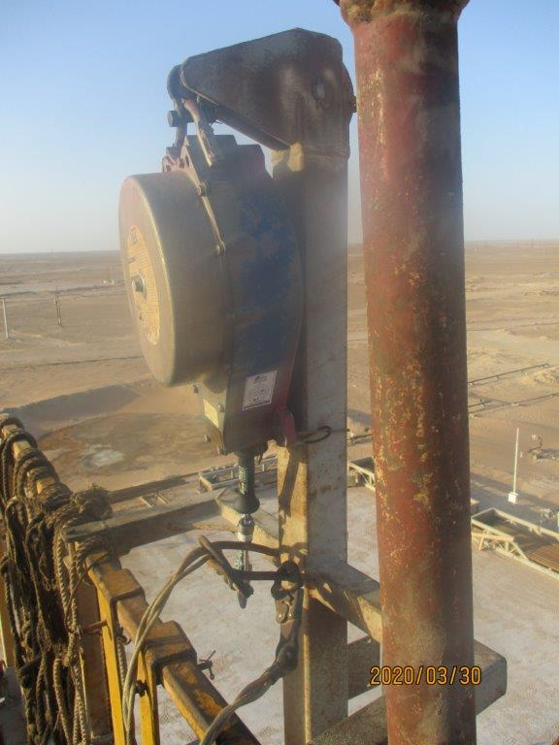
PDO Second Alert
Date: 30.03.2021 Incident title: HIPO #22 Drop
What happened?
On the 30th of March at about 15:46 after spotting the hoist and preparing the carrier for rig up, the crew were at their viewpoint positions and the driller on the controls for the mast raising operation. The driller was raising the mast from the horizontal position and through to vertical. As the mast was passing vertical to negative set back position, the derrick platform starts its natural movement away from the mast.
The derrick platform’s fall arrestor broke from its base and released from being caught, throwing it in the opposite direction and falling about six meters to the ground.
Your learning from this incident..
Ensure weekly DROPS inspections are completed properly, look for potential issues
Ensure secondary retention is fitted to all items of equipment at height
Ensure your routine checks on safety equipment includes inspection dates
Ensure proper supervision is in place for all safety critical operations, even if they seem routine
Ensure you complete a quality weekly drops inspection
Notes:
Ensure all dates and titles are input
A short description should be provided without mentioning names of contractors or individuals. You should include, what happened, to who (by job title) and what injuries this resulted in. Nothing more!
Four to five bullet points highlighting the main findings from the investigation. Remember the target audience is the front line staff so this should be written in simple terms in a way that everyone can understand.
The strap line should be the main point you want to get across
The images should be self explanatory, what went wrong (if you create a reconstruction please ensure you do not put people at risk) and below how it should be done.

Slide 2
Management self audit
Date: 30.03.2021 Incident title: HIPO #22 Drop
As a learning from this incident and ensure continual improvement all contract
managers must review their HSE HEMP against the questions asked below
Confirm the following:
Do you ensure that all site procedures and inspections are completed as per schedule?
Do you ensure that your dropped objects prevention program is audited?
Do you ensure your L3 audits are effectively completed for safety process compliance?
Do you ensure that your inspection processes are robust and cover all equipment in all circumstances?
Do you ensure your non-mandatory courses receive the same focus as required courses for completion compliance?
Do you ensure support, guidance and follow up with FLS individuals action plans?
* If the answer is NO to any of the above questions please ensure you take action to correct this finding.
Notes:
Ensure all dates and titles are input
Make a list of closed questions (only ‘yes’ or ‘no’ as an answer) to ask others if they have the same issues based on the management or HSE-MS failings or shortfalls identified in the investigation.
Imagine you have to audit other companies to see if they could have the same issues.
These questions should start with: Do you ensure…………………?

