Slide 1
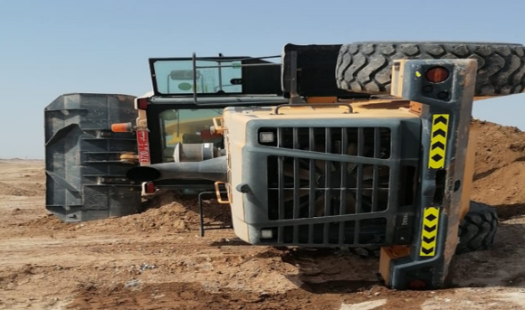
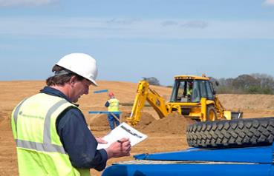
PDO Second Alert
Date: 23.05.2021 Incident title : HiPo#29
What happened?
Front end-loader working in a borrow pit area carrying out mixing of
soil with water, it skid and toppled to its side due to unsafe operation
of the loading bucket.
Your learning from this incident..
Always ensure crew members are communicated about the hazards in the TBT sessions.
Always ensure to carryout risk assessment incase of any change
Suspend the activity if the supervisor not available or moves away from site temporarily.
Intervene unsafe activities / violations and use your stop empowerment.
Always ensure adequate supervision and Hazard communication is in place
Notes:
Ensure all dates and titles are input
A short description should be provided without mentioning names of contractors or individuals. You should include, what happened, to who (by job title) and what injuries this resulted in. Nothing more!
Four to five bullet points highlighting the main findings from the investigation. Remember the target audience is the front line staff so this should be written in simple terms in a way that everyone can understand.
The strap line should be the main point you want to get across
The images should be self explanatory, what went wrong (if you create a reconstruction please ensure you do not put people at risk) and below how it should be done.

Slide 2
Management self audit
Date: 23.05.2021 Incident title : HiPo#29
As a learning from this incident and ensure continual improvement all contract
managers must review their HSE HEMP against the questions asked below
Confirm the following:
Do you ensure that supervisors communicate the Hazards to workforce?
Do you ensure that workers understand their roles and responsibilities while performing job?
Do you ensure that operator behavior is monitored as part of work inspections?
Do you ensure that the supervisors carryout spot inspection of worksites?
Do you ensure that the skilled workers are able to carryout their responsibilities ?
Do you ensure that supervisors discuss HEMP with their workforce during the Tric sessions ?
Do ensure proper supervision for out of site locations ?
Do you ensure PHs utilize the dynamic risk tool effectively while delivering the TBT ?
* If the answer is NO to any of the above questions please ensure you take action to correct this finding.
Notes:
Ensure all dates and titles are input
Make a list of closed questions (only ‘yes’ or ‘no’ as an answer) to ask others if they have the same issues based on the management or HSE-MS failings or shortfalls identified in the investigation.
Imagine you have to audit other companies to see if they could have the same issues.
These questions should start with: Do you ensure…………………?

