Slide 1
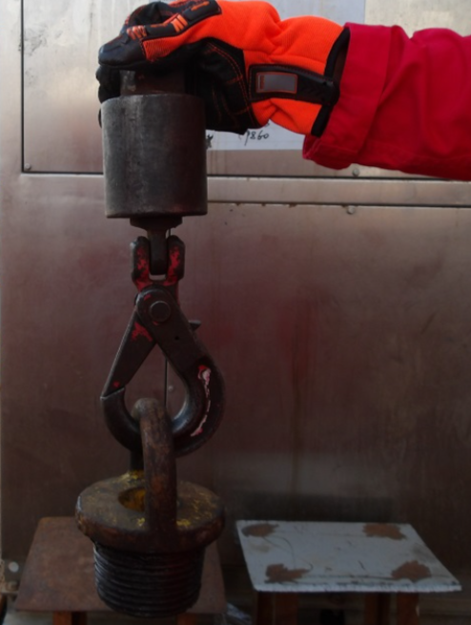
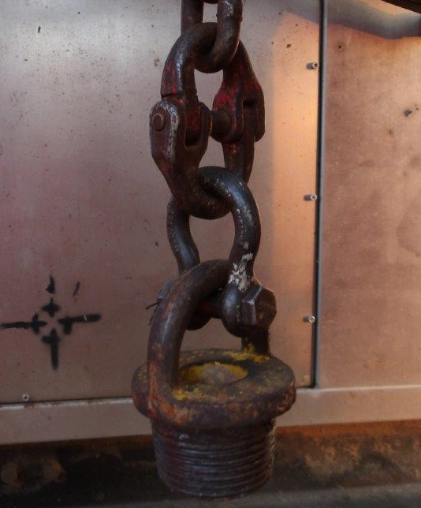
PDO Second Alert
Date:27/02/2024 Incident title: HiPo#10 Pattern: Drops Potential severity: C4P Activity: Laying down HWDP
What happened?
The operation was to laydown 4" HWDP, a roustabout was operating the air winch, while two floormen were assisting by pushing the DP from the mouse hole towards the V-door direction. The roustabout lowered the HWDP prematurely, causing it to land at the edge of the V-door opening. This led to the load slacking off, and as a result, the Shurloc hook got disconnected. Consequently, the HWDP fell from the rig floor into the pipe racks area. There were no individuals present in the No Go Zone area at the time of the incident, and no equipment sustained any damage.
Why it happened/Finding :
HWDP stuck at the tip of the V-door and while the winch operator is lowering it resulted in opening the Shurloc hook, which led to dropping the pipe.
The Shurloc hook was used although it is forbidden to be used in rig winch line operation as per SP-2079.
The Lay down tubular SOP doesn’t contain the use of 4-parts shackle. As well as it do not assign the competent winch operator.
The winch operator was incompetent operator, a Roustabout with 6-months experience.
The Shurloc hook was identified earlier as forbidden tool to be used in rig winch lines. However, it was installed back.
Your learning from this incident..
Always ensure to intervene and stop the job once needed.
Only four-part shackles to be used with the Rigs winch lines.
Always ensure proper inspection of tools prior use.
Always plan the job adequately and ensure all crew are aware about the plan.
Always ensure competent operator to operate the winch.
Always ensure ethe SOP covers all specific steps of the performed activity .
Always ensure proper inspection of tools prior use
Notes:
Ensure all dates and titles are input
A short description should be provided without mentioning names of contractors or individuals. You should include, what happened, to who (by job title) and what injuries this resulted in. Nothing more!
Four to five bullet points highlighting the main findings from the investigation. Remember the target audience is the front line staff so this should be written in simple terms in a way that everyone can understand.
The strap line should be the main point you want to get across
The images should be self explanatory, what went wrong (if you create a reconstruction please ensure you do not put people at risk) and below how it should be done.

Slide 2
Effective Learning
Date: 27 Feb 2024 PIM Number: 1163381 Pattern: Near Miss Potential severity: C4P
To make sure learning is translated to the site day to day activities , please answer the below questions :-
How learning can be implemented at site ?
Ensure to implement all Musta’ed 7 steps effectively.
Ensure to intervene and stop the job once needed.
Only four-part shackles to be used with the Rigs winch lines.
Conduct proper inspection of tools prior use.
Plan the job adequately and ensure all crew are aware about the plan.
Ensure competent operator to operate the winch.
Ensure the SOP covers all specific steps of the performed activity .
How can you sustain the action ?
To update the SOP and JHA to include the Shurloc hook never to be used with Rig winch line only 4-part shackles to be used.
To update the SOP & JHA and define that only competent operator shall operate the winch
To ensure the communication is done successfully
Ensure all actions are well tracked and closed
Regular SOP & JHA verification will be in place by WFRD Assurance team including verification of only 4-parts shackle to be used
Regular review of the HEMP, SOP, JSA & checklist.
Disclaimer
This document is provided for information only. It may not be relied upon for any purpose. Neither PDO nor any party providing information for this document accepts any liability for its accuracy, completeness, omissions, advice, or any consequences arising from its use, even if reasonable care was not exercised. No representation or warranty, express or implied, is made that following this document will achieve any specific results or meet any legal or regulatory requirements. This document does not constitute technical advice; consult a qualified professional if such advice is needed
Notes:
Guideline for Effective Learning & Sustainability
•Can be replicated across similar contractor / activities
•Shall be SMART- Specific ,Measurable , Achievable ,Realistic & Timebound
•Can be implemented in a months' time

Slide 3
PDO التنبية الثاني
Date:27/02/2024 Incident title: HiPo#10 Pattern: Drops Potential severity: C4P Activity: Laying down HWDP
ماذا حدث؟
كانت العملية تهدف إلى إنزال أنبوب الحفر الثقيل (HWDP) بقطر 4 بوصات، حيث كان عامل المساعدات (الروستابوت) يشغل الرافعة الهوائية، بينما كان اثنان من عمال الحفر يساعدان في دفع أنبوب الحفر من الفتحة الجانبية باتجاه بوابة منصة الحفر . قام عامل المساعدات بخفض أنبوب الحفر الثقيل قبل الأوان، مما أدى إلى هبوطه عند حافة فتحة بوابة منصة الحفر. تسبب ذلك في ارتخاء الحمولة، ونتيجة لذلك، انفصل خطاف الشيرلوك. وكنتيجة لذلك، سقط أنبوب الحفر الثقيل من منصة الحفر إلى منطقة رفوف الأنابيب. لم يكن هناك أي أفراد في منطقة الحظر وقت وقوع الحادث، ولم تتعرض أي معدات لأضرار.
نتائج التحقيق:
علق الأنبوب عند طرف V-door وأثناء خفض مشغل الونش للأنبوب فتح الهوك ، مما أدى إلى إسقاط الأنبوب.
تم استخدام هوك في الونش على الرغم من أنه من غير المسموح استخدامه في عمليات ونش الحفر وفقًا ل SP-2079.
لم يكن هناك تواصل مناسب بين مشغل ونش الحفر والفلور مان الذين يدفعون الأنبوب.
لا تحتوي إجراءات العمل القياسية لوضع الأنابيب على استخدام اصفاد ذات أربعة أجزاء. وكذلك لا تحدد مشغل ونش مؤهل.
كان مشغل الونش مشغلًا غير كفء، رستباوت مع خبرة 6 أشهر.
تم تحديد الهوك مسبقًا كأداة محظورة لاستخدامها في خطوط ونش الحفر. ومع ذلك، تم تثبيته مرة أخرى.
الدروس المستفادة من الحادثة..
دائمًا تأكد من التدخل وإيقاف العمل عند الحاجة.
يجب استخدام اصفاد من أربعة أجزاء فقط مع خطوط ونش الحفارات.
تأكد دائمًا من تفتيش الأدوات بشكل صحيح قبل الاستخدام.
تأكد دائمًا من التخطيط الملائم للعمل وضمان أن جميع أفراد الطاقم على دراية بالخطة.
تأكد دائمًا من توفير مشغل مؤهل لتشغيل الونش.
تأكد دائمًا من أن إجراءات التشغيل القياسية تغطي جميع الخطوات الخاصة بالنشاط المنفذ.
احرص دائمًا على إجراء فحص مناسب للأدوات قبل استخدامها.
Notes:
Ensure all dates and titles are input
A short description should be provided without mentioning names of contractors or individuals. You should include, what happened, to who (by job title) and what injuries this resulted in. Nothing more!
Four to five bullet points highlighting the main findings from the investigation. Remember the target audience is the front line staff so this should be written in simple terms in a way that everyone can understand.
The strap line should be the main point you want to get across
The images should be self explanatory, what went wrong (if you create a reconstruction please ensure you do not put people at risk) and below how it should be done.

