Slide 1
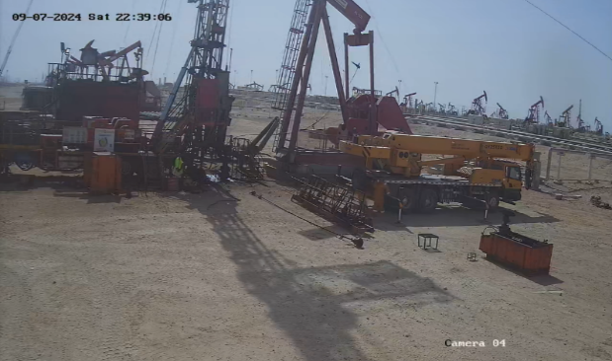
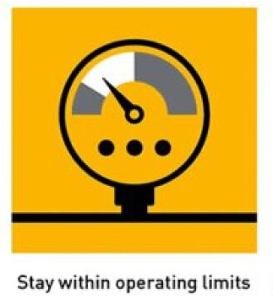
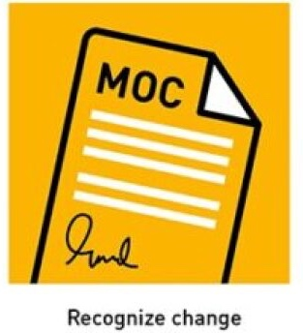
PDO Second Alert
Date: 8 Sep 2024 Incident title: Sucker Rod Release Hit on the ground Pattern: HIPO Potential severity: C4P
Target Audience: Derrickman, Drillers, NTP & Rig Manager
What happened?
At 9:30 am on September 8, 2024, the driller was pulling 1" sucker rod (SR) completion string out of the hole. As the string was stuck, the driller was trying to release the SR by moving it up and down. While working on the SR to free it, the SR elevator bails disconnected from one side of the elevator and slipped through the sucker rod hook. Then the bails, along with the elevator attached to the sucker rod, swung to the ground near the beam pump & bounced back to the well center, hitting the Xmas tree.
This resulted in the bails getting disconnected from the elevator and landing next to the cellar. No one was hurt during this event.
Why it happened? Finding:
Maximum allowable limit to pull Sucker rod was exceeded.
Inadequate planning and preparation for SR operation, the back-off tool was not available at the site.
Risk Normalization: The Over-Pull task was not considered as dynamic risk.
Zone management (hard barrier) was not implemented during POOH Sucker rod.
Inadequate process implementation on adherence to SOP & MOC.
Musta’ed steps were not followed.
Your learning from this incident:
Ensure that the Over-pull minimum and maximum limitations are set and clearly understood by the crew.
Implement Zone management (Hard Barriers) for Sucker rod operations.
Ensure Operating envelop is clearly understood and adhered to.
If the sucker rod gets stuck, follow each step of the procedure.
Confirm that the crew understands dynamic risk assessment and recognize change management.
Ensure that assurance checks are carried out to confirm adherence to SOP.
Photo explaining what was done wrong
Sucker rod fall in this area.
Do not exceed Over pull limitation.
Notes:
Ensure all dates and titles are input
A short description should be provided without mentioning names of contractors or individuals. You should include, what happened, to who (by job title) and what injuries this resulted in. Nothing more!
Four to five bullet points highlighting the main findings from the investigation. Remember the target audience is the front line staff so this should be written in simple terms in a way that everyone can understand.
The strap line should be the main point you want to get across
The images should be self explanatory, what went wrong (if you create a reconstruction please ensure you do not put people at risk) and below how it should be done.

Slide 2
Effective Learning
Date: 08 Sep 2024 Incident title: Sucker Rod Release Hit on the ground Pattern: HIPO Potential severity: C4P
To make sure learning is translated to the site day to day activities , please answer the below questions :-
How learning can be implemented at site ?
Explore engineering solutions to install a cut-off system when exceeding the overpull limit.
Enhance implementation of 48hrs look ahead: Review the background details of proposal and well history and prepare work plan for the well.
Update SOP and Risk Assessment for Zone management for SR operation (add hard barrier and dynamic risk factors)
Perform Campaign on
  Hoist Operational Limit &
  Management of change.
How can you sustain the action ?
Perform L2, L3 verification checks in MOC & SOP adherence.
Perform schedule competency assessment on Hoist Operational Limit.
Disclaimer
This document is provided for information only. It may not be relied upon for any purpose. Neither PDO nor any party providing information for this document accepts any liability for its accuracy, completeness, omissions, advice, or any consequences arising from its use, even if reasonable care was not exercised. No representation or warranty, express or implied, is made that following this document will achieve any specific results or meet any legal or regulatory requirements. This document does not constitute technical advice; consult a qualified professional if such advice is needed
Notes:
Guideline for Effective Learning & Sustainability
•Can be replicated across similar contractor / activities
•Shall be SMART- Specific ,Measurable , Achievable ,Realistic & Timebound
•Can be implemented in a months' time

