Slide 1
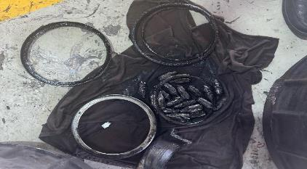
PDO Second Alert
Date:11/09/2023 Incident title: HiPo#41 Pattern: Fire Potential severity: B5(P) Activity: Driving
Target Audience: Drilling, Logistics, Operation & Construction
What happened?
The hub of a commuting bus rear right side wheel caught a minor fire just before reaching its destination. The drivers noticed the smoke when at halt at the traffic light. The drivers rushed to put out the fire, and then led the passengers to disembark from the vehicle to a safe place.
Why it happened/Finding :
High & extreme temperature after a long route driven.
Vehicle part was damaged causing a leak which led to friction igniting a small fire in the breaks.
Your learning from this incident..
Enhance inspections in vehicles.
Look for innovative ways/technological innovations made for inspections.
Inspecting vehicles before departure is a very effective process.
Ensure to follow Musta’ed 7 steps before your journey
Notes:
Ensure all dates and titles are input
A short description should be provided without mentioning names of contractors or individuals. You should include, what happened, to who (by job title) and what injuries this resulted in. Nothing more!
Four to five bullet points highlighting the main findings from the investigation. Remember the target audience is the front line staff so this should be written in simple terms in a way that everyone can understand.
The strap line should be the main point you want to get across
The images should be self explanatory, what went wrong (if you create a reconstruction please ensure you do not put people at risk) and below how it should be done.

Slide 2
Management self audit
Date:11/09/2023 Incident title: HiPo#41 Pattern: Fire Potential severity: B5(P) Activity: Driving
As a learning from this incident and ensure continual improvement all contract managers must review their HSE risk management against the questions asked below
Confirm the following:
Do you ensure the drivers check the vehicles before departing?
Do you ensure the drivers are aware of basic fire response?
Do you ensure all vehicles have the PDO/ROP emergency numbers available every time? And Visible?
Do you ensure that inspections are conducted by a competent person?
Do you ensure maintenance of vehicles are done up to the level of bus usage?
* If the answer is NO to any of the above questions please ensure you take action to correct this finding
Notes:
Ensure all dates and titles are input
Make a list of closed questions (only ‘yes’ or ‘no’ as an answer) to ask others if they have the same issues based on the management or HSE-MS failings or shortfalls identified in the investigation.
Imagine you have to audit other companies to see if they could have the same issues.
These questions should start with: Do you ensure…………………?

