Slide 1
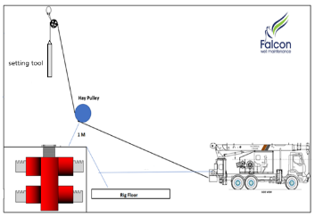
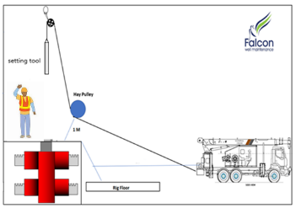
PDO Second Alert
Date: 02.01.2021 Incident: HiPo#02 Drops
What happened?
On the last run after the prong was set @ 80 m +/-; The slickline supervisor started POOH, and reduced the speed once close to surface. At 4 m below the rotary table, the slickline supervisor kept POOH while trying to reach the Assistant Operator via Walkie Talkie to give him signals to stop, meanwhile the tool string went out of the landing joint and hit the upper sheave causing the slickline wire to be parted and the tool string fell on the Rig Floor.
Your learning from this incident..
Ensure winch is stopped when at surface and signals confirmed before continuing operation.
Always ensure proper communication and clear signaling between winch operator and operator on rig floor.
Always ensure Drops red zones are well managed and followed. If in doubt STOP the job.
Always set winch alarm & shutdown and update it periodically throughout of operation.
Always adhere strictly to job procedures
Notes:
Ensure all dates and titles are input
A short description should be provided without mentioning names of contractors or individuals. You should include, what happened, to who (by job title) and what injuries this resulted in. Nothing more!
Four to five bullet points highlighting the main findings from the investigation. Remember the target audience is the front line staff so this should be written in simple terms in a way that everyone can understand.
The strap line should be the main point you want to get across
The images should be self explanatory, what went wrong (if you create a reconstruction please ensure you do not put people at risk) and below how it should be done.

Slide 2
Management self audit
Date: 02.01.2021 Incident: HiPo#02 Drops
As a learning from this incident and ensure continual improvement all contract
managers must review their HSE HEMP against the questions asked below
Confirm the following:
Do you ensure your Operators are competent in operating equipment?
Do you ensure that in TBT all aspect of hazards are covered and discussed before the job?
Do you have an assurance system is in place for your equipment preventive maintenance programs?
Do you ensure HEMPs are updated to reflect changes in SOPs?
Do you ensure procedural adherence is a part of your Assurance plan?
* If the answer is NO to any of the above questions please ensure you take action to correct this finding.
Notes:
Ensure all dates and titles are input
Make a list of closed questions (only ‘yes’ or ‘no’ as an answer) to ask others if they have the same issues based on the management or HSE-MS failings or shortfalls identified in the investigation.
Imagine you have to audit other companies to see if they could have the same issues.
These questions should start with: Do you ensure…………………?

