Slide 1
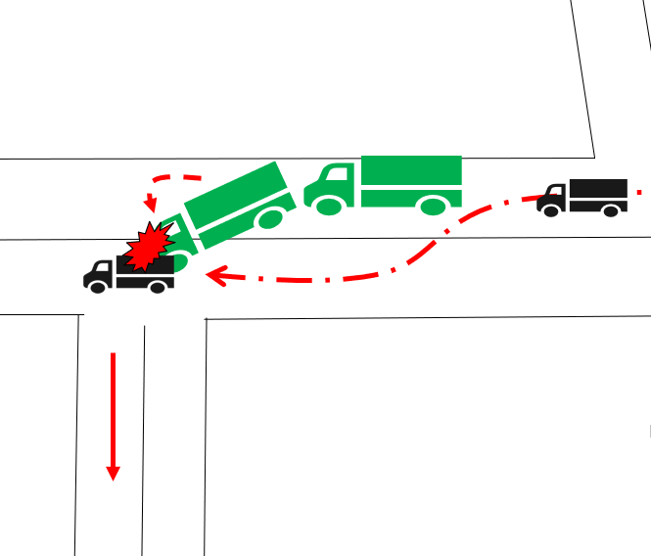
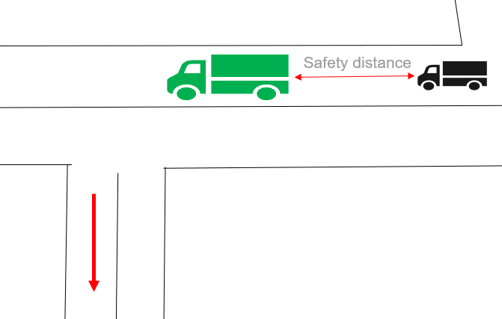
PDO Second Alert
Date:19/09/2021 Incident title: HiPo#54 Pattern: MVI. Potential severity: C4P
What happened?
On 19-09-2021 Field specialist was driving Pickup heading to Nimr camp. At approximately 15:49 hrs., there was a trailer moving in front of Pick up. Both Vehicles were headed same direction. Pickup driver was behind attempted to overtake the trailer whilst the trailer was taking a turn on the left side. The pickup driver tried to avoid trailer but eventually that leaded to a collision between both, the pickup flipped on its left side resulted total damage . There was slight damage to the trailer. Pickup Driver and Passenger reported immediately to the Clinic for medical check and released with no injuries sustained.
Why it happened/Finding :
Overtaking in the wrong position
Failure to follow (SP 2000) & defensive driving procedures (by overtaking near a T-junction)
Wrong decision taken by Pickup driver to overtake as he assumed that the trailer was trying to give a way for overtaking by slowing down the speed without making signal to indicate turn left.
Your learning from this incident..
Always ensure it is allowed to overtake before taking the decision.
Always follow Sp2000 procedure and apply defensive driving skills.
Always stop the driver if you observe any poor driving behavior.
Photo explaining how it should be done right
Target Audience: Drilling, Logistics, Operation & Construction
Notes:
Ensure all dates and titles are input
A short description should be provided without mentioning names of contractors or individuals. You should include, what happened, to who (by job title) and what injuries this resulted in. Nothing more!
Four to five bullet points highlighting the main findings from the investigation. Remember the target audience is the front line staff so this should be written in simple terms in a way that everyone can understand.
The strap line should be the main point you want to get across
The images should be self explanatory, what went wrong (if you create a reconstruction please ensure you do not put people at risk) and below how it should be done.

Slide 2
Management self audit
Date:19/09/2021 Incident title: HiPo#54 Pattern: MVI. Potential severity: C4P
As a learning from this incident and ensure continual improvement all contract managers must review their HSE risk management against the questions asked below
Confirm the following:
Do you ensure compliance to SP2000 and journey management system.
Do you ensure conduct defensive driving campaigns for drivers refreshing driving skills.
Do you ensure driving behavior hazard discussed and understood in morning meeting by all drivers.
Do you ensure effectively enforce STOP work authority.
Do you ensure adequate assurance of learning from incidents system.
Do you ensure effectively regular driving behavior evaluation for new defensive drivers.
* If the answer is NO to any of the above questions please ensure you take action to correct this finding
Notes:
Ensure all dates and titles are input
Make a list of closed questions (only ‘yes’ or ‘no’ as an answer) to ask others if they have the same issues based on the management or HSE-MS failings or shortfalls identified in the investigation.
Imagine you have to audit other companies to see if they could have the same issues.
These questions should start with: Do you ensure…………………?

