Slide 1
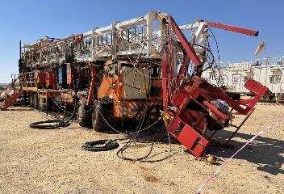

PDO Second Alert
Date: 05.01.2021 Incident type: HiPo#01 Drops
What happened?
The Hoist was being prepared for the rig move. The mast was scoped in,
travelling block and monkey board were secured. After having everyone
positioned in accordance with the responsibilities allocated during the
pre-task safety meeting, Driller started lowering the mast onto the
headrest.
While doing so, the top small hydraulic cylinder did not retract and the
large bottom cylinder came out of the mast raising mechanism housing
causing the mast to free fall onto the headrest
Your learning from this incident..
Always follow safe work practices and comply with written instructions
Always intervene and stop the work if conditions are unsafe
Always perform risk assessment and conduct pre-job safety meeting with all parties involved in the task
Always monitor pressure gauges and ensure they have valid calibration
Always maintain safe distance while raising/lowering the mast
Always stay away from red zones and be aware of line of fire hazards
Notes:
Ensure all dates and titles are input
A short description should be provided without mentioning names of contractors or individuals. You should include, what happened, to who (by job title) and what injuries this resulted in. Nothing more!
Four to five bullet points highlighting the main findings from the investigation. Remember the target audience is the front line staff so this should be written in simple terms in a way that everyone can understand.
The strap line should be the main point you want to get across
The images should be self explanatory, what went wrong (if you create a reconstruction please ensure you do not put people at risk) and below how it should be done.

Slide 2
Management self audit
Date: 05.01.2021 Incident type: HiPo#01 Drop
As a learning from this incident and to ensure continual improvement all Contract
Managers must review their HSE HEMP against the questions asked below
Confirm the following:
Do you ensure that you have a verification process of preventive and risk based maintenance performed on critical equipment?
Do you ensure a risk assessment is being applied prior to installation/purchasing of critical equipment?
Do you ensure that you have robust purchasing process that ensures procurement of correct material grades?
Do you ensure that equipment preventive maintenance is performed in accordance with OEM recommendations, International Standards AND based on operational risk?
* If the answer is NO to any of the above questions please ensure you take action to correct this finding.
Notes:
Ensure all dates and titles are input
Make a list of closed questions (only ‘yes’ or ‘no’ as an answer) to ask others if they have the same issues based on the management or HSE-MS failings or shortfalls identified in the investigation.
Imagine you have to audit other companies to see if they could have the same issues.
These questions should start with: Do you ensure…………………?

