Slide 1
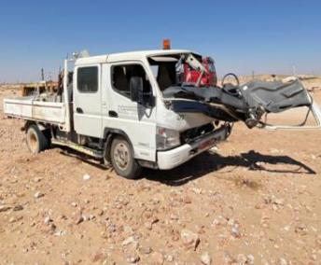
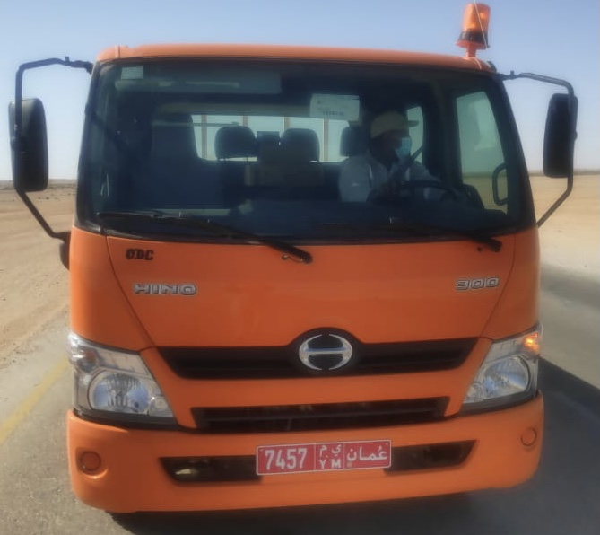
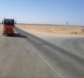
PDO Second Alert
Date: 07.01.2021 Incident title: HiPo#03 MVI
What happened?
A 3Ton canter was about to take a left turn from the graded road towards THL-124 moving at a slow speed was hit by a trailing trailer from another PDO contractor which was overtaking from the left side of the canter. The impact resulted in damage to front end of the canter .No injury to the personnel.
Your learning from this incident..
Always be alerted for the unexpected road hazards.
Ensure overtaking in safe zones.
Always follow defensive driving techniques.
Ensure to park in a safe spots if you are unsure of your destination.
Always check your blind spots
Notes:
Ensure all dates and titles are input
A short description should be provided without mentioning names of contractors or individuals. You should include, what happened, to who (by job title) and what injuries this resulted in. Nothing more!
Four to five bullet points highlighting the main findings from the investigation. Remember the target audience is the front line staff so this should be written in simple terms in a way that everyone can understand.
The strap line should be the main point you want to get across
The images should be self explanatory, what went wrong (if you create a reconstruction please ensure you do not put people at risk) and below how it should be done.

Slide 2
Management self audit
Date: 07.01.2021 Incident title: HiPo#03 MVI
As a learning from this incident and ensure continual improvement all contract
managers must review their HSE HEMP against the questions asked below
Confirm the following:
Do you ensure that the drivers are given clear instructions on parking vehicle at site?
Do you ensure that your drivers are driving as per the requirements of the road?
Do you ensure that your drivers follow defensive driving techniques?
Do you ensure to report the hazards identified on roads to appropriate authority?
Do you ensure that learnings from previous incidents are discussed in TBT?
* If the answer is NO to any of the above questions please ensure you take action to correct this finding.
Notes:
Ensure all dates and titles are input
Make a list of closed questions (only ‘yes’ or ‘no’ as an answer) to ask others if they have the same issues based on the management or HSE-MS failings or shortfalls identified in the investigation.
Imagine you have to audit other companies to see if they could have the same issues.
These questions should start with: Do you ensure…………………?

